Slide 1
Defining a Pacific Regional Observation Network (Discussion on Paper 9.6 - Annex 4)
Presented by: WRP – PMU Team
May 2026

Slide 2
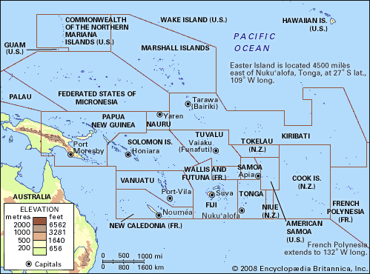
Why It Matters
High hazard exposure
Observations underpin early warning
Data gaps impact decisions
Notes:
The Pacific is one of the most dispersed regions globally, covering vast ocean areas with small island states spread across Melanesia, Micronesia, and Polynesia.
The challenge is not just the number of stations, but their distribution, sustainability, and connectivity.
A tiered regional approach allows us to prioritise critical global stations (GBON), support national operational networks (RBON), and still accommodate supplementary observations.
For donors, this map highlights the scale of investment required.
For NMHSs, it shows how national networks fit into a regional system.
For WRP SC, it reinforces the need for coordinated planning rather than isolated projects.”

Slide 3
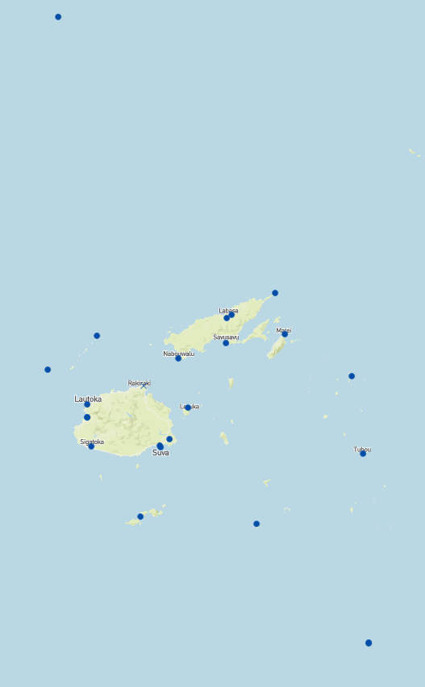
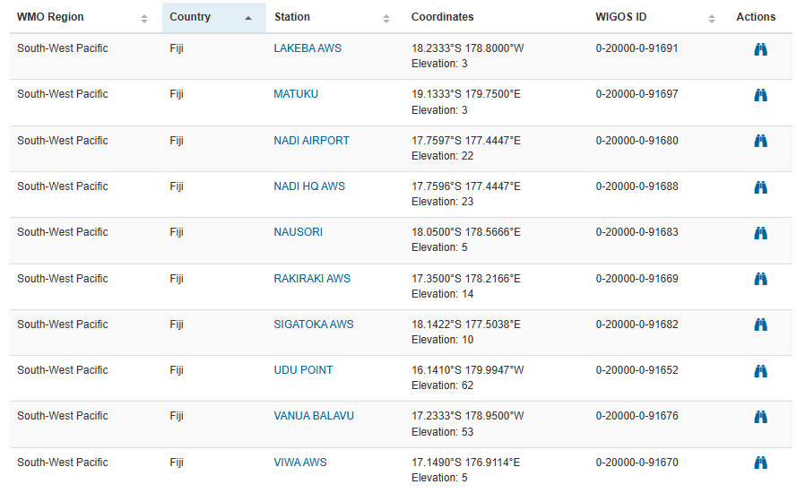
Current Challenges
Name¹ | WIGOS Identifier² | Proposed GBON Surface (SOFF)³ | Proposed GBON Upper-air (SOFF)³ | GOS / NWP | GSN | GUAN | CRS⁴ (daily rain, max/min temp) | Other⁵ (e.g. CIS-PAC5, ClimSA) | Designated RBON⁶ | Potential RBON⁷ | Tier⁸
Ba (Rarawai Mill) AWS |  |  |  |  |  |  |  |  |  | Y
Keiyasi AWS |  |  |  |  |  |  |  |  |  | Y
Koro Is AWS |  |  |  |  |  |  |  |  |  | Y
Korolevu AWS |  |  |  |  |  |  |  |  |  | Y
Kubulau AWS |  |  |  |  |  |  |  |  |  | Y
Labasa | 0-20000-0-91656 |  |  | Y |  |  |  |  |  | Y
Labasa AWS | 0-20000-0-91657 |  |  |  |  |  |  |  |  | Y
Lakeba | 0-20000-0-91691 | Y |  | Y |  |  | ☐ |  | Y | Y
Lakeba AWS | 0-20000-0-91691 |  |  |  |  |  |  |  |  | Y
Laucala Bay | 0-20000-0-91690 |  |  |  |  |  | ☐ |  |  | Y
Lautoka | 0-20000-0-91679 |  |  |  |  |  | ☐ |  |  | Y
Levuka AWS |  |  |  |  |  |  |  |  |  | Y
Lodoni AWS |  |  |  |  |  |  |  |  |  | Y
Lomaivuna AWS |  |  |  |  |  |  |  |  |  | Y
Matei | 0-20000-0-91665 |  |  |  |  |  |  |  |  | Y
Matuku | 0-20000-0-91697 | Y |  | Y |  |  |  |  | Y | Y
Matuku AWS |  |  |  |  |  |  |  |  |  | Y
Momi AWS |  |  |  |  |  |  |  |  |  | Y
Nabouwalu | 0-20000-0-91659 |  |  | Y |  |  | ☐ |  | Y | Y
Nadarivatu AWS |  |  |  |  |  |  |  |  |  | Y
Nadi | 0-20000-0-91688 |  |  |  |  |  |  |  |  | Y
Nadi Airport | 0-20000-0-91680 | Y | Y | Y | Y | Y | ☐ |  | Y | Y
Nadi AWS / NRL |  |  |  |  |  |  |  |  |  | Y
Nausori | 0-20000-0-91683 | Y |  | Y |  |  | ☐ |  | Y | Y
Nausori Intl Aerodrome AWOS |  |  |  |  |  |  |  |  |  | Y
Ono-I-Lau | 0-20000-0-91699 |  |  | Y | Y |  | ☐ |  | Y | Y
Ono-I-Lau AWS |  |  |  |  |  |  |  |  |  | Y
Penang Mill |  |  |  |  |  |  | ☐ |  |  | Y
Rakiraki | 0-20000-0-91669 |  |  | Y |  |  |  |  |  | Y
Rotuma | 0-20000-0-91650 | Y |  | Y | Y |  | ☐ |  | Y | Y
Rotuma AWS |  |  |  |  |  |  |  |  |  | Y
Saqani AWS |  |  |  |  |  |  |  |  |  | Y
Savusavu | 0-20000-0-91663 |  |  |  |  |  |  |  |  | Y
Seaqaqa AWS |  |  |  |  |  |  |  |  |  | Y
Sigatoka | 0-20000-0-91682 | Y |  | Y |  |  |  |  |  | Y
Sigatoka AWS | 0-20000-0-91682 |  |  |  |  |  |  |  |  | Y
SRIF Drasa Station AWS |  |  |  |  |  |  |  |  |  | Y
Suva | 0-20000-0-91689 |  |  |  |  |  |  |  |  | Y
Suva AWS |  |  |  |  |  |  |  |  |  | Y
Tokotoko | 0-242-3-88214 |  |  |  |  |  | ☐ |  |  | Y
Tokotoko Navua AWS |  |  |  |  |  |  |  |  |  | Y
Udu Point | 0-20000-0-91652 | Y |  | Y | Y |  | ☐ |  | Y | Y
Udu Point AWS |  |  |  |  |  |  |  |  |  | Y
Vanuabalavu | 0-20000-0-91676 | Y |  | Y |  |  |  |  | Y | Y
Vanuabalavu AWS |  |  |  |  |  |  |  |  |  | Y
Vaturekuka AWS |  |  |  |  |  |  |  |  |  | Y
Viwa | 0-20000-0-91670 | Y |  | Y |  |  |  |  | Y | Y
Viwa AWS |  |  |  |  |  |  |  |  |  | Y
Vunisea | 0-20000-0-91693 |  |  | Y |  |  | ☐ |  | Y | Y
Vunisea AWS |  |  |  |  |  |  |  |  |  | Y
Wainikoro AWS |  |  |  |  |  |  |  |  |  | Y
Yaqara AWS |  |  |  |  |  |  |  |  |  | Y
Yasawa-i-Rara | 0-20000-0-91660 | Y |  | Y |  |  |  |  | Y | Y
Yasawa-I-Rara AWS |  |  |  |  |  |  |  |  |  | Y
54
Fragmented systems
Limited capacity
Data gaps
20
8
Notes:
Inefficiency and sustainability issues

Slide 4
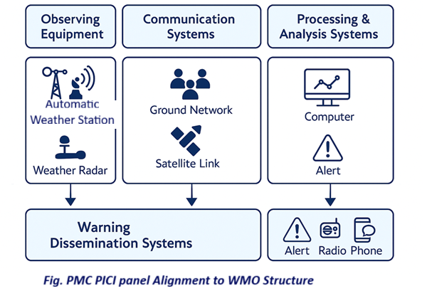
What is a PRO Network
Coordinated regional system
  Of all our observation stations
  Supporting sustainability
  Harmonised and standardized
  Peer support and partnerships
Aligned with WIGOS/ GBON/ RBON
  Clearly demarcated stations
  Compliance
  The world will know what we have
Notes:
It’s a system, not a project

Slide 5
Tiered Network Concept
Supporting the sustainability of the observation network is no small feat, in fact it is an on-going mountain of a challenge
But we in the Pacific are resilient, we are strong. We know how to prioritise and most times, to live without.
By working together, we are addressing our gaps. So this concept is about addressing the Big Mountain, one step at a time.
Tier 1: Reference (Global stations – GBON, GUAN, etc.)
Tier 2: Operational (Radars, AWOS, AWS, etc.)
Tier 3: Supplementary (sector specific support, targeted observation)

Slide 6
System of Systems
Integrates Met, Hydro, Ocean, Geo, etc.
Unified backbone

Slide 7
Strategic Priorities
1. Standardise where possible, observing technology for inter-operability and regional support. This may include the establishment of preferred supplier lists for observation equipment and instruments, maintenance and training.
2. Coordinate an OSCAR/Surface metadata improvement sprint across the region, supported by the WMO Regional Office and WRP partners, to resolve station identifiers, names, locations, operational status and instrument metadata.
3. Establish clear metadata stewardship roles for backbone stations (who updates OSCAR and when).
4. Confirm which project/programme stations (e.g., CIS-Pac5, ClimSA) have formal expectations for international exchange and ensure registration and exchange pathways align with those expectations.
5. Identify reference or operational stations at risk of failure due to obsoletion; minor parts, power, or comms issues and prioritise rapid stabilisation actions.
6. Expand the regional strategy scope to integrate aviation, hydrology, rainfall-only networks, geological hazards, and marine observing into a single “system-of-systems” Pacific observing plan.

Slide 8
Strategic Priorities
Strengthen regional approaches to calibration and field verification (including regional kits and shared training).
Implement routine monitoring and reporting using WDQMS (availability/timeliness/quality indicators) and agree a process for acting on persistent issues.
Develop and fund practical resilience upgrades for cyclone-prone and remote stations (including redundant communications and cyclone-rated installations).
Clarify and implement post-project sustainability plans for stations installed under short-term initiatives.
Formalise and support a regional lifecycle support model for critical backbone stations, including supply chain arrangements, spares pooling, shared maintenance mechanisms, and the safe removal and disposal of hazardous items such as expired batteries.
Refresh the regional backbone definition periodically through WRP governance to reflect evolving requirements, technology and climate risk.

Slide 9
Thank you, any questions?

