Slide 1
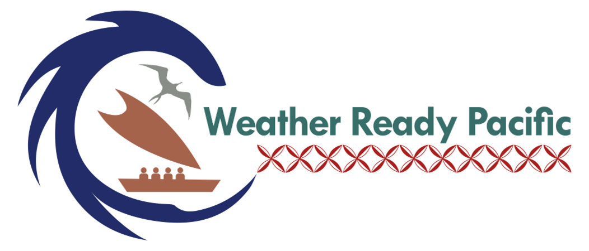
Emerging Pacific Hydo-MET/MHEWs Sustainable Asset
Maintenance Facility Model

Slide 2
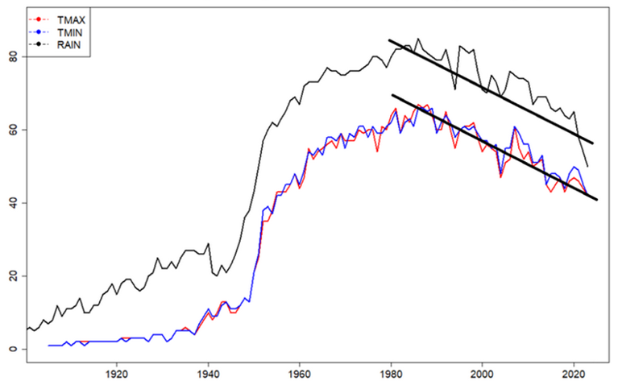
The maintenance Crisis of the Pacific Islands
High Cost of Maintenance and Replacement
Donor Funding Focuses on Capital Investment, Not Long-Term Operations
Limited Technical Workforce Capacity
Geographic Isolation and Logistics
Fragmented Regional Support Systems
Weak Asset Lifecycle Planning
Growing dependence on Digital systems

Slide 3
How activities in WRP are funded now (Hybrid-Model)
Pool Fund Becoming Operational in Mid-2026
DONORS
MEMBER COUNTRIES
(Beneficiaries)
WRP Investment Plan
WRP POOLED
FUND for Program Delivery
(SPREP/WRP)
WRP Implementation
Plan
USD191M – Over 10yrs
(2024-2033)
Direct
Bilateral/Ringfenced
Grants
(SPREP/WRP)
WRP Investment Plan
WRP Implementation
Plan
Current funding modality

Slide 4
How are we going to maintain these investments (particularly Infrastructure?)

Slide 5
Planned sustainable infrastructure activities for 2026
Options for Establishing a Sustainable Maintenance Fund – Consultant
Asset Management Information System Implementation - software & training
Establish Pacific Asset Management Capability, Plans and Lifecycle Cost Forecast

Slide 6
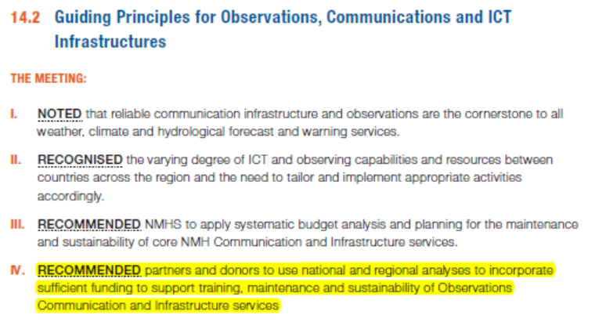
Recommendation from PMC-7

Slide 7
Model sustainable asset maintenance facility
National Governments
Direct contribution/Donors
Private Sector
Philanthropists
PACIFIC HYDRO-MET/MHEWS ASSET MAINTENANCE
INVESTMENT FACILITY
(TRUST)
Pacific Hydo-Met
Maintenance facility
Investment Plan
Investment
payouts for maintenance
Infrastructure maintenance fee
Cost recovery
Other charges
Data charges from ringfenced regional data
PACIFIC
HYDRO-MET/MHEWS Asset Management
OPERATIONAL FUND
(SPREP/WRP)
Regional
Instrument
Centre
MEMBER COUNTRIES
(Beneficiaries)
Fees & Charges

Slide 8
By Sep 2026
PACIFIC HYDRO-MET/MHEWS ASSET MAINTENANCE
OPERATIONAL FUNDS
(SPREP)
NI
TV
TO
SO
FJ
CI
NU
TK
VU
RM
PA
FM
SA
KI
PG
KICK OFF Financial
Model.
A maintenance
charge will be
charged to every
infrastructure
project
Funds kept in a
country account at
SPREP to be utilized
as required for
maintenance
Pool can be
invested upon
agreement by
countries
%
%
%
Establish a Pacific
Hydro-met/MHEWS
Asset maintenance
agreement at the Pacific
Meteorological
Council (PMC8) &
the Pacific
Meteorology
Ministers Meeting
(PMMM4)
Technical
Financial
NI
%
SO
CI
%
TO
PG
TK
%
TV
%
%
FJ
FM
%
NU
KI
%
VU
SA
%
PA
RM
%
%
%
%
Each Country has their own maintenance account managed
at SPREP which they contribute to through charging a certain % on infrastructure projects

Slide 9
Cost Saving and Operation cost reduction for NMHSs
For all the transformation infrastructure and systems implemented within countries in WRP there needs to be a serious look at the Operational costs at the NMHS level to try and reduce costs where it can be done. With better planning and the introduction of smart initiatives, these costs can be reduced so that funds can be redirected elsewhere to support development activities of the NMHSs.
Decarbonizing & Green powering the NMHSs (these activity has commenced through NMHSs power and fuel consumption survey that has been completed. On average across the region the NMHSs spend USD71,000 on Fuel and Power annually. These costs can be offset through the introductions of renewable energy.
Standardizing equipment (these activities have commenced)

