Slide 1
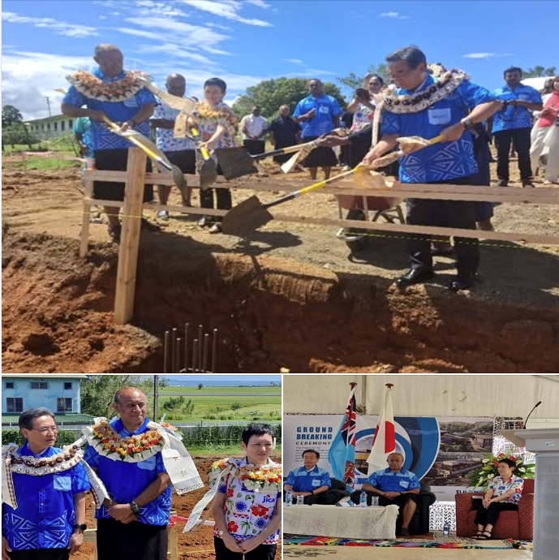


RTC–Nadi Development
Progress Update
WRP MEETING BRIEF
Mr Misaeli Fuanaki
Director of Meteorology / Permanent Representative of Fiji to WMO
Fiji Meteorological Service | Weather Ready Pacific Meeting | May 2026

Slide 2
OVERVIEW
Executive Progress Snapshot
One consolidated view of RTC–Nadi development progress for senior-level WRP discussion
WMO Review
FHEC Recognition
Core criteria fully met; final consideration pathway underway
Approximately 90% of required work completed; final evidence checks remain
BIP-MT Diploma
RTC Building
Concept note and budget ready; 10% completed; target accreditation April 2027
Groundbreaking completed; JICA/Japan-supported regional centre development launched
Exhibition Centre
Planning Documents
Artwork package completed and provided to contractor; 70% completed
Draft package prepared; awaiting DMET and Divisional Head inputs
Overall message: RTC–Nadi has moved from concept to structured development; next step is endorsement, funding support and controlled implementation.
Fiji Meteorological Service | RTC–Nadi Development Progress | Weather Ready Pacific Meeting

Slide 3
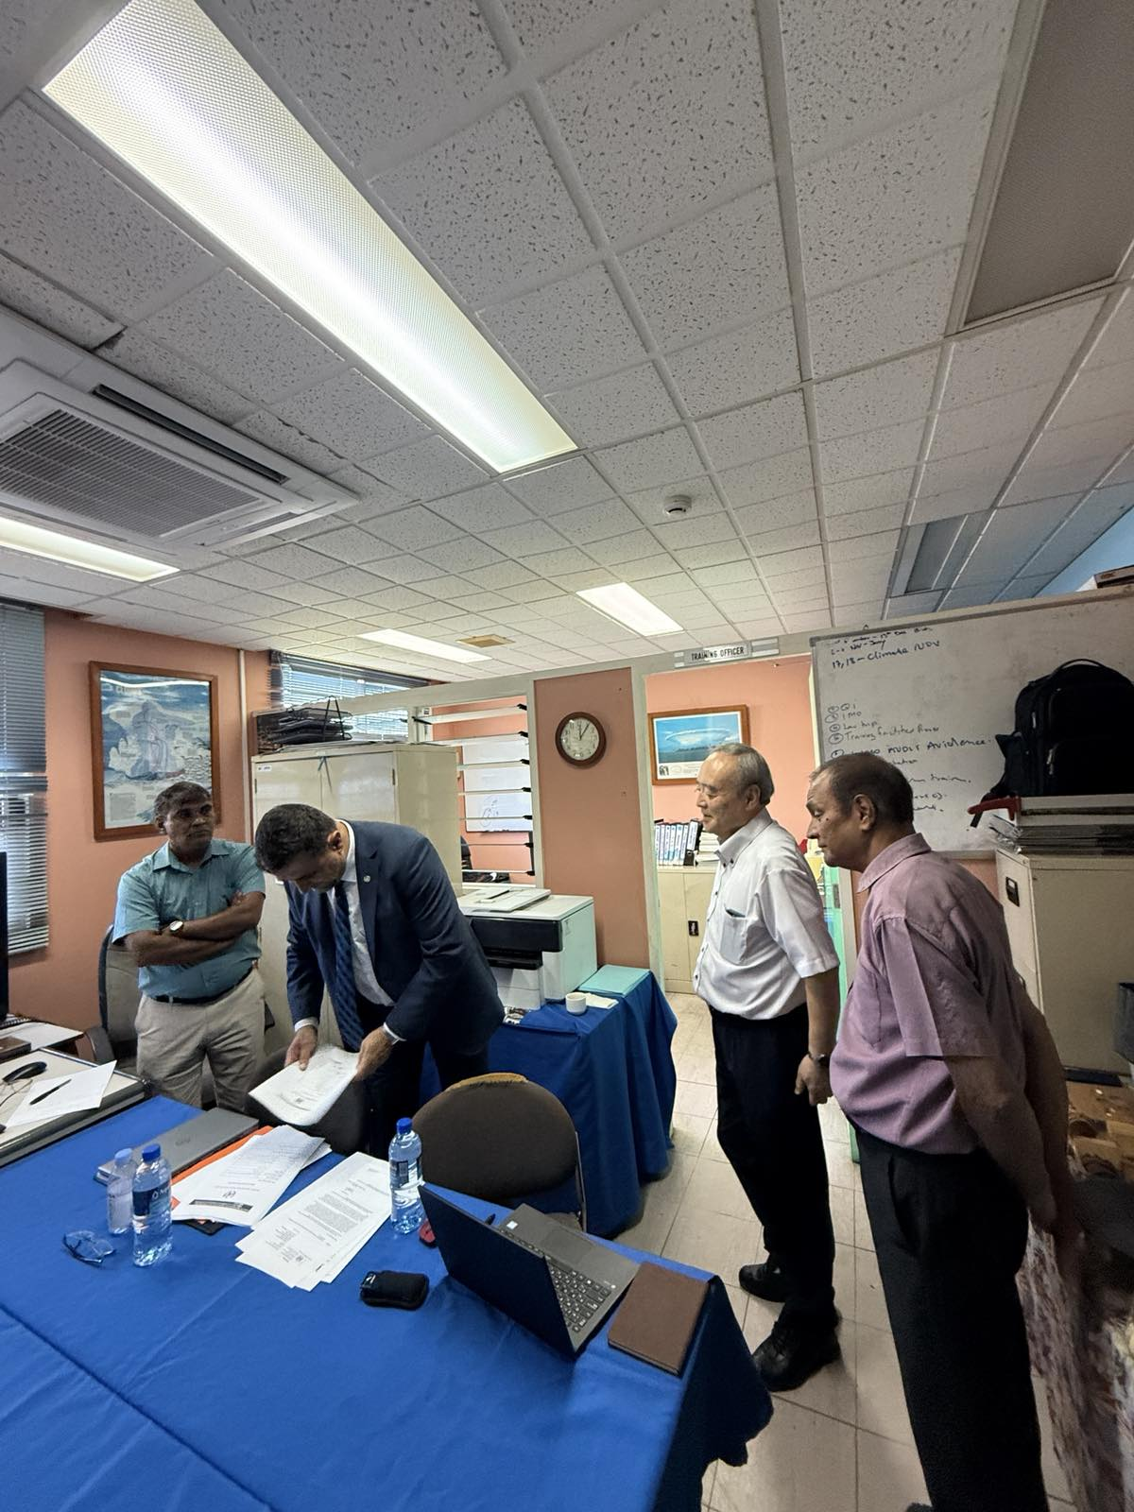
WMO RECOGNITION
WMO External Review Process
WMO has completed the external review process and confirmed the evidence base for FMS designation as a Regional Training Centre.
1
Proposal and RA V endorsement
Fiji PR submitted the RTC proposal and RA V endorsed the candidature.
2
External review mission
WMO review mission assessed FMS, Nadi from 11–14 November 2025.
3
Evidence assessed
Learning needs, design, delivery, assessment/evaluation and administration reviewed.
4
Final report issued
WMO transmitted the final report to Fiji for comments before EC-CDP consideration.
Status: from candidature review to final institutional consideration
Fiji Meteorological Service | RTC–Nadi Development Progress | Weather Ready Pacific Meeting

Slide 4


WMO RECOGNITION
WMO Review Outcome: Core Criteria Fully Met
The External Review Team strongly recommended that FMS be designated as a WMO RTC in RA V.
BIP-MT
WMO conclusion
FULLY MET
Identifying learning needs
All core criteria for designation are fully met.
FULLY MET
Designing the learning service
Recommendation
FULLY MET
Delivering the learning service
EC-CDP to recommend to WMO Executive Council that FMS be designated as a WMO RTC in RA V.
FULLY MET
Assessing and evaluating learning
Improvement actions
FULLY MET
Administering and managing learning
Strengthen strategic planning, QA records, dedicated staffing, cost model, distance learning and partnerships.
Fiji Meteorological Service | RTC–Nadi Development Progress | Weather Ready Pacific Meeting

Slide 5
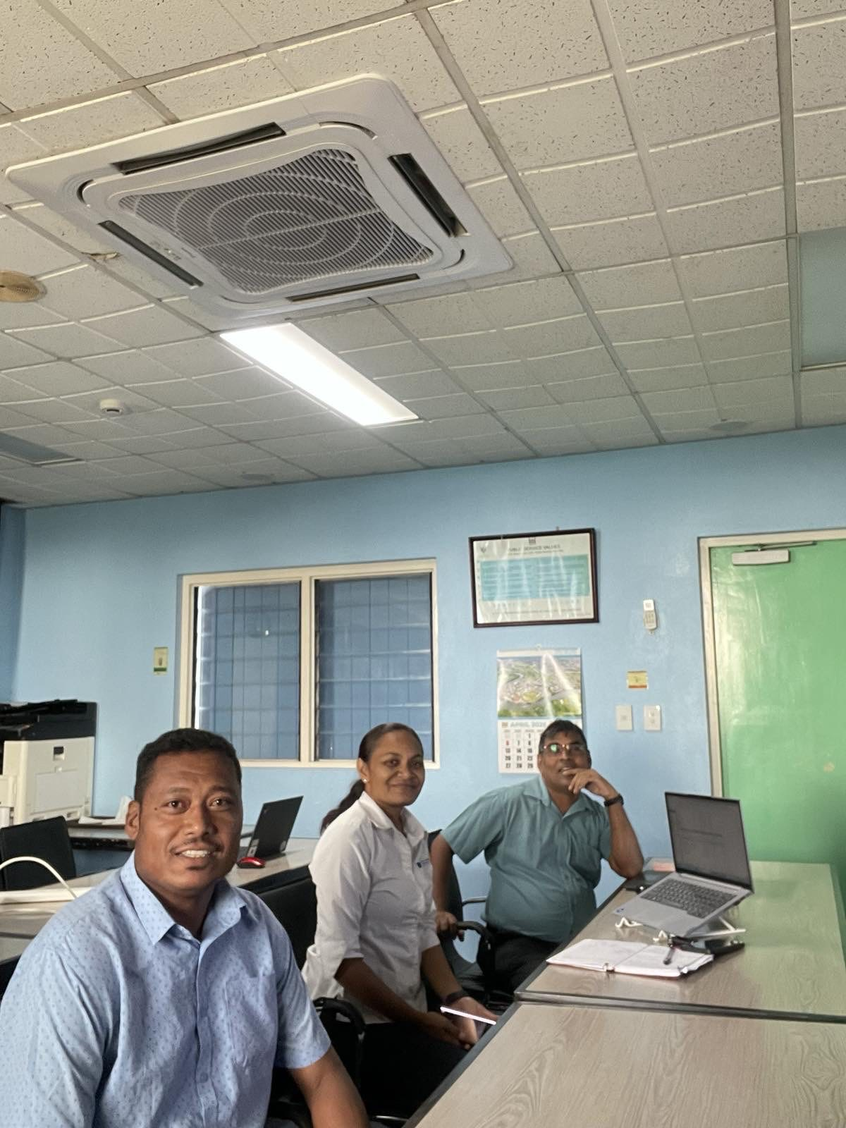
FHEC RECOGNITION
FHEC Recognition Progress
Approximately 90% of the required work has been completed toward recognition by the Fiji Higher Education Commission.
90%
Recognition work completed
• Institutional and governance documents prepared
• Quality assurance and training process documents drafted
• Business planning and financial information compiled
• Student-related forms, rules and operating documents advanced
• Evidence files being checked for final submission readiness
Current position
Final evidence checks and submission actions remain before recognition can be fully progressed.
Recognition strengthens the RTC’s ability to deliver recognised, quality-assured training for national and regional participants.
Fiji Meteorological Service | RTC–Nadi Development Progress | Weather Ready Pacific Meeting

Slide 6
FHEC REGISTRATION
FHEC Registration Pathway
Registration can proceed after FMS obtains the Certificate of Recognition from FHEC.
1
2
3
4
Recognition
Registration file
FHEC assessment
Outcome
Prepare portal application, checklist, fees and attachments
Complete final evidence checks and obtain Certificate of Recognition
Registration Committee assessment and site visit verification
Move toward full registration pathway
Key attachments to prepare
Immediate next actions
• Certificate of Recognition
• Business plan / financial forecasts
• Surety and guarantees agreement
• Legal status / registration documents
• OHS compliance certificates and licence
• Complete the remaining 10% evidence checks
• Respond to FHEC queries
• Prepare for site visit and records verification
• Plan funding for annual FHEC fees after recognition
Fiji Meteorological Service | RTC–Nadi Development Progress | Weather Ready Pacific Meeting

Slide 7
QUALIFICATION DEVELOPMENT
BIP-MT Upgrade to Diploma Level
Progress towards a recognised diploma-level qualification for RTC–Nadi.
10%
Work completed
Concept note and budget ready
FMS leads with USP support
EQAP/FHEC approached
Budget and concept note have been prepared to guide the qualification upgrade process.
FMS will lead the qualification writing, working with USP for academic support.
EQAP and FHEC have been approached to support the accreditation pathway.
Now
2026
2026–27
Apr 2027
10% completed
Write diploma qualification with USP
EQAP/FHEC review and revisions
Accreditation completed
Target completion for BIP-MT qualification accreditation: April 2027
Fiji Meteorological Service | RTC–Nadi Development Progress | Weather Ready Pacific Meeting

Slide 8
INFRASTRUCTURE
RTC Building and Regional Centre Development
Project for the Development of Regional Centres for Meteorological Services and Disaster Risk Reduction in the Pacific.
Groundbreaking
JICA / Japan support
10 April 2026 | FMS HQ, Nadi
Grant support worth up to approx. FJD 27 million
• RTC, RIC and Disaster Risk Reduction Awareness Facility included in the development.
• Building concept, layout and education/training facility plans prepared.
• Facility will strengthen FMS capacity and provide a modern training platform for Pacific NMHS officials.
• Design aligns with WMO standards, ISO-focused practices and regional early-warning capacity development.
Development pathway: planning → construction → commissioning → regional delivery
The new building will transform FMS from a training provider into a stronger Pacific regional training hub.
Fiji Meteorological Service | RTC–Nadi Development Progress | Weather Ready Pacific Meeting

Slide 9
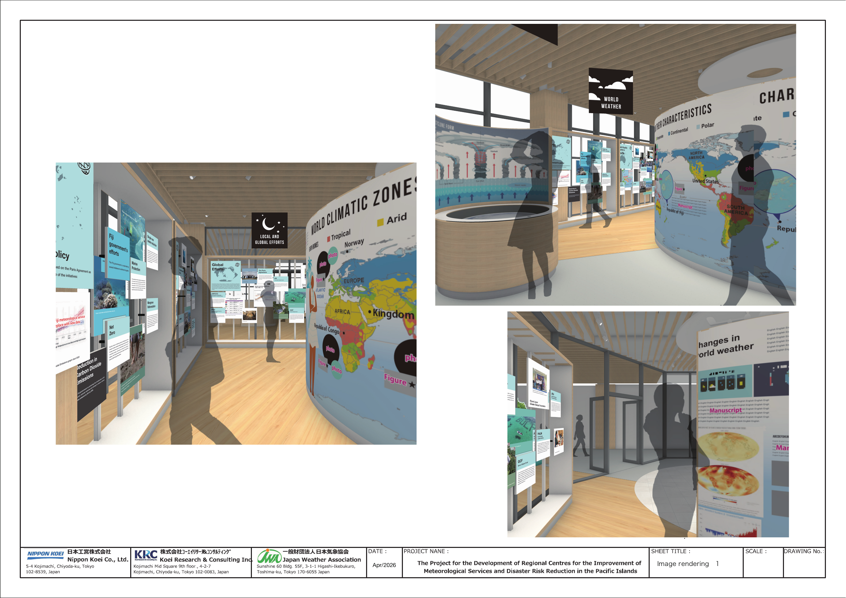
INFRASTRUCTURE
RTC Exhibition Centre Development
Artwork package completed and handed to the contractor for final exhibition design.
70%
Work completed
Artwork completed
The exhibition artwork package has been completed.
Provided to contractor
Artwork has been handed over to the contractor for detailed design.
Design phase progressing
Contractor will translate the artwork into the final exhibition design and installation package.
Remaining 30%: final design refinement, approval, production, installation and handover.
Fiji Meteorological Service | RTC–Nadi Development Progress | Weather Ready Pacific Meeting

Slide 10
PLANNING DOCUMENTS
RTC–Nadi Planning Documents Developed
Core establishment and quality documents have been prepared by the FMS Training Division.
Strategic & Operational Framework
Business Plan 2026–2030
RTC mandate, governance, operations, delivery model and financing approach for 2026–2028.
Business purpose, operating model, services, target beneficiaries, financing and roadmap.
Governance & TOR
Academic Governance & QA
Governance, management, advisory, academic and administrative arrangements.
Academic oversight, programme review, assessment quality and continuous improvement.
Student & Integrity Procedures
Funding/Sponsorship Agreement
Student tuition, grievance, refund, winding-up, academic integrity and honesty arrangements.
How funding, sponsorship, donor support and participant support will be managed and reported.
Current position: initial draft package prepared — awaiting DMET and Divisional Head review, inputs and endorsement.
Fiji Meteorological Service | RTC–Nadi Development Progress | Weather Ready Pacific Meeting

Slide 11
PLANNING DOCUMENTS
How the Documents Fit Together
The draft package creates one operating system for RTC–Nadi.
Strategic
Framework
Business
Plan
Governance
& TOR
Quality &
Academic Rules
Funding &
Student Support
Sets direction and RTC mandate
Defines delivery, cost and sustainability
Clarifies oversight and accountability
Controls training, assessment and records
Manages sponsorship, fees and grievances
End product after review: an endorsed RTC–Nadi document suite that supports WMO alignment, FHEC recognition/registration, regional training delivery, transparent funding and auditable quality assurance.
Fiji Meteorological Service | RTC–Nadi Development Progress | Weather Ready Pacific Meeting

Slide 12
TIMELINE
Completion Timeline to January 2027
All RTC–Nadi planning documents are targeted for finalisation, endorsement and controlled issue by January 2027.
May–Jun
2026
Jul–Aug
2026
Sep–Oct
2026
Nov–Dec
2026
Jan
2027
Draft package prepared
Internal technical review
Partner alignment
Finalisation & control
Completion target
Decision point: confirm the review pathway now so all draft plans can be completed and issued by January 2027.
Fiji Meteorological Service | RTC–Nadi Development Progress | Weather Ready Pacific Meeting

Slide 13




RTC–FIJI INSTITUTIONAL ARRANGEMENTS
Institutional Mandate, Ownership and Funding Support
technical
guidance
WMO
Government of Fiji
RTC–Fiji should be presented as a nationally
owned, regionally responsive and WMO-aligned
training institution anchored within Fiji
Meteorological Service governance.
Owner
PMC Chair
NMHS Directors*
academic
collaboration
USP
Fiji Meteorological Service (FMS)
Controlling Authority
regional
coordination
1
Ownership and control
Panel Chair
WMO RTC Nadi, Fiji
RTC–Fiji operates under the Fiji Meteorological Service,
with the Government of Fiji and FMS retaining institutional
ownership and strategic oversight.
Specialized Training Institution
partner
support
JICA / Development
Partners
2
Legal and policy foundation
Its mandate is supported by Fiji’s meteorological and
hydrological responsibilities, internal governance controls,
and WMO obligations. FMS act 2024 looks after the Legal foundation
Scholarships /
Fellowships /
Training Support Funds
Regional Participants /
Students
Courses at
RTC Nadi, Fiji
3
Regional purpose
The RTC serves Pacific NMHSs by strengthening
forecasting, climate, hydrology, aviation and technical
competencies across the South-West Pacific.
National Ownership
Regional Service
Student Support
✓
The institutional model should demonstrate clear ownership, clear accountability, and a
practical funding pathway that enables Pacific participants to attend RTC training programmes.
Fiji Meteorological Service | WMO Regional Training Centre – Nadi

Slide 14
TIMELINE
One View: What Must Be Completed by When
Integrated timeline for all RTC–Nadi development workstreams.
Workstream
Target
Status
WMO recognition pathway
2026 EC-CDP / EC pathway
Review completed; core criteria fully met
FHEC recognition/registration
By January 2027 package readiness
90% recognition work completed
BIP-MT diploma upgrade
April 2027
10% completed; budget and concept note ready
Planning documents
January 2027
Drafts prepared; awaiting DMET/Divisional Head inputs
RTC building and exhibition
2027–2028
Building launched; exhibition centre 70% completed
WRP support
2026 onward
Funding and technical support requested
Overall message: RTC–Nadi is progressing across all workstreams; next step is coordinated support, endorsement, funding and controlled implementation.
Fiji Meteorological Service | RTC–Nadi Development Progress | Weather Ready Pacific Meeting

Slide 15
WRP SUPPORT
Support and Decision Requested from WRP
Targeted support will convert RTC–Nadi readiness into sustained regional delivery.
Funding support
Technical support
Regional coordination
Support BIP-MT diploma development, FHEC annual fees and regional participant sponsorship.
Support development of BIP-M course development
Advisory support for quality systems, assessment design, LMS and WMO/FHEC alignment.
Assist with nominations, training calendar dissemination and partner alignment.
SME and trainer support
Digital learning
Implementation control
Build a regional trainer pool and support Training of Trainers activities.
Support Moodle/LMS strengthening, e-learning content, digital assessment and records.
Support dashboards, monitoring, reporting and evidence management.
Decision sought: acknowledge progress, support RTC–Nadi as a regional training platform, and consider targeted funding and technical support for priority gaps.
Final message: RTC–Nadi is ready to become a regional training engine for the Pacific.
Fiji Meteorological Service | RTC–Nadi Development Progress | Weather Ready Pacific Meeting

Slide 16
FUNDING ENVELOPE
Indicative Budget Summary and Decision Requested
Estimated costs are indicative and can be refined during donor discussion and course planning.
FJD 1.12M
Indicative first-year package
FJD 602k
Estimated annual recurrent support from Year 2
4
Priority support areas
Apr 2027
BIP-MT accreditation target
How the support will be used
Decision requested from WRP
Consider targeted funding support for BIP-MT diploma development, FHEC recognition and registration costs, LMS strengthening, and regional participant sponsorship.
Consider funding support and explore BIP-M & BIP-H course development
Result: RTC–Nadi becomes a stronger regional training platform for Pacific NMHSs.
1 BIP-MT / BIP-M/H development
Create a recognised qualification pathway for Pacific meteorological and hydrological staff.
2 FHEC recognition / registration
Meet national recognition, registration and compliance requirements.
3 LMS and online courses
Improve Moodle, online materials, digital assessment and learner records.
4 Participant sponsorship
Enable Pacific NMHS officers to attend BIP-MT/M/H and micro-qualification courses.
Fiji Meteorological Service | RTC–Nadi | Donor Support Request | Weather Ready Pacific Meeting

Slide 17
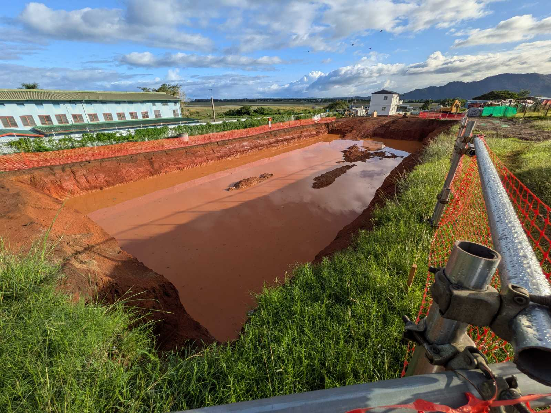
Construction: Current status
Notes:
The dug area for construction of the building, underground will be room for piles and cabling, water piping etc then ground floor for RIC and then RTC

Slide 18
RIC Current Status of Establishment.
- Two new staff recruited at Senior Technical Officer
- Supported by current RNF team – major documents been prepared in draft forms
- Fijian Government made two new positions available
- JMA through JICA assisting with documentation review and guidance.
- Staff learning through online portal Udmey.com site.
- Building construction started though delays due to weather conditions, Government processes and difficulties in getting Overseas workers and opening of bank account by the
- Dai Nippon Construction – Japanese Locally registered company

Slide 19
RIC Compliance with WMO Requirements.
Accreditation to ISO/IEC 17025-2017 and continual compliance towards the standard
Challenges & Gaps.
New to subject to staff, lack of knowledge – training required for understanding and implementing the ISO/IEC 17025-2017, Specific requirements such as determine the uncertainties for calibration values.
Additional staffing and resourcing needed

Slide 20
RIC Support Required;-
Capacity building of staff on ISO/IEC 17025-2017 and associated regulation,
Engagement of a consultant to guide and ensure all documents and processes aligned to RIC and ISO/IEC 17025-2017 is adhered,
Support Mock audit by ISO/IEC accredited body such as NATA or IANZ

Slide 21
Vinaka
Notes:
“Reduce global warming with a simple life style”. The main cause of
global warming lies in the excessive consumption of energy and
resources of the earth by human beings. It is now time for us to take
some real steps to mitigate climate change. A simple life style is the key
to success. Let us all contribute our effort for the goodness of the earth.

