Slide 1


Communications & Engagement Strategy
2026 – 2033
FOURTH STEERING COMMITTEE 2 JUNE 2026

Slide 2
Communications is a Sustainability Instrument
Not a visibility add-on: a strategic enabler
Pacific hydrometeorological and early warning services
are trusted, understood, accessible, and sustainably supported;
with strong two-way communication and stakeholder engagement.
Trust & Ownership
Sustained Financing
Community Preparedness
Pacific nations own and lead their met services — WRP communications reinforces that identity
Targeted evidence-based messaging builds the political and donor case for long-term investment
Clear, actionable warnings reach the last mile — saving lives when it matters most

Slide 3
Five Communications Objectives
Grounded in the WRP Results Framework
CO1
CO2
CO3
CO4
CO5
Increase
Programme Visibility
Strengthen Trust &
Understanding
Support Sustainability
Benchmarks
Embed Two-Way
Communication
Strengthen Internal
Alignment
All WRP content must be:
Accessible
Credible
Actionable
Timely
Inclusive
Pacific-owned
Each KRA either generates content that needs to be communicated, or IS communications work in its own right.

Slide 4
Audience-Centred Messaging
Right message, right audience, right channel
Pacific Communities
NMHSs
Pacific
Governments
Media
Driver: Access to reliable info protects lives
Driver: Recognition, resources & technical credibility
Driver: National security & economic protection
Driver: Compelling stories with real stakes
Act early. Stay safe.
WRP invests in you - you are the backbone.
Investing in MHEWS = investing in national security.
Real people. Real warnings. Real lives saved.
Donors
SPREP Programmes
Driver: Demonstrable impact & sustainability
Driver: Their work depends on climate & weather data
Your investment builds permanence.
WRP intelligence makes your work more effective.

Slide 5

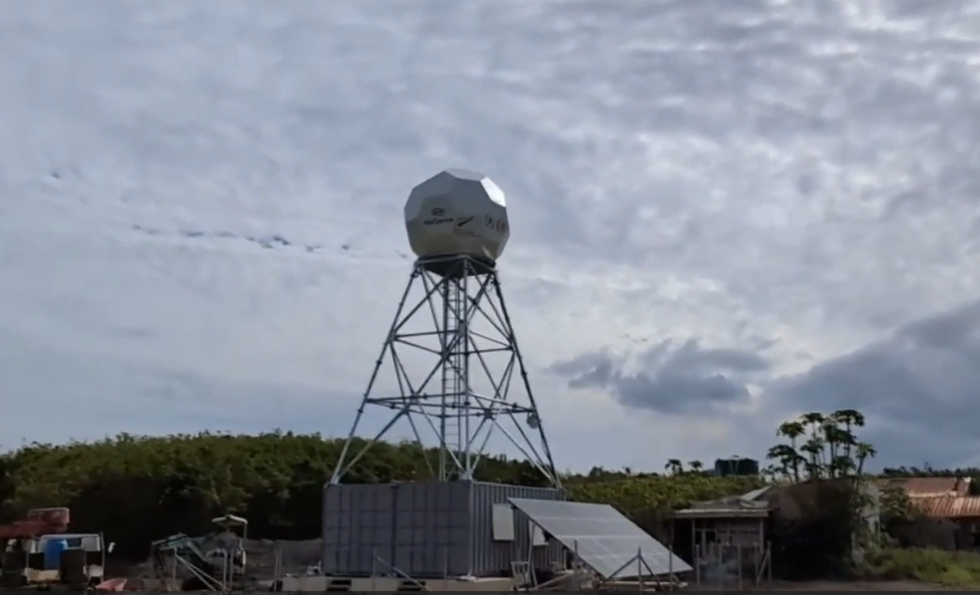
COPE Booklets Launch - Tokelau
Weather Ready Pacific is a
Pacific-led regional initiative
that strengthens early warning
systems,safeguards economies,
And protects lives across the
Blue Pacific.
Tonga Radar
"Early warnings save lives.
Pacific leadership sustains them."

Slide 6
Five-Step Engagement Cycle
Moving from information push to active listening
PLAN
COMMUNICATE
LISTEN
ADAPT
PARTNER
Map audiences.
Align messaging to sustainability benchmarks.
Consistent, culturally relevant messaging. Showcase Pacific leadership.
Community feedback loops. Track trust indicators.
Adjust services and messaging based on feedback and monitoring.
Trust-based relationships aligned with Pacific values.
Community feedback loops are built into this cycle and linked directly to WRP MERL processes — ensuring community voices shape both services and reporting.

Slide 7
Sustainability Communications
Track 1 and Track 2 are the backbone of WRP's sustainability agenda
Track 1
Track 2
Structural
Foundations
Mainstreaming
Into Systems
▸ Secure formal government ownership of weather infrastructure
▸ Embed weather services into national budgets & legislation
▸ Establish long-term, predictable financing for Pacific Met Services
▸ Integrate into disaster risk frameworks and land use planning
▸ Asset Management Roadmap (current priority)
▸ Make services a standard government function; not project-dependent
▸ Sustainable Financing Roadmap (from ~2028)
▸ Comms role: amplify policy wins and integration stories
▸ Comms role: politically sensitive stakeholder engagement
▸ Services endure beyond programme funding cycles

Slide 8
GEDSI & Communication Channels
Inclusive by design, Pacific-first in delivery
GEDSI in Communications
Communication Channels
GEDSI is not a checklist: it shapes how WRP communicates at every level.
SPREP & WRP Website
Primary home - updated monthly
Plain language + local languages for low-literacy audiences
Pasifika Met Newsletter
Quarterly WRP headline feature
Gender balance, age diversity, persons with disabilities in active roles
Social Media via SPREP
Amplified through partners & NMHSs
Subtitles and alt text on all digital content
Video & YouTube
Mobile-optimised, subtitled
Pre-test messages with marginalised communities
Annual Impact & Sustainability Report
Q1 each year - 2-page brief also
Avoid deficit framing of Pacific communities
Policy Briefs & Infographics
Plain language, decision-support tools
Women, OPDs and community reps quoted and credited
Radio & Print / Community
Critical in low-connectivity contexts
Quarterly GEDSI Checklist audits

Slide 9
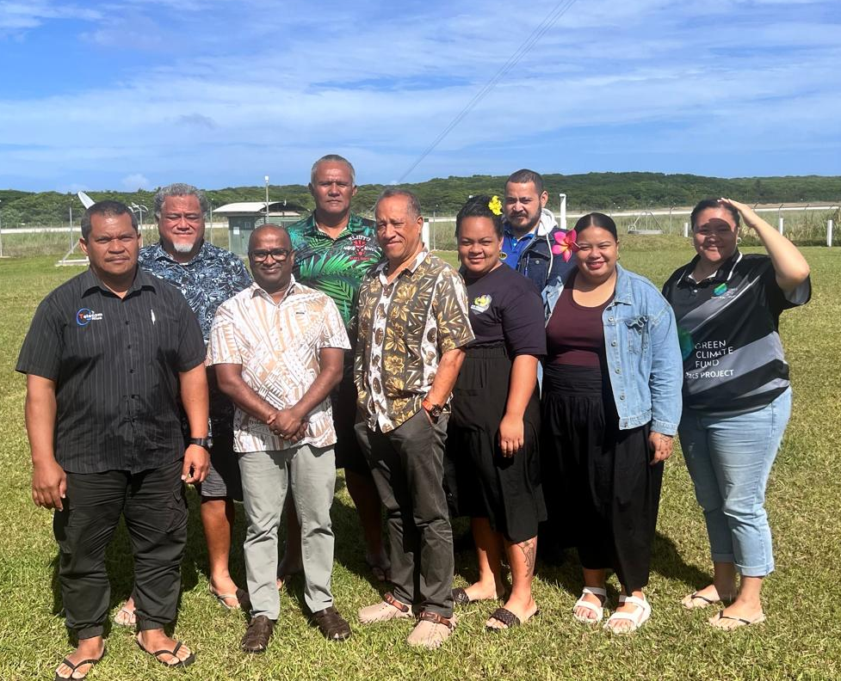
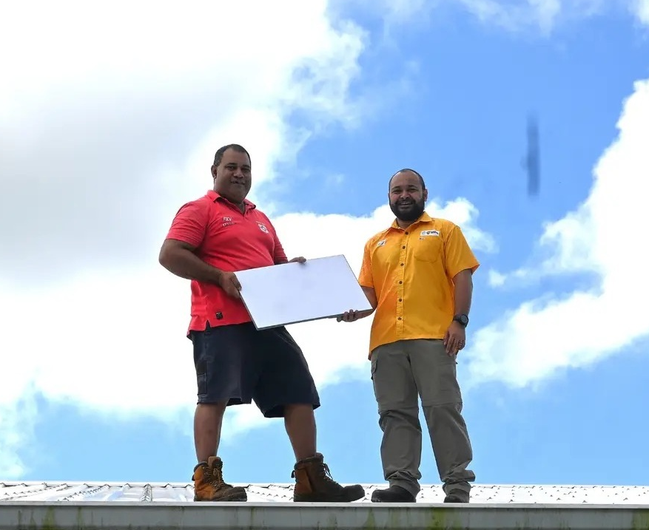
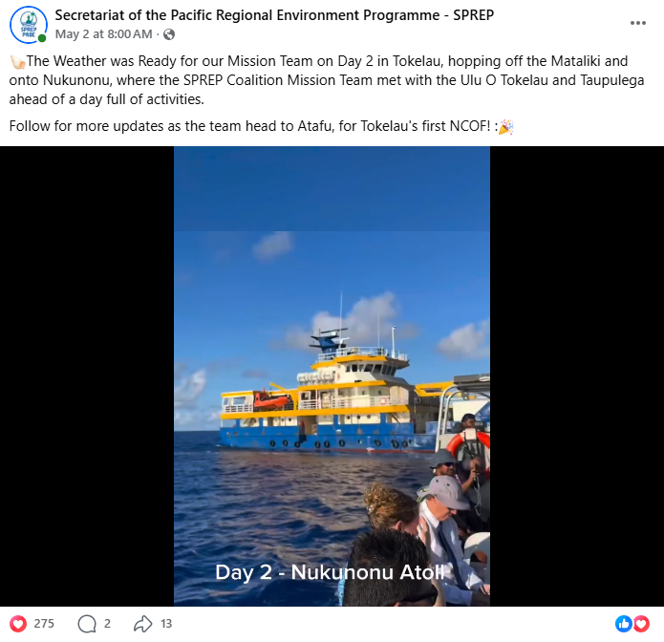
Pacific-Led Storytelling
NMHSs are at the heart of WRP's communications identity
Niue CAP Training
Tonga Starlinks Distribution in ‘Eua
📷
[ Social media post
screenshot ]
Five Story Types (MERL-linked)
Learning
Performance
Impact
Most Significant Change
Case Study
Story selection and dissemination managed jointly by the CKMO, MERLA Officer and WRP Program Manager

Slide 10
2026 Communications Action Plan
Two strategic priorities driving the year ahead
Priority 1
Priority 2
Increase Investment Pledges
Strengthen Pacific NMHS Support
Q2 2026
Q3 2026
Q4 2026
▸ Publish Strategy & Branding Guide
▸ Full PMC8 comms package
▸ Annual Impact Report
▸ WRP Investment Case brief
▸ NMHS video testimonials
▸ Stakeholder satisfaction survey
▸ Digital asset library & Canva brand kit
▸ GEDSI spotlight story
▸ NMHS country success stories
▸ Brief NMHS comms contacts
▸ Mid-year sustainability snapshot for donors
▸ 2027 communications calendar
▸ SC4 Champion messaging toolkit

Slide 11
Governance, Monitoring & Evaluation
Accountable, evidence-based, MERL-linked
Governance & Approval Flow
Monitoring & Evaluation Areas
CKMO (drafts & coordinates)
Visibility
Media mentions, social engagement, web traffic, newsletter open rates
PMU (input)
Trust
Stakeholder surveys, community feedback integration rates (MERL C11/C12)
WRP Programme Manager (review)
Sustainability
MHEWS in national budgets, funding predictability, asset uptime
SPREP Comms Division (clearance)
Behavioural Change
Case studies of warning use, evidence of preparedness actions
Director CSI (final approval)
Inclusivity
GEDSI checklist compliance, accessible formats (MERL B40/B41)

Slide 12
SC4 DECISION REQUIRED
SC4 Decision 9.7.1:
The SC endorses the WRP Communications and Engagement Strategy 2026–2033, including its strategic outcome, five communications objectives, core narrative, engagement framework, GEDSI commitments, sustainability communications approach (Track 1 and Track 2), governance arrangements, and monitoring and evaluation framework.
Totō hau tōkiga nei, aua na tupulaga e fāi mai.
Plant a seed today for future generations.

