Slide 1
Jan 2026 – May 2026
Progress (non-MERL) Update
WRP – PMU
Notes:
I would like to share with the hydrometeorological and wider multi-hazard early warning services (MHEWS) sector, a presentation on the summary written progress report of Weather Ready Pacific (WRP). This preliminary report begins to capture our significant achievements and challenges encountered over the past six months (January-June 2025), with previous achievements and challenges having been presented at prior Steering Committee (SC) Meeting/s. Progress is categorised against our six (6) key result areas, under the overlapping inception and phase 1 implementation stages. Pending a number of key inception phase activities (including the MERL Framework) being approved at SC3, September 2025 it is anticipated that a complete Six-Monthly Progress Report, in line with the submitted structure will be available in 2026. A more elaborate and outcomes-focused Annual Progress Report for 2025, based on the submitted structure, is anticipated to be shared at SC4, May 2026.

Slide 2
Purpose
For Members to note the progress made in the implementation of WRP activities and finances
To present Members with a preliminary written progress report
For Members to accept the written Progress and Budget Tracking Report

Slide 3
KRA 1 – Governance, Management and Coordination
Disbursed USD 242,399.39
14 chapters of Operations Manual – significant progress
GEDSI strategy yet to be operationalized
Pooled Fund development in progress
MERLA Officer and CKM Officer filled; GEDSI/ESS Officer still in progress
Updated WRP Implementation Plan and Funded Work Plan V2.1
  Minor update only for budget reallocation and reforecasting.

Slide 4
KRA 2 – People Capability
Disbursed USD 47,296.57
3 Students for 2026 BIP-M intake
  Support for three meteorologists from Vanuatu, Samoa and Fiji currently undertaking formal BIP-M training at BoM.
  Course Dates: 12 Jan (Orientation)
  11 November (Graduation)
2026 BIP-MT planning underway – September, Tonga
Concept note developed and under review​
Proposed course dates: 28 September – 4 December (10 weeks)​
Delivered in Tonga by Bureau of Meteorology trainer, incollaboration with FMS and TMS trainers​
Up to 20 participants from various NMHSs​
Additional training spots still available – seeking NMHS nomination

Slide 5
Delivery of Common Alerting Protocol (CAP) Training – RMI, FSM, Kiribati, PNG, Niue
CAP training delivered to RMI, FSM, Kiribati, PNG and Niue across March – May 2026.
86 participants attended over all five countries
Overall, participants demonstrated a % increase in knowledge of CAP, as well as % increase in confidence in using CAP.

Slide 6
KRA 3 – Observation network infrastructure
Disbursed USD 31,148.90
Solomon Islands Radar Installation Project
Update January – May 2026​
Groundwork started with main contractor - excavation began on 5 May ​
Tower base template, fencing, power supply/shelter arrived in Honiara in February​
Tower shipped, expected to arrive late May, EWR Radar shipped, expected to arrive mid-June ​
All sub-contractors pre-qualifications and contracts in place, including main local contractor, sitesecurity, secure off-site storage, electrical contractor; site supervisor role filled.​
First MetService groundwork trip completed with site established and initial works started ​
Second installation trip planned May-June, with changes due to on-site conditions (primarily a highwater table)​
Final installation of tower, radar, power supply commissioning re-schedule for August/Septemberdue to site conditions ​
Overall timeline and project completion has been pushed back due to higher-than-expected rainfallin late 2025 and early-mid 2026, which has delayed the construction

Slide 7
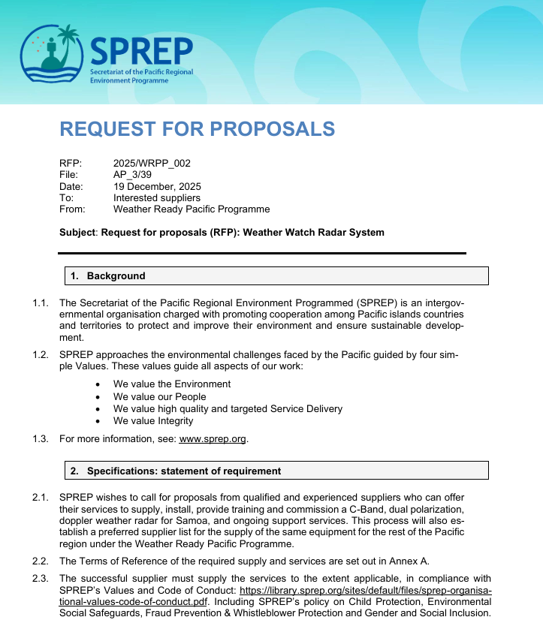
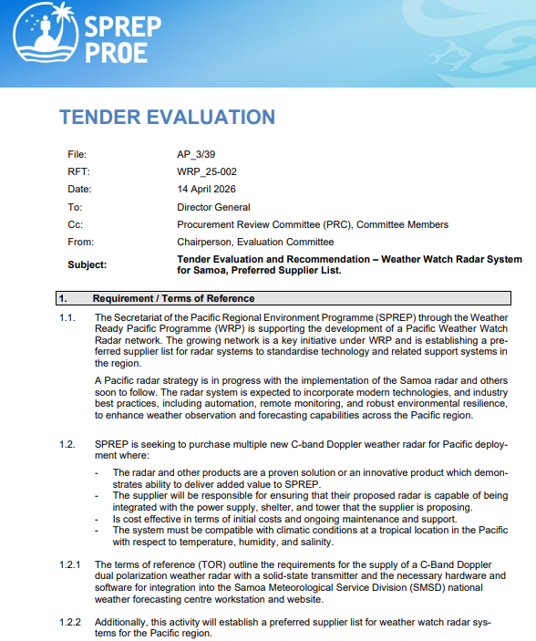
WRP Radar Procurement and Preferred Supplier Panel
Update January – May 2026
Samoa Radar
Preferred supplier list
3 identified suppliers
Preferred supplier agreement documentation in progress
procurement and award completed
Land lease agreement in progress

Slide 8
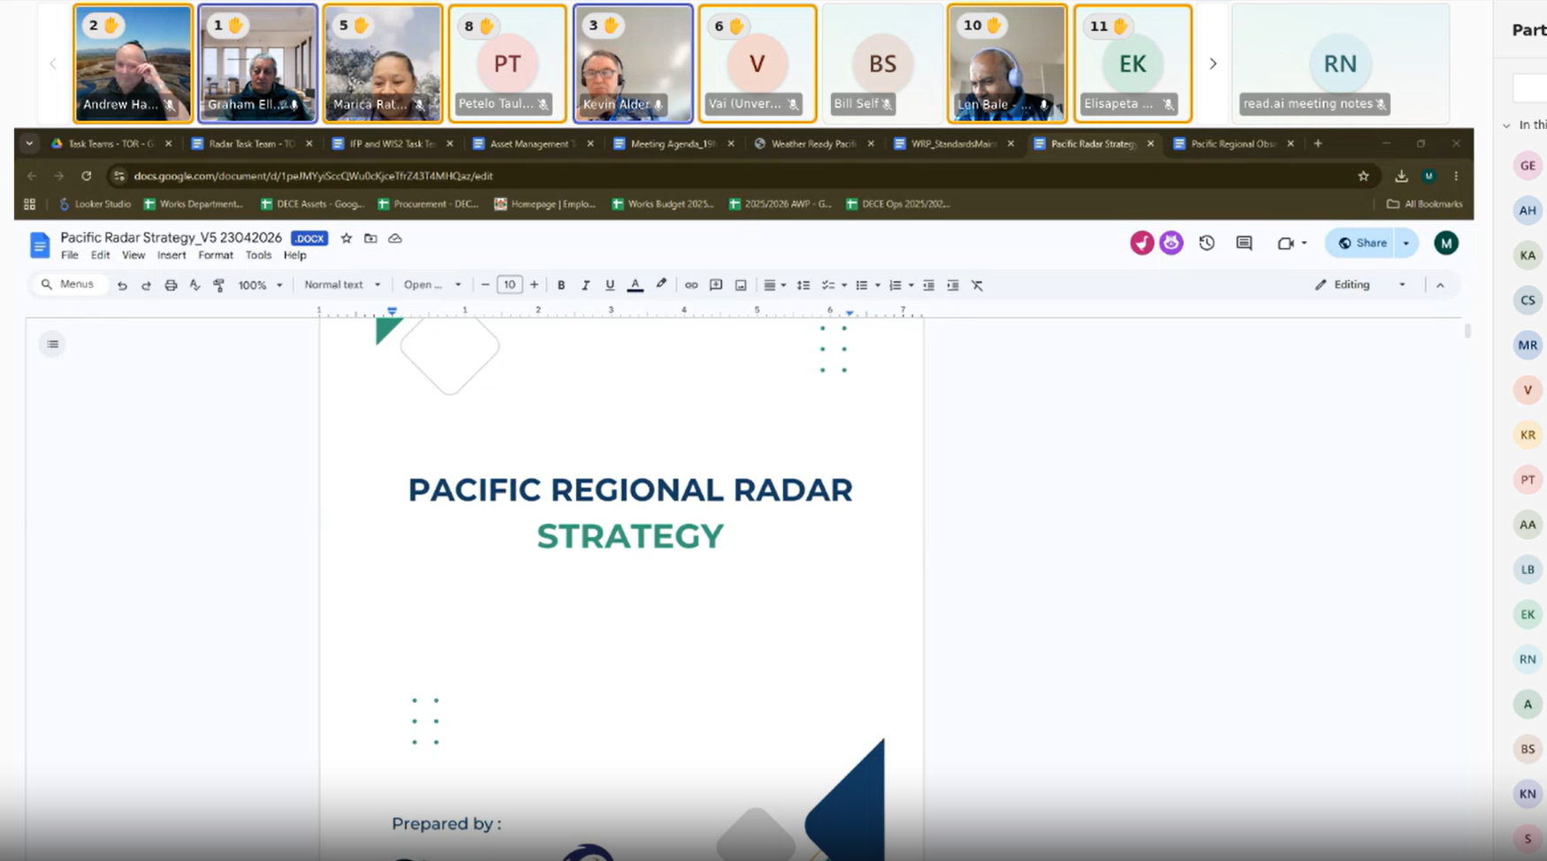
Regional Radar Strategy
Update January – May 2026
Strategy updated, particularly with upgraded radar maps and radar installation criteria
Final copy sent to PICI panel for review on 01/05/2026
PICI panel virtual meeting on 19/05/2026 endorsed the document to move forward to PMC

Slide 9
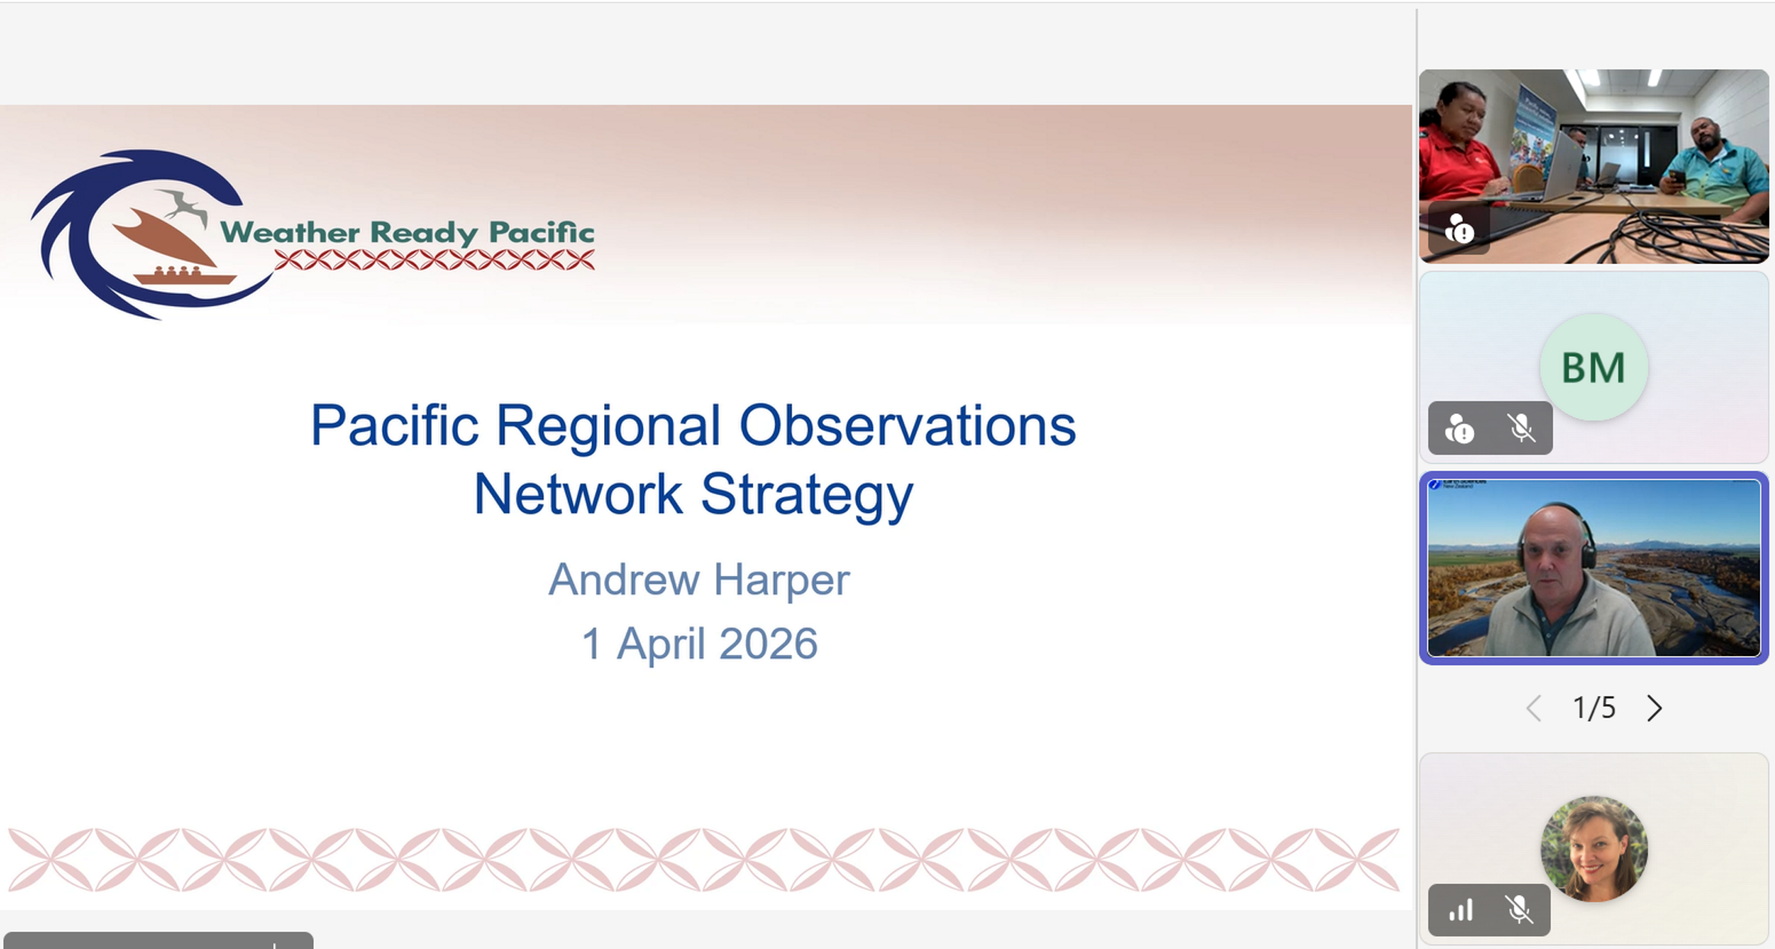
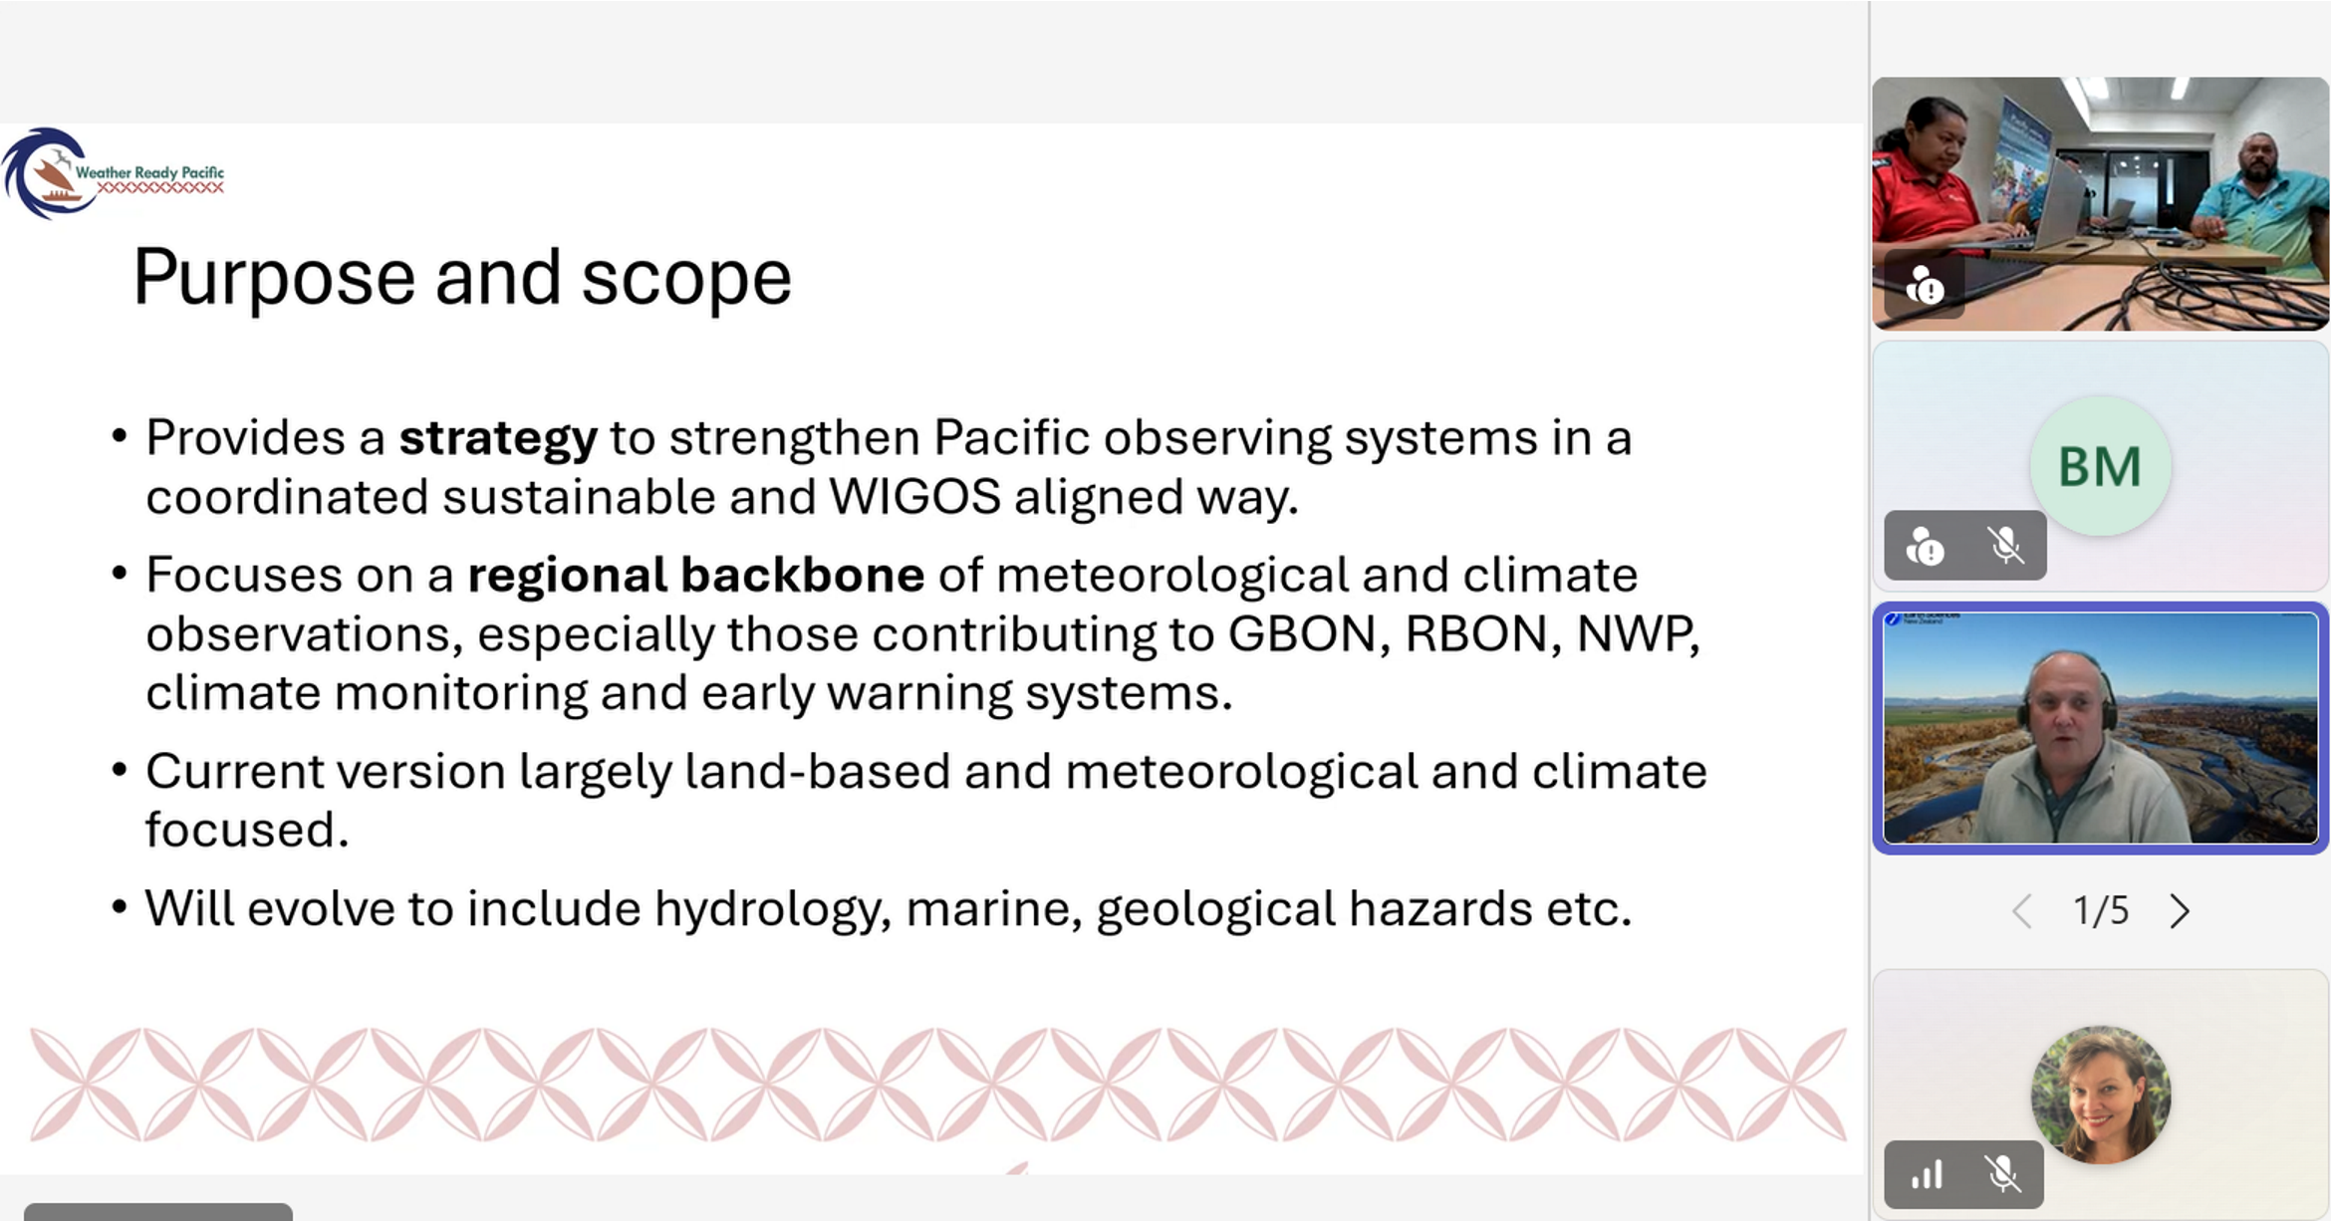
Regional Observations Network Strategy
Update January – May 2026
Regional observations network stocktake updated based on self-reported inputs from Chch Workshop, WIGOS and OSCAR performance
Strategy Document developed based on Chch priorities and inputs
Shared and presented to PICI Panel (May 2026). It was endorsed for PMC review.
Can guide refurbishment workplan for WRP and for COSPPac Climate Reference Stations
Shared and presented to WRP TAC (Apr 2026)

Slide 10
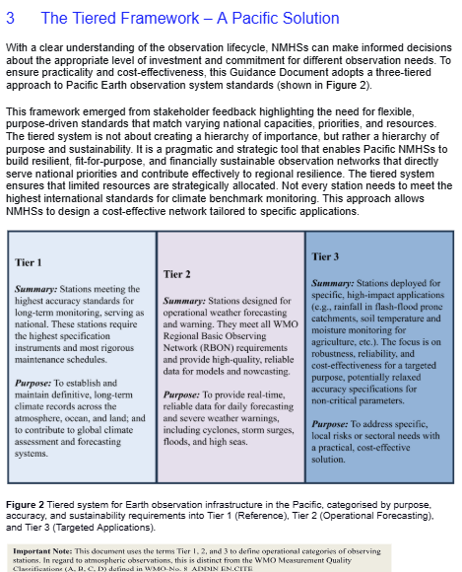
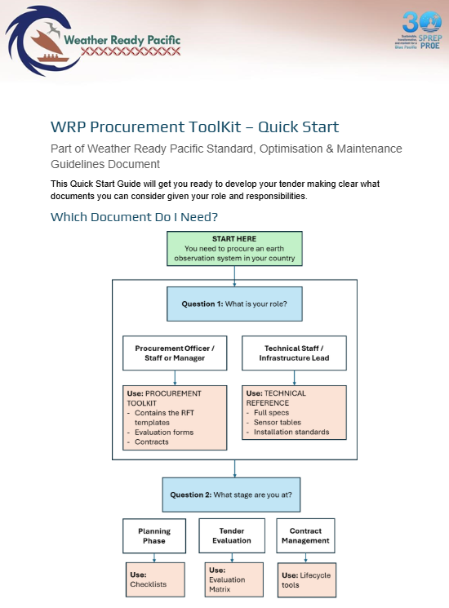
Guidance Document for Standardisation and Maintenance of Meteorological Equipment
Progress
Draft workshopped in Christchurch (Nov 25)
Further refined and circulated to WRP TAC (Dec 2025)
Circulated to all PMC Panels (March 2026)
Presented to WRP TAC (1 Apr 2026)
Presented to PICI Panel (19 May 2026)
Next Steps
SC endorse for pilot use in project procurement
PMC and PMMM high-level endorsement
Explore expansion into geo-hazard equipment
Consider developing a tool to make it more user-friendly (e.g. online prompt-based platform or app)

Slide 11
Work on Hydrology Strategy
LiDAR Strategy – SPC
Notes:
Informed by in-country needs assessments, MetService led the rollout and review of a Severe Weather Pilot across the 2024-2025 tropical cyclone season. It aimed at co-designing enhancements to existing Severe Weather programmes, enhancing foundations and improving severe weather forecasting in pilot countries: Fiji, Niue and Tonga. In addition to the capability building outlined under KRA 2, the pilot enhanced standard operating procedures (SOPs), provided in-country guidance, developed digital interactive flowcharts, enhanced coordination and communication between NMHS, NDMOs and first responders; and strengthened regional cooperation and knowledge sharing among tropical cyclone warning centres in Fiji, Australia and New Zealand. The pilot modelled adaptive management by continuously gathering user feedback through weekly surveys, an endline survey, validation interviews, and collaboration meetings; and making improvements to the pilot accordingly.
Planning to develop an Integrated Forecasting Platform (IFP) and strengthen Regional Specialised Meteorological Centres (RSMCs) has progressed. This aims to capitalise on rapidly growing artificial intelligence and machine learning technology that is expected to be a major disruptor and opportunity for the hydrometeorological sector (if used ethically). The first stage of this project will be an IFP peer review scheduled for August 2025, aimed as assessing the suitability, supportability, and sustainability of systems and processes developed under the Severe Weather Forecasting Pilot to inform the development of a Pacific-wide IFP and its transition to regional ownership over the next decade.
Discussions and desktop scoping, in coordination with the COSPPac team, of an operational coastal inundation forecast system for Tokelau have commenced. Implementing partners are likely to include: the Tokelau Ministry of Climate, Ocean & Resilience (MiCORE), Australian Bureau of Meteorology (BoM), the Pacific Community (SPC), the Climate and Oceans Support Program in the Pacific (COSPPac), the Pacific Islands Marine and Ocean Services (PIMOS) Panel, and may also include Samoa Met Division and/or Fiji Meteorological Services in the operationalisation phase.

Slide 12
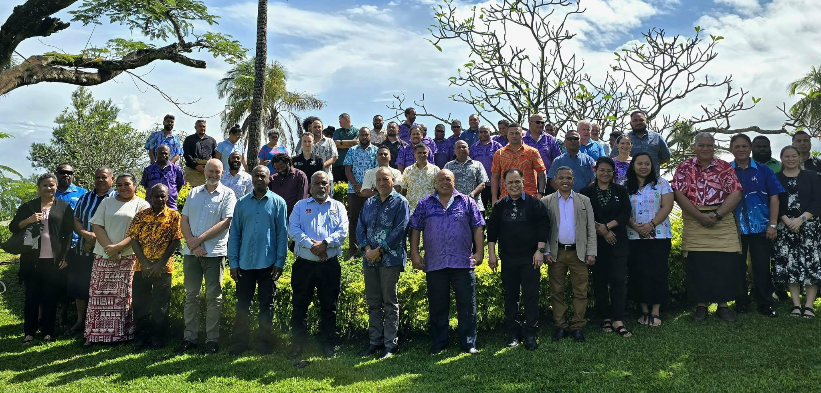
Regional LiDAR Site Prioritization Framework
LiDAR ACQUISITION IN RMI
Blended investments across 4 projects (WRP, GCF TCRP, RMI L&D, COSPPac) to leverage economy of scale and reduce cost.
Procurement completed – Contract awarded in Dec. 2025
April survey delayed due to Fuel Shortage on Island
New mobilisation date: 24 June 2026
Coordinated regional approach aligned with UNDP, leveraging PRDEMM, PGSC and PIMOS to build momentum
April 2026 consultation convened key national actors (Met, NDMO, Lands & Survey) to align priorities
Clear recommendations: LiDAR is critical infrastructure → requires full value chain investment and high‑level political mobilisation

Slide 13
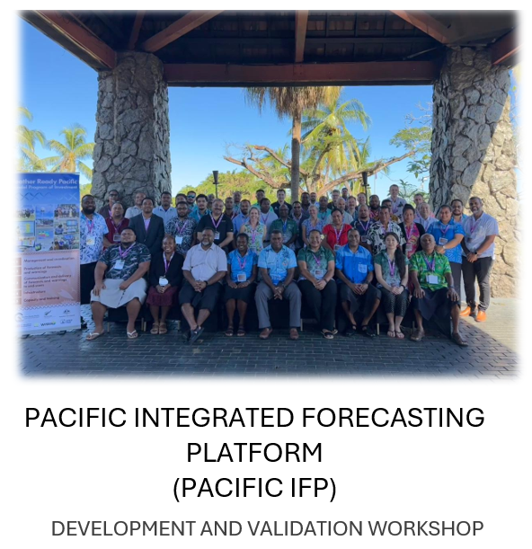
Pacific Integrated Forecasting Platform
KRA 4 – Forecast and Warning Production
Disbursed USD 460,764.66
Update January – May 2026
Design team engaged for the Pacific IFP – Phase 1;
Development workshop held in April 2026, in Nadi, Fiji with technical staff from 12 Pacific NMHS and 7 partner agencies
 | Name | Agency | Role
1 | Cameron Lethlean | BoM (Aus) | Project Manager, Business Analyst
2 | Stephen Wood | BoM (Aus) | Technical Lead, ICT Forecasting Specialist
3 | Gabor Szikszai | Met Service NZ | Data Process Analyst
4 | Myles Johnson | Met Service NZ | Solutions Architect
5 | Raveen Das | Met Service NZ | Pacific Forecast Specialist, Training Lead
6 | Max Marno | Synoptic Data (US) | Project WIS2.0 specialist
7 | Michael Dymond | Met Service UK | Technical Architect (Task Team)

Slide 14
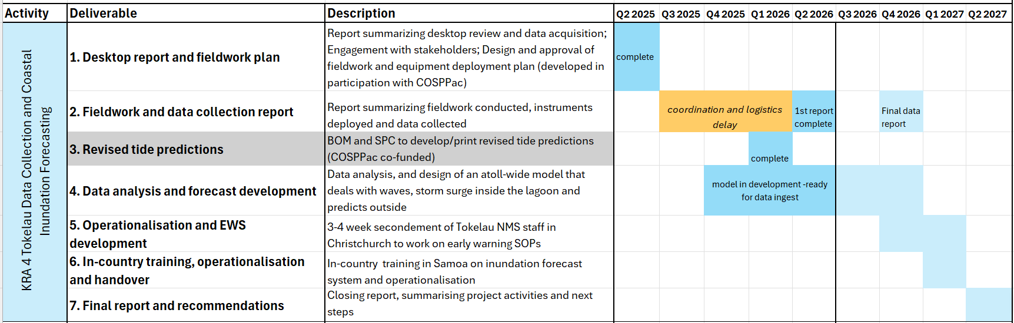
Operational Coastal Inundation Forecast System for Tokelau
In progress, as delayed sensor deployment compresses time for training and operationalisation of the forecast system
Notes:
Informed by in-country needs assessments, MetService led the rollout and review of a Severe Weather Pilot across the 2024-2025 tropical cyclone season. It aimed at co-designing enhancements to existing Severe Weather programmes, enhancing foundations and improving severe weather forecasting in pilot countries: Fiji, Niue and Tonga. In addition to the capability building outlined under KRA 2, the pilot enhanced standard operating procedures (SOPs), provided in-country guidance, developed digital interactive flowcharts, enhanced coordination and communication between NMHS, NDMOs and first responders; and strengthened regional cooperation and knowledge sharing among tropical cyclone warning centres in Fiji, Australia and New Zealand. The pilot modelled adaptive management by continuously gathering user feedback through weekly surveys, an endline survey, validation interviews, and collaboration meetings; and making improvements to the pilot accordingly.
Planning to develop an Integrated Forecasting Platform (IFP) and strengthen Regional Specialised Meteorological Centres (RSMCs) has progressed. This aims to capitalise on rapidly growing artificial intelligence and machine learning technology that is expected to be a major disruptor and opportunity for the hydrometeorological sector (if used ethically). The first stage of this project will be an IFP peer review scheduled for August 2025, aimed as assessing the suitability, supportability, and sustainability of systems and processes developed under the Severe Weather Forecasting Pilot to inform the development of a Pacific-wide IFP and its transition to regional ownership over the next decade.
Discussions and desktop scoping, in coordination with the COSPPac team, of an operational coastal inundation forecast system for Tokelau have commenced. Implementing partners are likely to include: the Tokelau Ministry of Climate, Ocean & Resilience (MiCORE), Australian Bureau of Meteorology (BoM), the Pacific Community (SPC), the Climate and Oceans Support Program in the Pacific (COSPPac), the Pacific Islands Marine and Ocean Services (PIMOS) Panel, and may also include Samoa Met Division and/or Fiji Meteorological Services in the operationalisation phase.

Slide 15
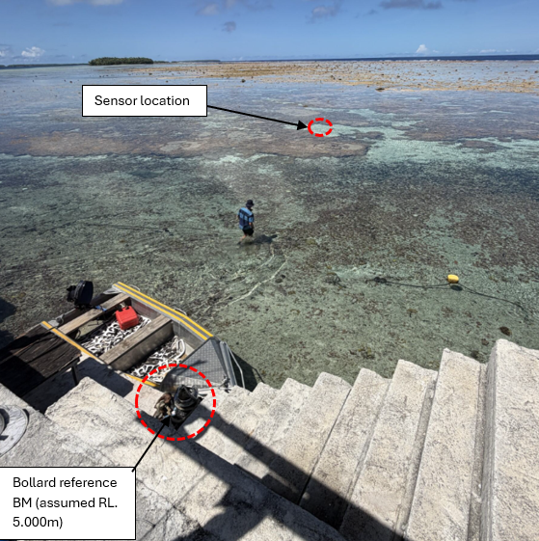
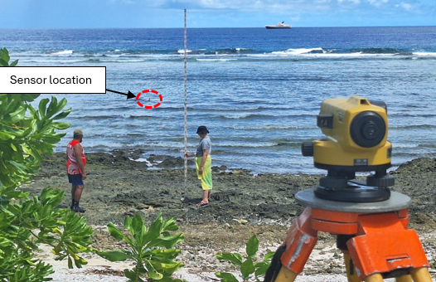
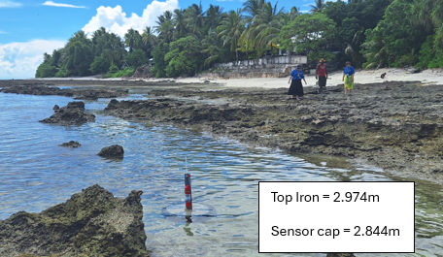
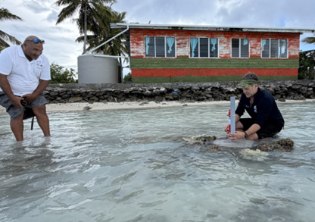
Operational Coastal Inundation Forecast System for Tokelau
Progress
4 RBR pressure sensors deployed and benchmarked in Fakaofo, Nukunono, and Atafu in April 2026
Skeleton forecast model nearly complete
Initial discussions with Tokelau and Samoa Met teams on training
Next steps
Data to be collected in 6 months during follow-up visit
Data ingest into model, testing, verification
Training and operationalisation of the system
Notes:
Informed by in-country needs assessments, MetService led the rollout and review of a Severe Weather Pilot across the 2024-2025 tropical cyclone season. It aimed at co-designing enhancements to existing Severe Weather programmes, enhancing foundations and improving severe weather forecasting in pilot countries: Fiji, Niue and Tonga. In addition to the capability building outlined under KRA 2, the pilot enhanced standard operating procedures (SOPs), provided in-country guidance, developed digital interactive flowcharts, enhanced coordination and communication between NMHS, NDMOs and first responders; and strengthened regional cooperation and knowledge sharing among tropical cyclone warning centres in Fiji, Australia and New Zealand. The pilot modelled adaptive management by continuously gathering user feedback through weekly surveys, an endline survey, validation interviews, and collaboration meetings; and making improvements to the pilot accordingly.
Planning to develop an Integrated Forecasting Platform (IFP) and strengthen Regional Specialised Meteorological Centres (RSMCs) has progressed. This aims to capitalise on rapidly growing artificial intelligence and machine learning technology that is expected to be a major disruptor and opportunity for the hydrometeorological sector (if used ethically). The first stage of this project will be an IFP peer review scheduled for August 2025, aimed as assessing the suitability, supportability, and sustainability of systems and processes developed under the Severe Weather Forecasting Pilot to inform the development of a Pacific-wide IFP and its transition to regional ownership over the next decade.
Discussions and desktop scoping, in coordination with the COSPPac team, of an operational coastal inundation forecast system for Tokelau have commenced. Implementing partners are likely to include: the Tokelau Ministry of Climate, Ocean & Resilience (MiCORE), Australian Bureau of Meteorology (BoM), the Pacific Community (SPC), the Climate and Oceans Support Program in the Pacific (COSPPac), the Pacific Islands Marine and Ocean Services (PIMOS) Panel, and may also include Samoa Met Division and/or Fiji Meteorological Services in the operationalisation phase.

Slide 16

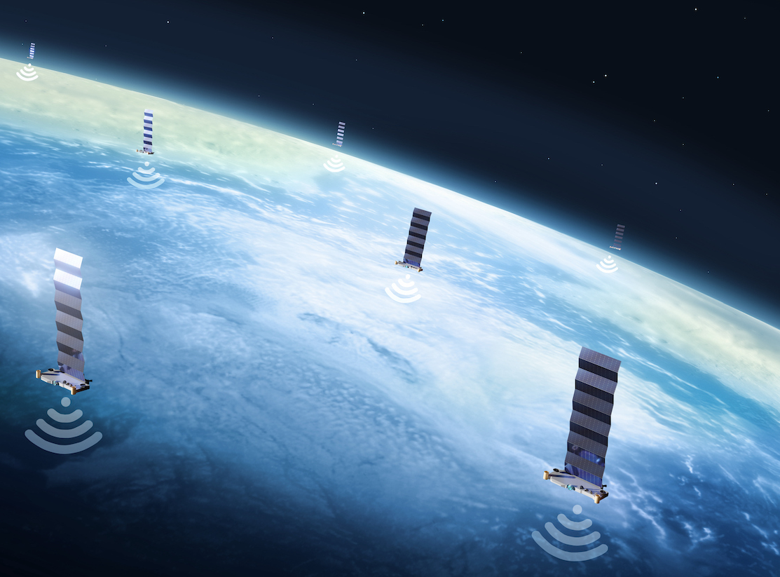




Rollout of Starlink systems
KRA 5 – Communication & delivery of forecasts and warnings to end users
Countries supported
Kiribati
Solomon Islands
Tonga
Niue
Disbursed USD 63,917.21
Notes:
Concept Plans to roll out Starlink systems in Kiribati, Tonga and the Solomon Islands (EW4ALL Countries) were received and are being assessed by the PMU, with particular consideration being given to sustainability. It is noted that 11 PICTs have requested starlink support, with additional countries to be provided support after the initial roll-out.

Slide 17

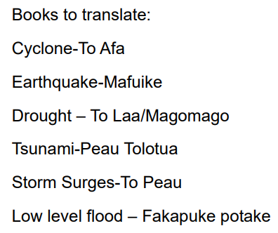

COPE Series Translations booklets Niue and Tokelau

Slide 18
KRA 6 – Risk information & hazard preparedness
(investment plan still in progress)

Slide 19
Spending/Committments
SPREP disbursed USD 1,033,643 within the January-April 2026 window.
Commitments as at 30 April 2026:
USD 1,489,472 committed by SPREP under contract or purchase order
USD 2,251,085 committed by MetService under contract or purchase order
USD 315,856 committed by Earth Science NZ under contract or purchase order
WRP Programme Budget for 2026 - USD 10,992,580
TOTAL DISBURSED + COMMITTMENTS = USD 5.09 million (as at 30 April 2026)

Slide 20
Recommendations for SC Consideration
WRP_SC4 is requested to note the progress made across the implementation of WRP activities
WRP_SC4 is requested to accept and endorse the Preliminary Progress and Budget Tracking Report

