Slide 1
Sustainability Roadmap
Progress Update
(Reference to WRP-SC Paper 9.6)

Slide 2
Background
Two key roadmaps were proposed as part of the approved WRP Sustainability Framework of the Pacific Hydrometeorological Services and incorporated in the WRP Implementation Plan and Funded Work Plan;
Training and Capacity Development Roadmap
Sustainable Financing and Asset Management Roadmap – approved at SC2

Slide 3
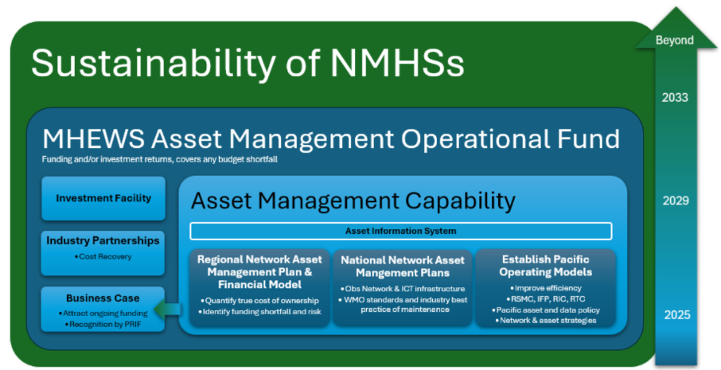
Roadmap for Sustainable Financing and Asset Management

Slide 4
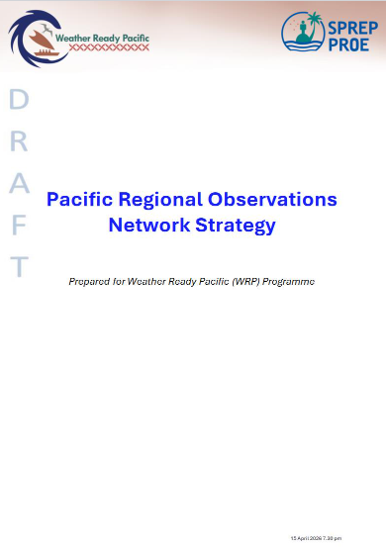
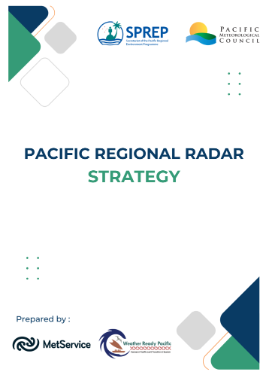
Asset Improvement Strategies
Asset classes | Improvement Strategy | Status
AWS network (incl AWOS) | Pacific Regional Observation Network Strategy (Annex 4) | Endorsed by PICI Panel - will be working with countries to define station tiers
Manual observation network
Upper air network
Wave buoy and Ocean network |  | NYC
Tide gauge network |  | NYC
Radar Network data | Pacific Regional Radar Strategy (Annex 5) | Endorsed by PICI Panel
Hydrology and Flood network | Pacific Regional Hydrological Services Strategy | In development (SPC)
Seismic Network |  | TBC
ICT Infrastructure | Pacific ICT Architecture and Strategy | In development. Prelim ICT Architecture endorsed by PICI Panel
Buildings |  | NYC
Notes:
o The Asset Policy identifies the strategies required at a regional level, to guide improvement in the Pacific context. As there are unique challenges to each asset type, different strategies are required.
o Several strategies are tabled to this SC for Approval, having already been endorsed by PICI Panel (Annex 4-5)
o These will be also tabled to PMC for approval.

Slide 5
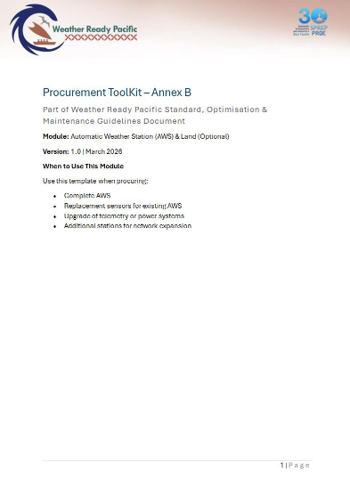
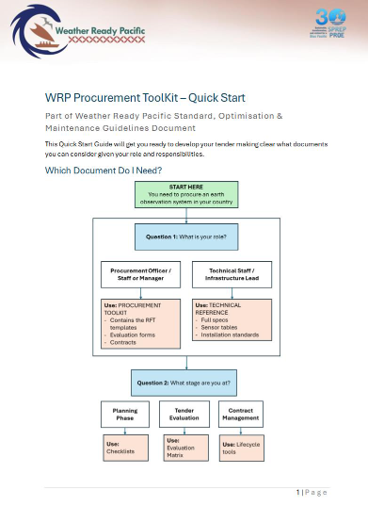
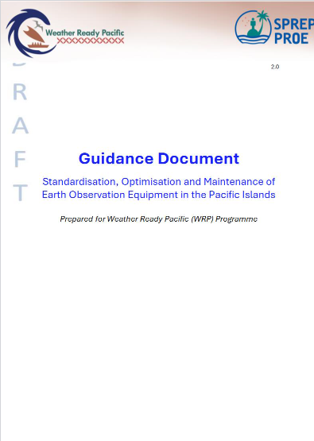
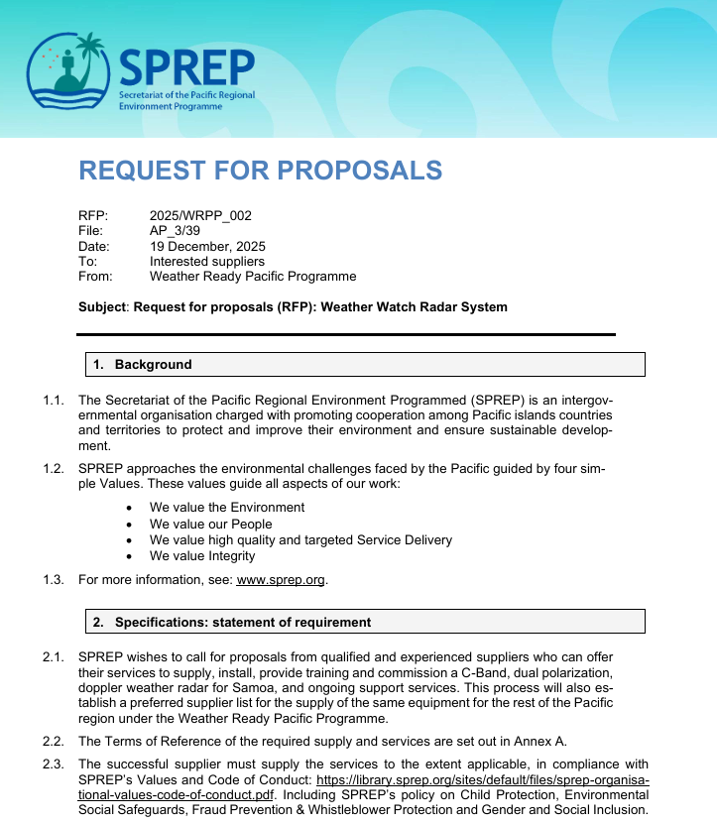
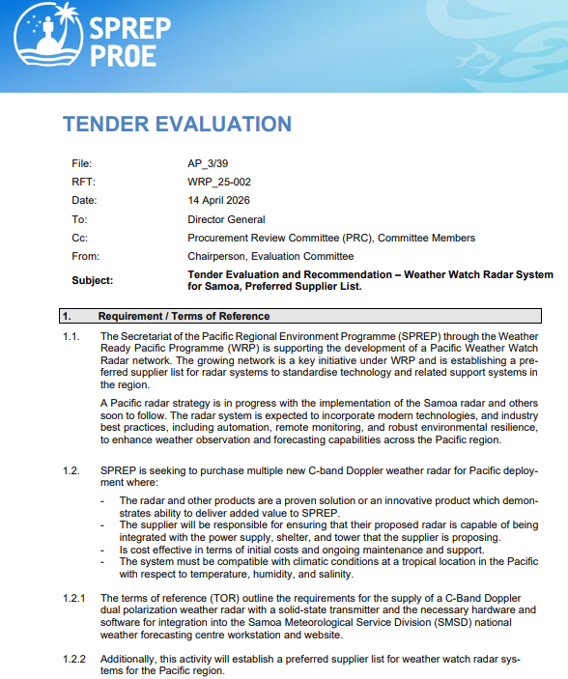
Improving Efficiencies
Description | Updates
Guidance Document for Standardisation, Optimisation and Maintenance of Earth Observation (Annex 6) | Presented to and endorsed by PICI panel Will incorporate geological hazard observations
Preferred supplier panels – Radar confirmed | Evaluation works completed Contract documentation in progress
RTC and RIC | Building construction in progress in Nadi, Fiji
Integrated Forecasting Platform | Details in the Progress presentation
Task Teams for Panels | 3 Teams established in the PICI panel to support governance and technical oversight for major projects

Slide 6
Roadmap for Sustainable Financing and Asset Management

Slide 7
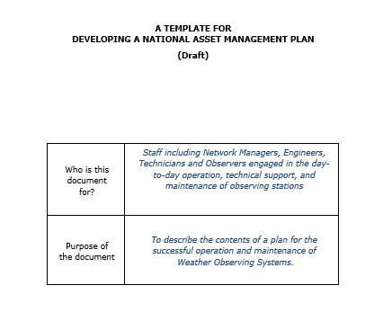
National Asset Plans – Annex 7.0
What it is…
outline how assets will be managed at country level, all assets identified, improvement/upgrades and maintenance activities and costs, in alignment with and reference to the regional Asset Strategies.
Progress to date…
preliminary template has been developed in alignment with WMO operations and maintenance manual.
template will be continually reviewed and refined for improvements and changes in requirements and technology, this may include the engagement of a specialist as part of developing the regional network asset management plan and lifecycle cost.
These have been shared to several countries to pilot, and will progressively rollout to all countries within the next two years.
PNG is the first country that have worked on their draft National Asset Management Plan and working with WRPP partner (ESNZ) to review them.

Slide 8
Roadmap for Sustainable Financing and Asset Management

Slide 9
Regional network asset management plan and financial model
Pacific Regional Observation (PRO) Network (In Progress)
This network is the critical stations that will be financially supported by the MHEWS Asset Management Operational Fund, supplementing national and international (i.e SOFF) funding to ensure sustainable maintenance and operations of these assets.
A stocktake of existing observation assets across the Pacific has been developed.
Determining which assets will be part of the PRO network will carried out as part the National Asset Plans development
Regional Asset Management Plan (Not commenced)
Once the PRO network is identified with each country, this will be captured in the Regional Asset Plan and lifecycle cost model.
A specialist consultant will be engaged to ensure the plan is robust and can support the business case and spending allocations of the MHEWS Asset Management Operational Fund.

Slide 10
Roadmap for Sustainable Financing and Asset Management

Slide 11
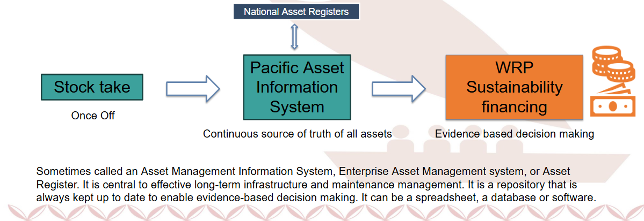
Why an Asset Information System?
This system will be the source of truth for all assets under the Pacific Meteorological Asset Policy and be kept in line with national Asset registers. KRA 3, Activity 3.1.1
This system will be used by all Pacific NMHSs, SPC and Technical Partners supporting the operations and maintenance of hydrometeorological assets.
Procurement Technical Requirements have been developed and procurement process to commence mid 2026.
Task Team for Asset Management will govern and support the selection of the system and project team roll out of system across the pacific.

Slide 12
Terms of Reference (Draft requirements)
Multi organization access
Option for cloud or on-premise hosting
Inventor management
Cost tracking and forecasting
Maintenance work management
Condition and performance monitoring
Asset records and performance assessment
IoT integration options
Reporting and dashboards
Data export and APIs,
Backup and disaster recovery

Slide 14
Roadmap for Sustainable Financing and Asset Management
Investment Facility & MHEWS Aset Management Operations Fund (in progress)
Industry Partnership (in progress)
Business case (yet to commence)

Slide 15
Recommendations for Paper 9.6
To note and discuss progress on implementation of roadmaps
&

Slide 16
Decisions for Paper 9.6
WRP Dec. 9.6.1 – Endorse the continued development for PMC approval
- a Pacific Meteorological Asset Policy and
- a Meteorological Data Framework and
- MHEWS Asset Operations and Investment Facility Concept
WRP Dec. 9.6.2 – Approve the Pacific Regional Observation Strategy, Radar Strategy, Guidance Document for Standardisation, Optimisation and Maintenance, and Procurement Guidelines and preliminary Pacific ICT Architecture Design.
WRP Dec. 9.6.3 – Endorse the development of National Asset Management Plans for each country in 2026 and 2027, which will define the Pacific Regional Observation (PRO) Network of critical infrastructure that will be financially supported by the MHEWS Asset Management Operational Fund, supplementing national funding.

