Slide 1
WRP Steering Committee Meeting
IFP Phase 1 Update and Phase 2 Decision
Cameron Lethlean
Solomon Islands, 29 May to 02 June2026

Slide 2
Purpose
The following decision is requested of the WRP Steering Committee (WRP_SC4)
  1. WRP SC4 Approves the Pacific Integrated Forecasting Platform Phase 2 to adopt the Fiji Meteorological Services IBL software system and high-level Architecture Design

Slide 3
Recap of the IFP Peer Review
Review the level of suitability, supportability and sustainability of the existing systems, processes and capability developed under severe weather pilots and Fiji Met Service, for further development and expansion into a Pacific Integrated forecasting platform and migration to Pacific ownership and management over the next decade.
The high-level capabilities required for the IFP advised by WRP are:
Data ingestion/ integration
Processing/ visualisation
Forecast production/ generation
Dissemination
These capabilities are assessed across key service areas of Public Weather, Aviation, Marine, Severe Weather and Geo Hazards.
Notes:
Cam

Slide 4
Findings from the Review of Fiji
Capability | Current Platforms
Data Ingestion | Not able to ingest all AWS and observations data in pacific countries they provide services, satellite limited. Limited access to low-cost NWP Products, as well as ingestion of high-resolution NWP model data into production and visualisation systems. ENSEMBLE data is also underutilised.
Processing/visualisation | Many external web pages used to access full set or required data.
Forecast production/generation | Heavily manual, typing text without much automation and significant benefit would be derived from graphical production techniques and automated form-based data input (e.g. model derived input). There is also only manual verification of products. There is reliance upon outdated/unsupported AIFS applications or basic email/office applications.
Dissemination/transmission | A system is lacking that enables dissemination as part of a single/simpler process.
Notes:
Cam

Slide 5
Options Considered For IFP
Do Nothing.
Use and expand the NZ SWFP tool to become full IFP.
Existing Fiji Software Expansion
Procurement: Utilise a procurement process to go to market for a commercial off the shelf (COTS) software that suits the requirements of the IFP.
Develop bespoke software from the ground up (e.g. Hire developers/contractors, utilise available open-source software).
Notes:
Cam

Slide 6
Options Considered for IFP
 | Description | Pros | Cons
1 | Do Nothing. | No cost | Does not meet the needs of Pacific NMHSs
2 | Use and expand the NZ SWFP tool to become full IFP. | Piloted in several countries | Primarily visualisation, no production and dissemination Substantial additional development needed at high costs and time. A bespoke solution unlikely to scale from a visualisation‑focused pilot to a full IFP.
4 | Procurement: Go to market for a commercial off the shelf (COTS) software that suits the requirements of the IFP. | Open procurement is a viable option | Currently small number of vendors globally with the necessary meteorological and hydrological expertise and experience. (e.g. Info-Electronics Systems and MeteoFrance software - Meteofactory/Synergie-Web, IBL). Longer implementation timeline - delay 12-18 months
Notes:
Cam

Slide 7
Options Considered for IFP
 | Description | Pros | Cons
3 | Existing Fiji Software Expansion (IBL) | Proven software already in Pacific (Fiji, Samoa) Faster delivery – avoids 12–18 months procurement Proven vendor – trusted, responsive Ready-to-use capability and standard compliance (i.e. aviation, impact-based forecasts, ICAO IWXXM and WIS 2.0) Configurable to country-specific needs Low-bandwidth solution – full functionality across constrained environments Pacific led and Regional hub at Fiji Regional support available - Aus/NZ/UK | Incur ongoing costs
5 | Develop bespoke software from the ground up (e.g. Hire developers/contractors, utilise available open-source software). | Could potentially reduce some upfront capital costs | Significant compliance, sustainability, and delivery risks Cannot realistically deliver a complete IFP without some paid software components. Require ongoing access to highly specialised software engineering skills, regular upgrades, testing and bug fix, operational deployment (~5+ extra staff) Higher whole‑of‑life costs than an established commercial off-solution (known costs). Longer implementation timeline
Notes:
Cam

Slide 8
Recommendation (IFP)
Existing Fiji software expansion: Use existing licenced software (e.g. IBL Visual Weather and BoM TC Module) to enable enhanced product generation and dissemination across the WRP region and a phased project to expand upon IBL VW licencing to implement Online Weather across the WRP Region for a web-based solution.
PHASE 1 (2026 - 2027): UPLIFT FIJI MET & ARCHITECTURE DESIGN
PHASE 2a (2027 - 2028): VISUALISATION – ALL COUNTRIES
PHASE 2b (2027 - 2029): PRODUCTION & DISSEMINATION – ALL COUNTRIES
Utilise the existing VW software within Fiji Met Service
Improved ingest and visualisation.
Improved forecast efficiency (including more automation)
Forecast Production, text and graphical.
Geohazard data.
Expand IBL software use to develop Online Weather capability.
Data visualisation.
Work done to set up phase 1 rolls into this phase.
Expands Visualisation to all 15 countries.
Works in low bandwidth areas
Expand the use of Online Weather for product generation and dissemination.
Expands option of product generation to all 15 countries.
Provides full functionality that can be accessed remotely.
Notes:
Cam

Slide 9
IFP Project Phase 1 Update
Activity 1 – Architecture Design
High-level architecture approach design developed
Design approach includes WIS2.0 data flow
Progressing towards detailed solution architecture design (SAD)
Activity 4 – Infrastructure Implementation
Implementation Plan for WIS2.0 regional pilot being developed.
Working on data feeds, INGEST for VW Uplift
Activity 5 – Change, Communication and Training
Commencing in coming 1-2 months bringing on-board Training Lead.
Activity 2 – VW Uplift
Access to VW development environment Fiji
Identified gaps in bandwidth/ISP Fiji in progress
Validated IBL approach as IFP Workshop Fiji
Analysing aviation SOPs/WIs
Product data collection underway in Fiji
Commenced aviation VW upgrade build
WRP Team: Ofa Fa'anunu, Marica Ratuki, Jessica Yeung
The IFP Project Team: Cameron Lethlean, Myles Johnson, Stephen Wood, Gabor Szikszai, Raveen Das
FMS: Leonard Bale, Amit Singh, Misaeli Funaki & others.
Activity 3 – TC Module Upgrade
Some initial discovery meetings commencing at BOM
Scheduled within the next 2-3 months
Notes:
Steve

Slide 10
Activity 1
Pacific IFP Development Workshop Outcomes
Unanimous support for architecture design
Preliminary ICT gaps identified in countries
Unanimous support for Phase 2 implementation with IBL Online Weather
Notes:
Cam

Slide 11
Activity 1 - IFP Architecture Overview
IFP Data Sharing
Agreement (Paper 9.6 – Annex 3.0
KEY:
Global
Regional
Other PICT
IFP
Pacific IFP
National
Notes:
Steve

Slide 12
Country/Organisation | Pacific WIS2.0 Architecture Option
SPC | Set up and run your own WIS2.0 node
Vanuatu | Set up and run your own WIS2.0 node
Tonga | Set up and run your own WIS2.0 node
PNG | Set up and run your own WIS2.0 node
Nauru | Use a shared WIS2.0 node (supported by the region)
Cook Islands | Use a shared WIS2.0 node (supported by the region)
Federated States of Micronesia | Run a national WIS2.0 node within the Pacific WIS2.0 hub (supported by the region)
Fiji | Run a national WIS2.0 node within the Pacific WIS2.0 hub (supported by the region)
Samoa | Set up and run your own WIS2.0 node or Run a national WIS2.0 node within the Pacific WIS2.0 hub (supported by the region)
Solomon Islands | Set up and run your own WIS2.0 node or Run a national WIS2.0 node within the Pacific WIS2.0 hub (supported by the region)
Tokelau
Tuvalu
Palau
Marshall Islands
Niue
Kiribati

Slide 13
Activity 2 - Fiji Capability Uplift
IFP Data Sharing
Agreement (Paper 9.6 – Annex 3.0
INGEST required data:
2.1.1 Observations Ground Based (AWS. RADAR, River)*
  Atmospheric based (Satellite- Himawari)
  Marine Observations
2.1.2 NWP
  ACCESS Suite (Access R, G)
  USGFS
  AUSWAVE
  ECMWF (High resolution global 0.1 degree Deterministic, select ensemble)
  Other
2.1.3 Data use cases
  *Data requirements and detailed use cases – additional data as determined.
Visualisation: Display user stories –visualisation approach for all ingest data
Forecast Process:
Detailed forecast preparation analysis:
Product outputs
Review all SOPs, Work instructions
Product Preparation and Generation:
Efficient product preparation/generation processes
developed
Validate desired outputs.
Notes:
Steve

Slide 14
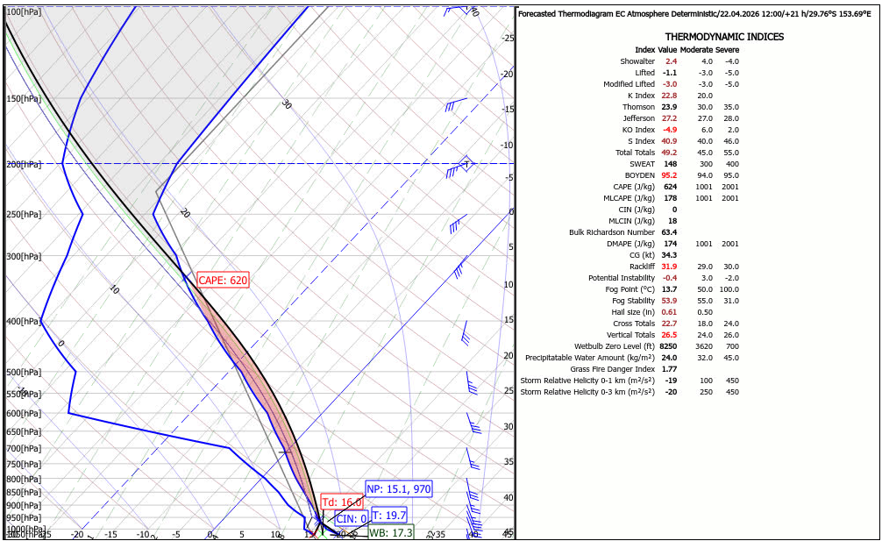
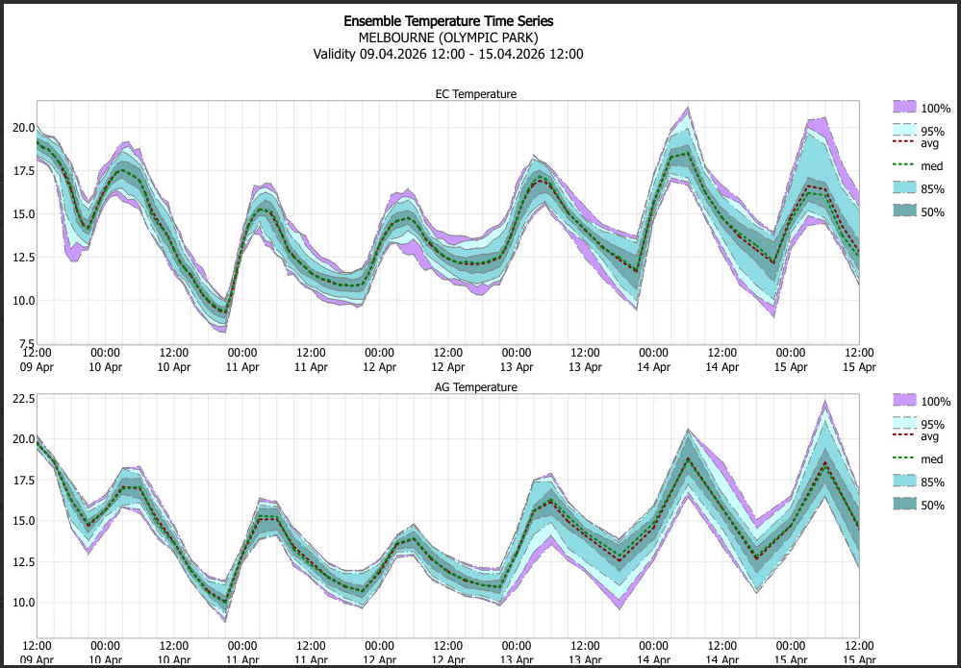
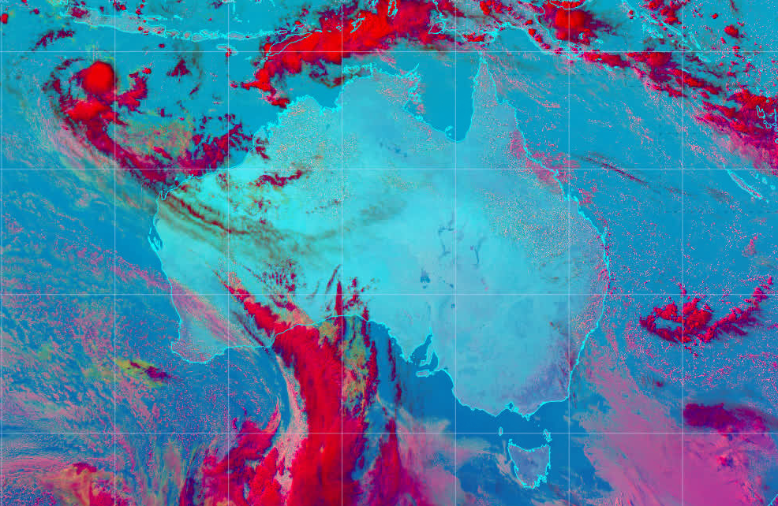
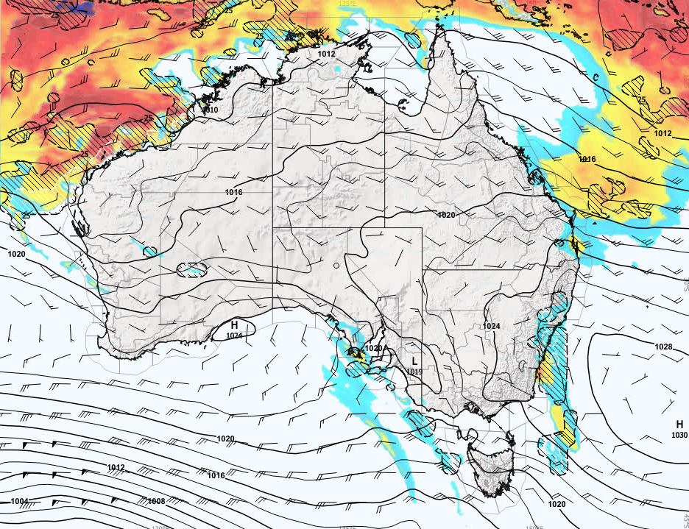
Enhancing Visualisation Capabilities
Tailored to the forecast process
Advanced visualisation capabilities (point location data).
Customisable for different data and product requirements

Slide 15
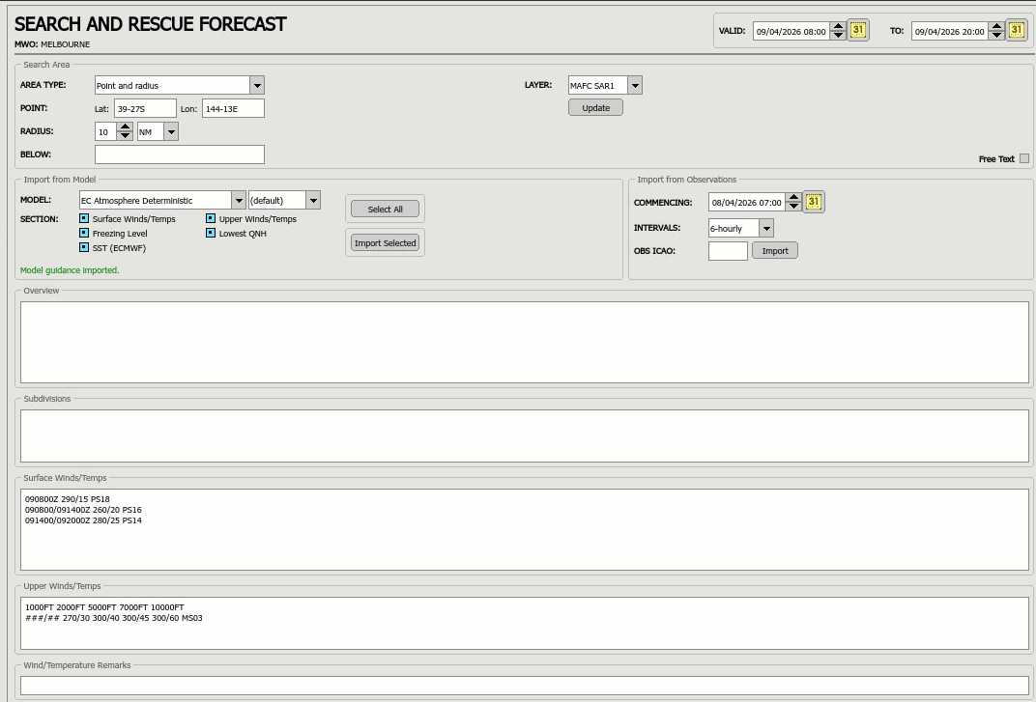
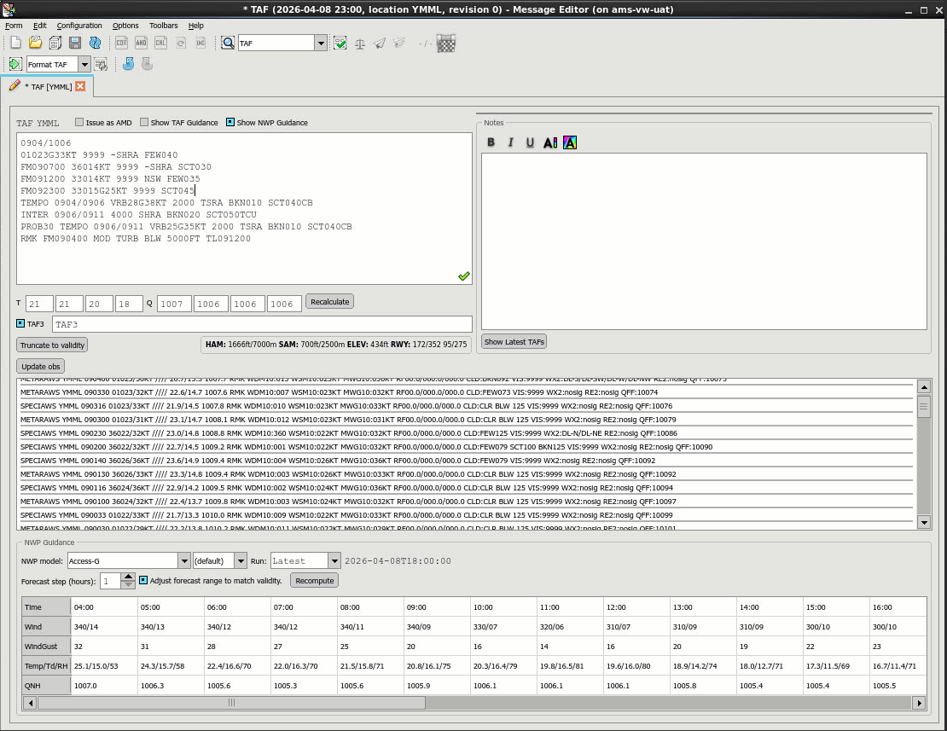
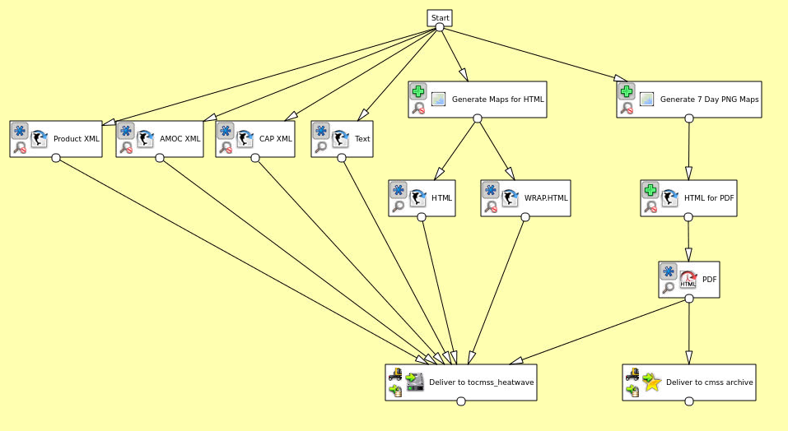
Efficient Form based Forecast Production
Pre-populated data
Tailored output to product requirements
Customisable for different products
Pipeline product generation
Supported by xml backend
Notes:
Form example

Slide 16
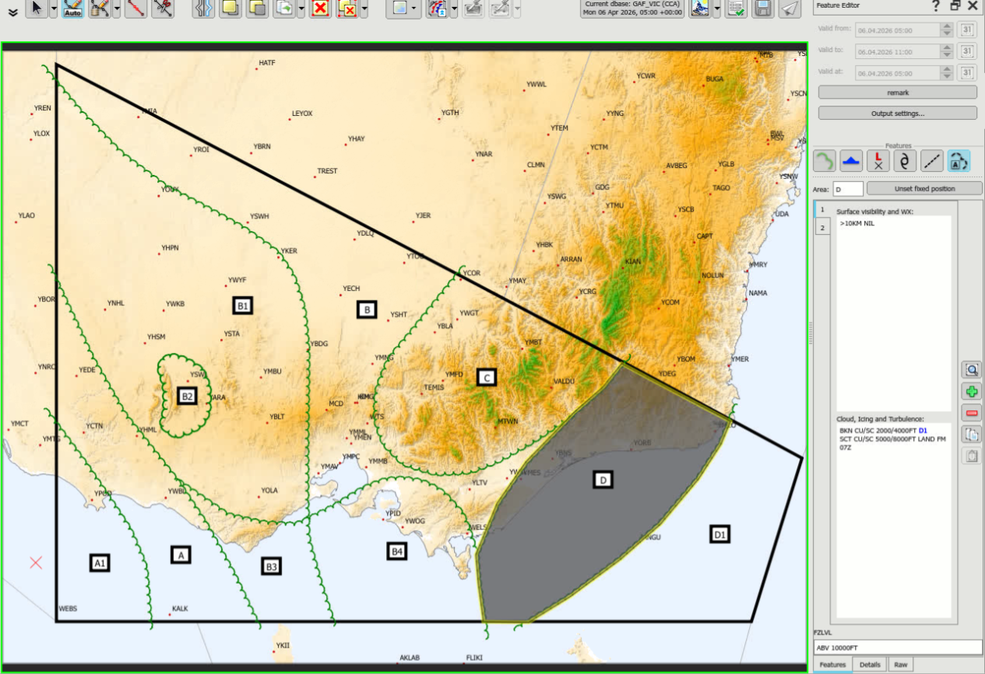
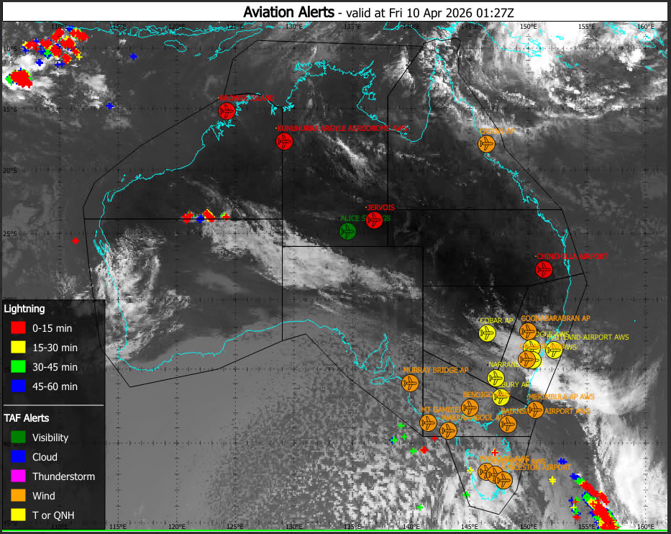
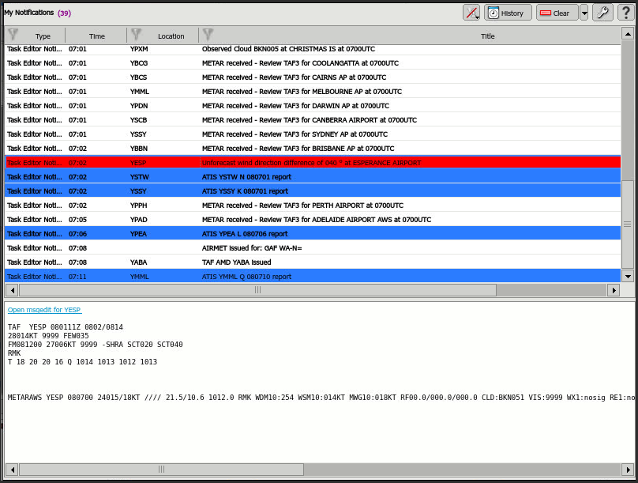
Efficiency gains - Aviation Forecasting
Graphical Aviation Production -GAF
Graphical Alerts
Notifications of significant events/criteria exceedance
Can be configured to suit requirements
Notes:
GAF

Slide 17
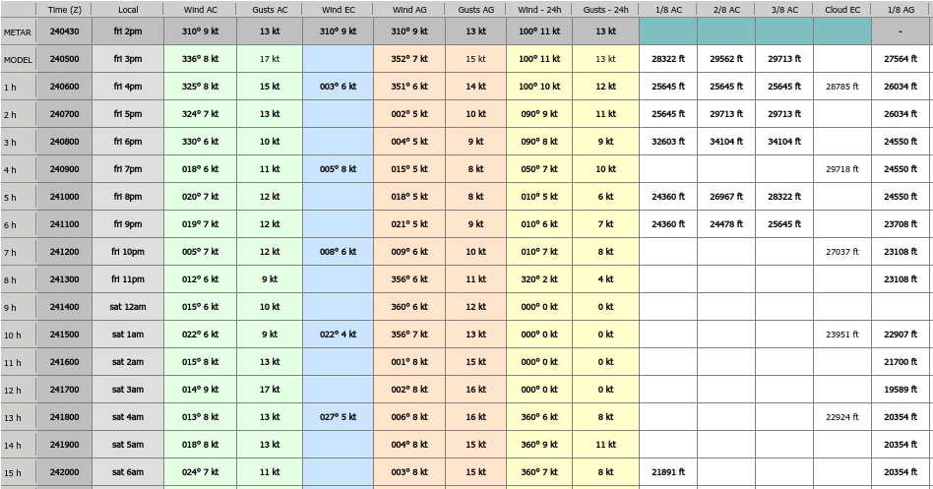
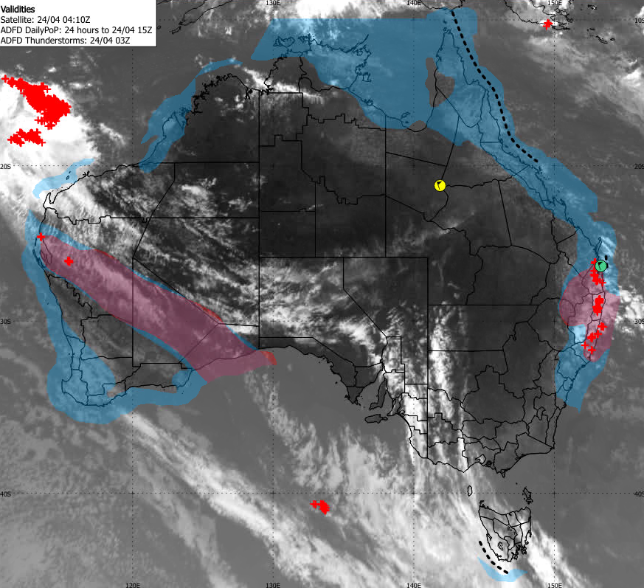
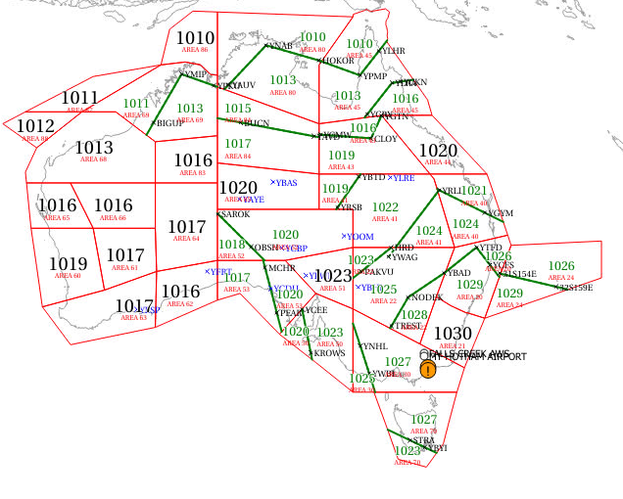

Various types of Graphical Alerts
Comparing forecasts to observations

Slide 18
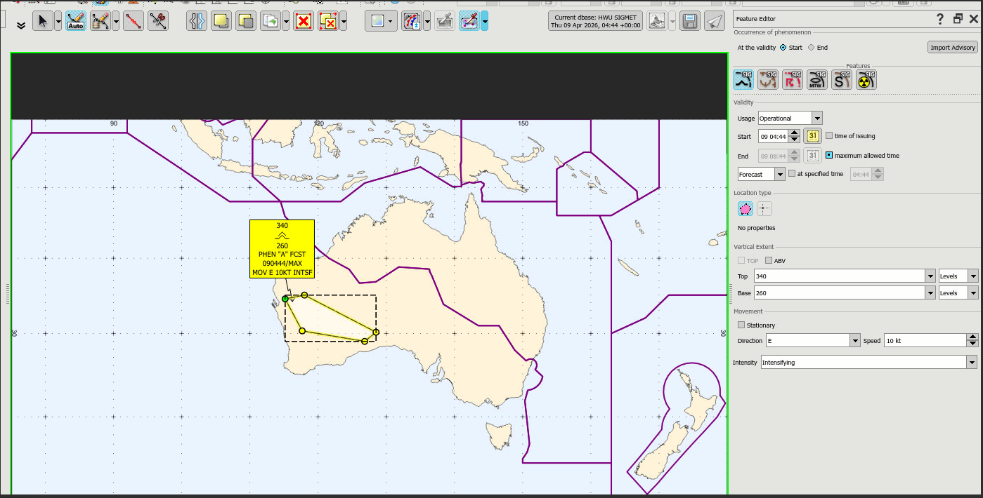
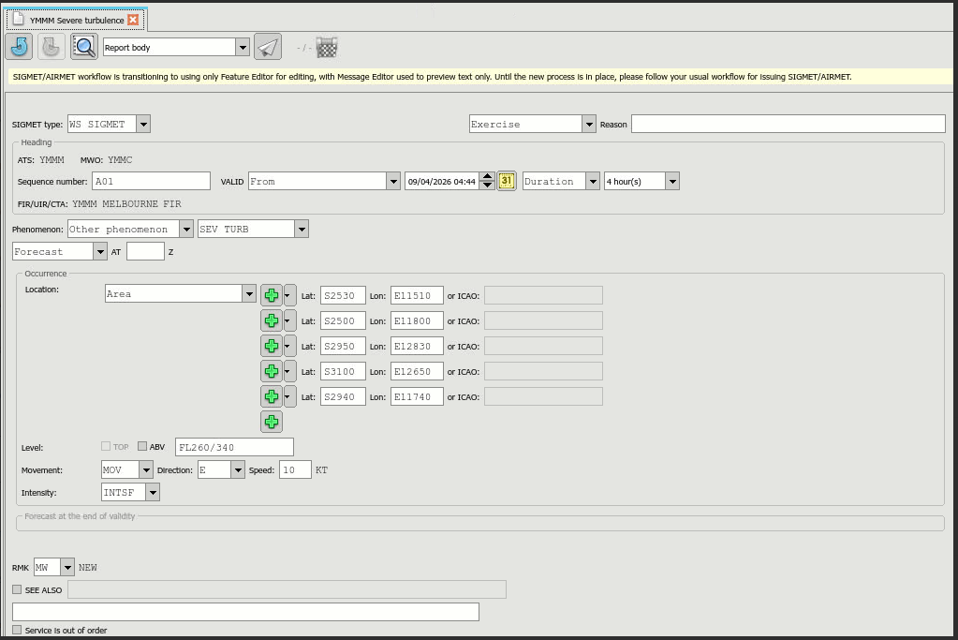
Streamlined SIGMET production
Notes:
SIGMET production

Slide 19
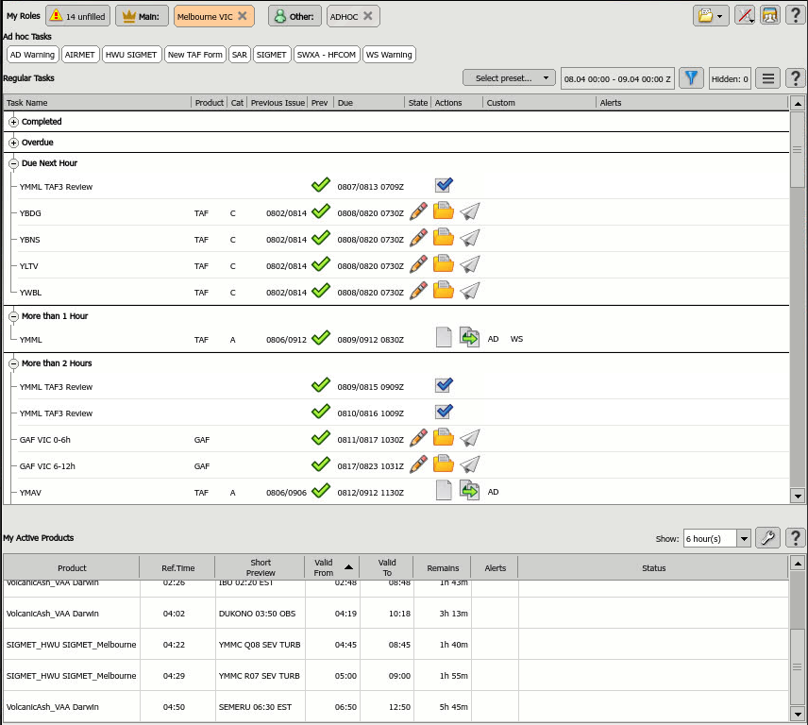
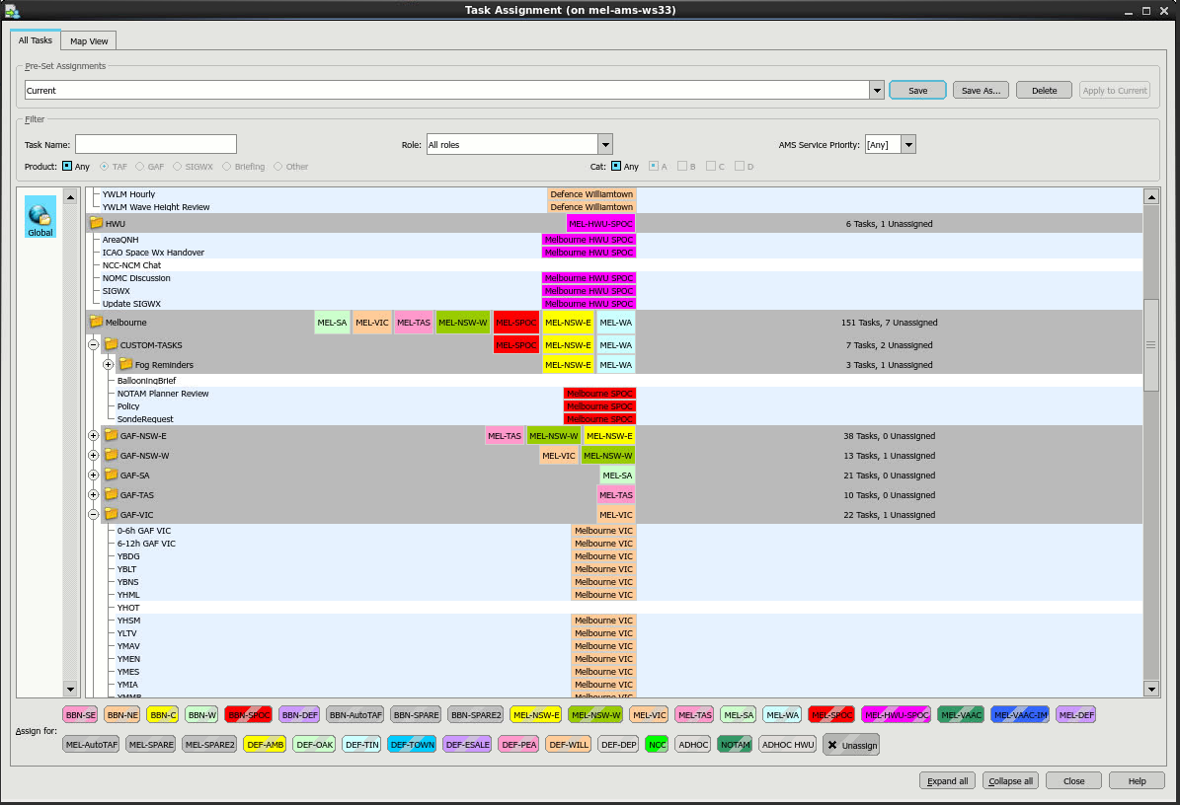
Workload Management
Role Allocation
Task allocation and tracking
Notes:
Role assignment form

Slide 20
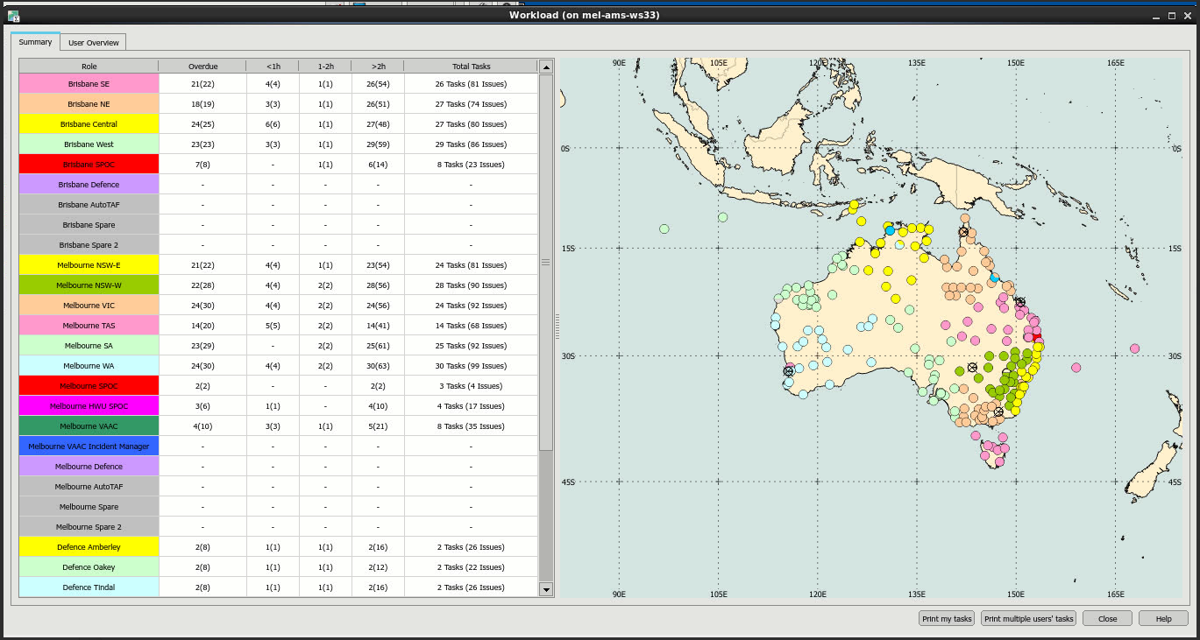
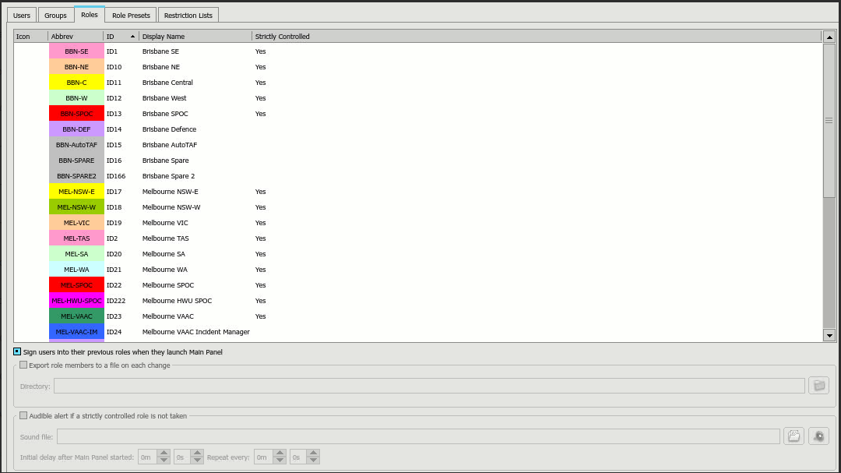
Manage Workload
Configuration of roles to match the forecasting centre for each (NMHS)
Notes:
Role configuration

Slide 21

IFP Expansion to the Pacific
Phase 1 (Visual Weather) is utilised for Phase 2 (Online Weather) to expand capabilities to all countries
Ingest, Visualisation, Forecast Process uplift, Efficient Production and generation of products
Fiji
IFP
TC Module
Data sharing (WIS2.0)
Tonga, Samoa, Solomon lslands, Vanuatu, PNG
Approach:
Visualisation =>access to all countries
"Like-for-like" Products: Country by country analysis and build (based upon Fiji approach/learnings)
Additional use cases captured
Cook Islands, Federated States of Micronesia (FSM), Kiribati, Marshall Islands, Nauru, Niue, Palau, Tokelau, Tuvalu
Notes:
Steve

Slide 22
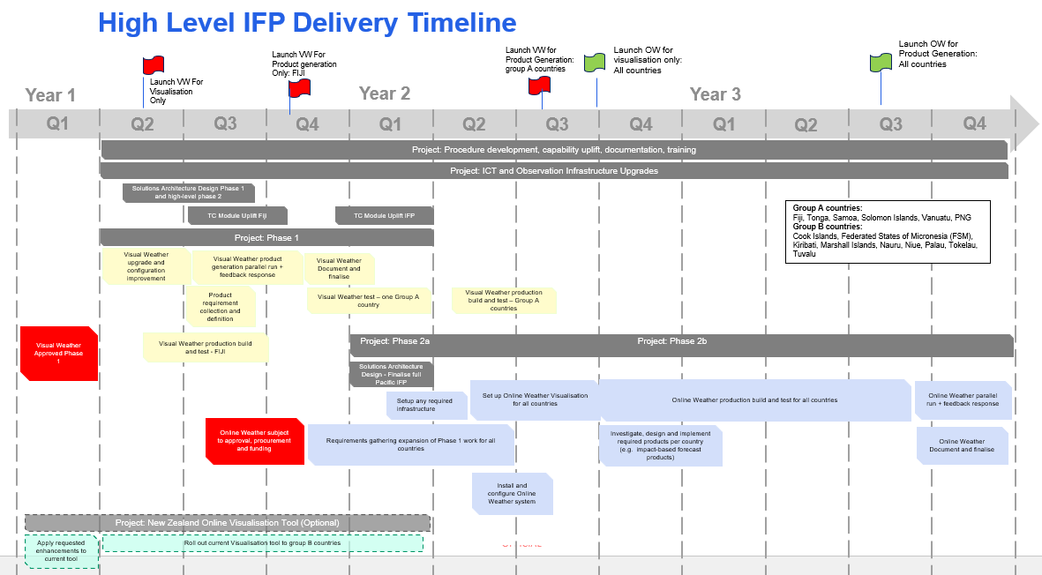
Notes:
Steve

Slide 23
Purpose
The following decisions are requested of the WRP Steering Committee (WRP_SC4)
  1. WRP SC4 Approves the Pacific Integrated Forecasting Platform Phase 2 to adopt the Fiji Meteorological Services IBL software system and high-level Architecture Design

Slide 24
End

Slide 25
Appendices

Slide 26
IFP Architecture -IFP System Context View
Notes:
Steve

Slide 27
IFP Architecture – PDTS System Context
Notes:
Steve

Slide 28
IFP Architecture – WIS2 Node Context
Notes:
Steve

