Slide 1
FY2025 Annual Report
01 January 2025 – December 2025
Steering Committee Paper 4.1 Presentation
1-2 June 2026
Honiara, Solomon Islands

Slide 2

IMPACT PATHWAY
OVERALL OBJECTIVE: Climate and disaster resilient Pacific Island communities have improved safety, security, socio-economic well-being and prosperity
SPECIFIC OBJECTIVE: Pacific communities, governments and industries have inclusive multi-hazard early warning systems, forecasts, and information to reduce the impacts of extreme weather and other natural hazard events, including those exacerbated by climate change
KEY RESULT AREAS
OUTPUTS - We will deliver:
INTERMEDIATE OUTCOMES – We will seek to achieve:
OUTCOMES – We will influence:
IMPACTS – We will contribute to:
KRA 6 Risk
Information and
preparedness
Human and economic cost of extreme events and climate change in the Pacific reduced
_____________
Pacific economies and livelihoods are climate and disaster resilient
_____________
Pacific security is stronger
_____________
Pacific peoples have access to safe and reliable transport and communications systems
_____________
Pacific hydrometeorological and multi-hazard early warning services are more integrated, impactful, sustainable and resilient
OP6.1 Standardised, interoperable and inclusive multi-hazard data produced, stored and shared with resilience partners
OP6.2 Roles and responsibilities established for coordinating, updating, and reviewing hazard inputs into risk knowledge products, preparedness and response plans/procedures
IO6.1 Multi-hazard and multi-agency approach increasingly reflected in risk products, preparedness and response plans/procedures
IO6.2 Multi-hazard early warnings include traditional knowledge and are accessible to diverse and vulnerable communities
O6 – More informed and targeted disaster preparedness and responses inclusive of all genders, abilities, cultures and socio-economic groups
O5 - Pacific communities, governments, industries and travellers increasingly trust, understand forecasts and warnings
KRA 5
Communication and
delivery of forecasts
and warnings to end
users
OP5.1 Pacific capacity and collaborative approaches to deliver locally-relevant, impact-based, inclusive and accessible forecasts and warnings for end users strengthened and sustained
IO5.1 PRP members and communities collaborating effectively to communicate impact-based forecasts and warnings (inclusive of traditional knowledge) to all Pacific end users
IO5.2 Skills, knowledge and confidence of community members increased
Service value chain expansion
O4 – All Pacific end users assured access to relevant, timely, reliable, accessible and actionable forecasts and warnings
KRA 4
Forecast and
warning
production
OP4.1 An integrated Pacific forecasting platform established and operating sustainably to global standards
OP4.2 Pacific forecasting capacity expanded and maintained
IO4.1 Quality forecasting data increasingly collected, integrated, analysed, monitored and maintained in the Pacific and integrated into the global meteorological system
IO4.2 Pacific forecasting and warnings increasing in accuracy
O3 - Pacific hydrometeorological services using and sustaining a growing Pacific-owned and controlled asset, data and knowledge base for public benefit
KRA 3
Observation
network
infrastructure
OP3.1 Interoperable, affordable and resilient observation network infrastructure progressively remediated, expanded and sustained
OP3.2 WMO-designated Pacific Regional Instrument Centre established and sustainably managed
IO3.1 Observation, monitoring and detection systems and real-time data supply expanded and enhanced
IO3.2 Pacific NMHS increasingly have robust, fit-for-purpose and well- maintained observation infrastructure
O2 - Pacific hydrometeorological services have increasing influence in national, regional and multilateral settings
KRA 2
People capability
OP2.1 WMO-designated Pacific Regional Training Centre established and sustainably managed
OP2.2 Inclusive leadership and technical capability strengthening programmes established and delivering ongoing training to industry standards
OP2.3 Continuous learning and mentoring opportunities provided
IO2.1 Training services increasingly Pacific-based and integrating Pacific learning methods
IO2.2 Skills, knowledge and confidence of NMHS personnel increased
IO2.3 Retention of staff and capacity within the sector improved
O1 - Pacific hydrometeorological services collectively securing ongoing, reliable and diverse finance and technical expertise
Enablers
KRA 1
Governance,
management and
coordination
OP1.1 WRP governance, management and pooled financing mechanisms established, mandated and equipped to coordinate a sustainable Pacific-led programme
OP1.2 Sustainable hydrometeorological financing facility and resource mobilisation approach established
OP1.3 Transformative GEDSI strategy adopted and integrated across governance, management and partner programming
IO1.1 WRP governance, management, financing and coordination mechanisms are collaborative, inclusive, equitable, mutually accountable and value maximising
IO1.2 Pacific hydrometeorological services generating regular and sustainable returns on investment
IO1.3 Investor confidence in Pacific-led development and management of hydrometeorological services increased
ASSUMPTIONS: We can build momentum to attract sufficient investment | Political will remains | Organisational contexts remain favourable | External shocks can be accommodated | Services are more relevant if include modern and traditional knowledge
Pacific-led and owned
Driven by Pacific peoples | Responsive to local needs, cultural contexts |
Integrating traditional knowledge | Harmonised (local, national, regional, global)
Inclusive, equitable and empowering
Rights-based | GEDSI-responsive | Active, meaningful participation | Precautionary
Collaborative
Mutually accountable and transparent | Coordinated | Partnership-based
Transformative and sustained
Visionary | Structural and systemic | Agile | Enduring
PRINCIPLES:

Slide 3
Things to Note
Evidence Base & Methodology
On the RAG Status Ratings
Consolidated from executing agency reports
Ratings are deliberately conservative
All data and information are sourced directly from executing agency reports. Consolidated, synthesised, quality-checked for reasonable assurance
Some RAG ratings may appear contestable. They have been kept conservative by design — to avoid inflating early progress and to preserve the ability to demonstrate meaningful, incremental improvement from one reporting period to the next.
Assessed against the MERL Framework
Progress assessment is grounded in the MERL Framework endorsed by the Steering Committee in September 2025 — the first time a formal evidence framework has been applied to WRP reporting.
Ratings are evidence-informed, not evidence-derived
Progress measured from baselines to targets, where possible
Where baselines exist, progress has been tracked against Phase 1 targets. Some placeholder targets have not yet been reviewed or realigned to reflect the current programme context and dynamics.
In the absence of a formal analytical framework, ratings reflect the PMU's best professional judgement applied consistently across KRAs, informed by available MERL data.
A formal analytical framework is being developed
Authored by the MERL and GEDSI team
To ensure consistent interpretation of progress year-on-year — using the same lens across all reporting periods — the PMU is developing a formal analytical framework for SC endorsement, following internal consultation and external review.
Primarily written by WRP MERLA Officer, MERL Consultants Kat and Nicole, GEDSI Consultant Susan, with contributions from the Programme Manager, Programme Advisor and WRP PMU

Slide 4
Things to Note – cont.
This report is evidence that our MERL is working.
Phase 1 targets are provisional and will undergo a thorough review
01
Implementation targets were set as placeholders during programme design. Some are yet to be formally reviewed, validated, and agreed with EA/WRP PMU to reflect current programme realities.
MERL indicators are being strengthened
02
The MERL Framework — endorsed in September 2025 — is a first iteration. Review to take place post SC4 with amendments proposed to be tabled for SC5 deliberation/endorsement.
Developing a LENS to guide progress assessment
03
To ensure consistent, evidence-derived interpretation of progress across reporting periods, a formal analytical framework will be developed for deliberation/endorsement by SC5 following internal and external reviews.
Identifying these gaps IS the MERL working.
A credible programme knows what it doesn't yet know — and commits to fixing it.

Slide 5
Things to Note – cont.
Also included are 10 Stories (Qualitative Signals) in slide 15-16:
  Six Performance Stories - KRA 2-4, GEDSI (BIP-M, GEDSI/MERL, regional workshop, SWP–Niue’s experience, GSMA cell broadcasting, SPREP-PDF MoU)
  Three Learning Stories - KRA 1 (PMC/SC, SWP – Feedback/AM, IFP)
  One Impact Story - KRA 3 (Tonga Radar)
Appendix 1 – Summarized MERL Table
Appendix 2 – FY2025 Budget Tracking
Appendix 3 – Summarized Program Risk Register

Slide 6
Purpose:
To report on FY2025 programme performance and seek Steering Committee notation, acceptance and endorsement of paper 4.1— with a forward look at 2026 priorities.
Outline
1
01
03
Programme at a Glance & Status
Effectiveness, GEDSI, Sustainability & ESS
02
04
Progress by Key Result Area
(KRAs 1–6)
Programme Management & Governance

Slide 7
1.0 Overall Programme Status – Indicative Output-Based Assessment
Strong foundations built in 2025 — implementation must accelerate decisively in 2026
Status by Key Result Area
OVERALL STATUS AMBER
Progress underway; path forward
clear. Acceleration needed in 2026.
KRA 1
Governance
AMBER
KRA 2
People Capability
GREEN
KRA 3
Observation Net. Infra
GREEN
KRA 4
Forecast & Warning Prod
AMBER
KRA 5
Comm. & Delivery to End Users
AMBER
KRA 6
Risk Info. & Preparedness
AMBER-RED
Key Numbers — FY2025
Evidence from the field — see full stories in the deck:
USD 28.5M
USD 3.9M
LEARNING STORY
PERFORMANCE STORY
Total Committed
Funding up to 2025
Actual
Expenditure 2025
Governance & IFP
9 BIP-M/MT Graduates
When country engagement was missing — and what we changed
Permanent national capacity uplift across 7 Pacific countries
15
9
IMPACT STORY
Tonga Weather Radar
Active
Partners
BIP-M/MT
Graduates
Earlier, more specific, more actionable warnings — first time ever

Slide 8
Summary – Money Matters
3 Active Donors
DFAT (Australia), NZ MFAT, UK WISER
USD 18.1M
Managed directly by SPREP
USD 10.4M
Managed by executing agencies
14%
Of committed funding spent in 2025
25% below budget
Due to recruitment delays, procurement establishment, EA invoice timing

Slide 9
AMBER
KRA 1: Governance, Management & Coordination
Building the institutional foundation for a Pacific-led,
decade-long programme
8
3 ✓
5
6 FTE
+3
15
Governance &
Partnership Mechanisms
Governance Studies
Completed
Frameworks
Fully Adopted
PMU Staff
in Post
Active WRP
Partners
KEY ACHIEVEMENTS
KEY CHALLENGES
GEDSI Strategy 2025–2033 approved 6 months ahead of schedule
MERL Framework, Sustainability Framework & Governance Review finalised
All 3 governance studies complete (Alignment Review, Risk Matrix, Asset Register)
PFIF Phase 1 legal framework completed
10-year BoM–SPREP Strategic Relationship Arrangement signed
MHEWS Readiness Fund operational — first 2 Concept Notes approved
3 critical PMU roles vacant: MERLA, ESS/GEDSI, Communications Officers
Output 1.2 financing facility not yet commenced
Operations Manual still in development (due May 2026)
~50% of projects with GEDSI actions identified; only ~25% implementing
Pacific-led activities estimated at ~20–25% only
Pooled fund operationalisation delayed — affects programme efficiency
Notes:
Output 1.2
Sustainable hydrometeorological financing facility and resource mobilisation approach established

Slide 10
KRA 2: People Capability
GREEN
Investing in the people who stand between a
weather event and a community's response
4
72
>100
Training Programmes
Established & Delivering
Training Sessions
Delivered
People Trained
across 15 PICs
74
61
9
Active CoP
Members
Peer Exchanges
& Webinars
BIP-M/MT
Graduates
Severe Weather Pilot — Standout Results (MetService / Fiji / Tonga / Niue)
100%
+39%
+45%
+42%
100%
reported increased confidence
accuracy confidence gains
timeliness confidence gains
collaboration confidence
applying skills in their work
Notes:
Achievements:
4 training programmes established and delivering — BIP-M Wellington and BoM Melbourne (both WMO-accredited), BIP-MT Nadi, and HydroMet Technician CoP. A13 = 4
72 training sessions delivered across all programmes — 3 formal accredited, 44 weekly online Severe Weather Pilot collaboration meetings, 25 workshops and other sessions. A14 = 72
9 BIP-M and BIP-MT graduates in 2025 — 3 from Tonga and Kiribati (Wellington), 3 from Samoa (Melbourne), 3 from Cook Islands, PNG, Tuvalu and Vanuatu (Nadi BIP-MT). Each is a permanent uplift in national forecasting capacity. A15 → 9 graduates
Severe Weather Pilot: 100% of participants reported increased confidence; +39% accuracy, +45% timeliness, +42% collaboration confidence gains. 100% applying skills in their work. B9 = 100%; B10 = 100%; B11 = 100% — MetService only
2 Communities of Practice operating: HydroMet Technician CoP (74 members, 15 PICs, Pacific-led convener); Severe Weather Outlook CoP (44 weekly meetings, Fiji Met increasingly leading). A16 = 74; A18 = 61
61 peer exchanges and webinars delivered — far exceeding the Phase 1 target of 5 sessions by December 2026. A18 = 61
JICA contract signed November 2025 for RTC construction at Fiji Met Service — WRP-supported FMS participation in contract signing. Construction target December 2027. A11 → 2027
Challenges:
Pacific Meteorology Leadership Programme (PMLP) not yet established — at concept stage only. Target: September 2026. A13 → PMLP pending
0 formal twinning partnerships established. Informal mentoring is active through the Severe Weather Pilot (MetService ↔ Fiji/Tonga/Niue) but does not meet the A17 formal definition. A17 = 0; target 5 by Dec 2028
Post-training survey data available for MetService programmes only — ESNZ, BoM and SPREP PMU survey data not yet collected, limiting programme-wide evidence of impact. Standardised survey tools to be rolled out to all EAs in 2026. B8, B9, B10, B11 → partial
RTC Governance and Business Model not yet formally adopted (ADB activity at 30% progress). Business Model Review deferred to 2026. WMO designation and JICA construction both targeted for 2027. A1 RTC = 0 adopted; A12 = 0
No staff retention or career progression baseline data collected — attrition rates not systematically tracked across Pacific NMHS. Baseline collection to be progressed through PIMS review and annual NMHS survey in 2026. B12, B13, B14 → no data

Slide 11
GREEN
KRA 3: Observation Network
Infrastructure
You cannot forecast what you cannot observe
National Stocktake
Tonga Radar
Operational
Regional Obs
Workshop
Solomon Islands
Radar Pre-Con
Samoa Radar
Procurement
~700 stations
across 15 PICs
First WRP-funded
infrastructure in use
65 reps from
14 PICs, Nov 2025
Contracts signed;
UXO assessment done
RFQ issued Dec 2025;
closes Feb 2026
ACHIEVEMENTS
CHALLENGES
3 observation studies completed (stocktake, NAMP templates, WMO procurement standards)
Regional Radar Strategy in draft — to be formally endorsed SC4 (June 2026)
WRP Infrastructure & ICT Adviser joined PMU October 2025
JICA contract signed for RIC construction at Fiji Met Service (target Dec 2027)
Only ~40% of ~700 stations (~280) registered in OSCAR global database
All 5 regional network plans still in draft; 4 plans not yet started (ocean, hydrology, ICT, upper air)
AMIS (Asset Management Info System) at concept stage only — critical dependency
7 of 8 NMHS ICT staffing LOAs delayed — significant delivery gap

Slide 12
AMBER
KRA 4: Forecast & Warning Production
Building the technical and operational foundation
for a Pacific-owned integrated forecasting system
Integrated Forecasting Platform (IFP) Journey
Peer Review
Complete
14/15 Met
Director 1:1s
Phase 1 SC
Endorsement
Design
Workshop
IFP Phase 1
Deployment
Sep 2025
Dec 2025
Sep 2025
Apr/May 2026
2027–2029
KEY ACHIEVEMENTS
KEY CHALLENGES
IFP Peer Review: 5 options assessed; SC endorsed Phase 1 (Fiji Met as regional hub)
6 studies completed incl. ICT baseline (11 PICs), IFP Survey (11 countries)
5 Severe Weather Pilot tools operational in Fiji, Tonga & Niue — extended 12 months
15 forecasting SOPs developed across 3 countries through Severe Weather Pilot
IFP Phases 2 & 3 not approved — insufficient country engagement was the key governance learning of 2025
0 IFP platforms installed — first deployments not expected before 2027–2029
7 of 8 ICT staffing LOAs still pending (LOA finalisation delays)
Aviation, marine & community SOPs not yet initiated

Slide 13
AMBER
KRA 5: Communication & Delivery
to End Users
A warning that does not reach the right person, in the right
language, at the right moment, is not a warning
Status Note: KRA 5 is the KRA with the highest volume of planned 2026 activity. Most planned activities reflect programme sequencing — the path forward is clear but decisive acceleration is required in 2026.
Common Alerting Protocol (CAP) Baseline — Pre-WRP
1 PICT — CAP Fully Adopted (Solomon Islands)
9 PICs — CAP in Development or Test Mode
2 PICs —
Not Yet Started
2 PICs — No Data Available
KEY 2025 ACHIEVEMENTS
PRIORITY ACTIONS 2026
GSMA-PITA Cell Broadcast Workshop: 5-day intensive, ~28 orgs, 3 countries produced implementation roadmaps
Starlink communications installed at Tonga Met Service — first WRP-supported warning infrastructure
COPE book translations contracted for Niue & Tokelau
MHEWS TWG established under Pacific Resilience Partnership
Commence CAP training across multiple PICs — highest impact KRA 5 activity
Finalise COPE book translations and distribution
Finalise Starlink LOAs for Solomon Islands & Kiribati
Fill Communications Officer vacancy — critical for KRA 5 acceleration

Slide 14
AMBER-RED
KRA 6: Risk Information &
Preparedness
Ensuring communities have the risk knowledge to translate warnings Into protective action — endorsed Sep 2025
Context: KRA 6 was formally endorsed by the WRP Steering Committee in September 2025 to align with UN Early Warnings for All (EW4All). As a newly established KRA, no Investment Plan has yet been developed and no formal KRA 6-specific activities have commenced.
Early Cross-KRA Contributions
LiDAR Survey
(from KRA 4)
COPE Booklets
(from KRA 5)
MHEWS TWG
(from KRA 1)
First concrete multi-agency coordination mechanism for EW4All alignment under Pacific Resilience Partnership
FUGRO contracted for terrain & hazard mapping — contributes to multi-hazard risk data (Output 6.1)
Community hazard preparedness booklets for Niue & Tokelau — contributes to inclusive community preparedness (Output 6.2)
CRITICAL 2026 PRIORITY: Complete the KRA 6 Investment Plan, Implementation Plan and Funded Work Plan — without it, no KRA 6-specific activity targets can be set or costed, and WRP's EW4All commitments remain without a programmatic vehicle.

Slide 15
Stories (Qualitative Signals)
KRA 1 — Learning Story 1: Building Something New examines what it truly requires to establish a Pacific-led programme in a sector ready for change: building a capable PMU, coordinating multiple donors and executing agencies, and navigating the operational pressures of a first year — while holding the line on Pacific ownership. (see page 31)
KRA 1 — Learning Story 2: The Skill of Adaptive Management draws on the Severe Weather Forecasting Enhancement Pilot to make a programme-wide argument: that adaptive management is not a licence to deviate from commitments — it is a commitment in itself. The pilot earned the right to adapt by building the feedback infrastructure first. For WRP, this is the model of how the programme should operate across all its work. (see page 33)
KRA 2 — Performance Story 1: From Aviation Briefings to BIP-M Certified follows Lineni Fifita of Tonga, one of nine WRP-funded graduates who returned home in 2025 with an internationally recognised WMO qualification — and what that qualification means for the service she returns to. (see page 38)
KRA 2 — Performance Story 2: Learning to Programme Well, Together documents how GEDSI and MERL were embedded directly into the 2025 WRP Planning Workshop — building the reflective and inclusive programming capability the programme needs to deliver on its own values. (see page 39)
KRA 3 — Impact Story 1: Seeing the Storm Before It Arrives documents what changed for Tonga when its first weather radar became operational — from inference-based forecasting to direct observation, and from generalised warnings to earlier, more specific, more credible alerts. This is the clearest illustration in 2025 of what WRP investment means in practice for communities. (see page 44)

Slide 16
Qualitative Signals-cont
KRA 3 — Performance Story 3: Seeing the Whole Picture describes how a regional workshop in November 2025 brought together 65 representatives from 14 Pacific Island countries to collectively map the region's observation network crisis for the first time — and turn it into a shared plan of action. (see page 49)
KRA 1 / KRA 4 — Learning Story 3: Getting the Foundations Right follows the IFP journey and what it taught WRP about partnership, shared vision, and the patience that complex change requires. When the Steering Committee did not approve IFP Phases 2 and 3 in May 2025, WRP treated that as signal rather than setback — completing one-on-one meetings with 14 of 15 Met Directors and reforming how major decisions are prepared. (see page 55)
KRA 4 — Performance Story 4: A Safe Space to Get It Right follows the emergence of a peer forecasting community within the Severe Weather Pilot — and the moment a meteorologist from Niue's small service used that community to build the confidence to issue a warning that was right, and that protected lives. (see page 56)
KRA 5 — Performance Story 5: Alert on Every Phone describes WRP's partnership with GSMA on cell broadcasting — technology that sends an alert to every handset in an affected area without requiring credit, a SIM card, or internet connection — and what it means for the Pacific communities most likely to be cut off when warnings matter most. (see page 60)
GEDSI — Performance Story 6: No One Left Behind documents the partnership between SPREP and the Pacific Disability Forum, signed in September 2025, and what it means for a programme whose stated purpose includes reaching the people most at risk and least reached by existing warning systems. (see page 67)

Slide 17
EFFECTIVENESS
Are we achieving what we set out to achieve?
FY2025
Summary
Early signals are encouraging. Long-term community outcomes will take years to measure.
Overall
Underway
On track
On track
Solid foundational progress. Moving in the right direction — most consequential delivery lies ahead.
KRA 1 · Governance & Partnerships
KRA 2 · People Capability
KRA 3 · Observation Networks
15 partners. 10-yr BoM–SPREP agreement. 3 active development partners.
6 qualified meteorologists. 33 trained. 100% applied skills. 2 CoPs active.
~700-station regional stocktake done. Priorities set for 2026 investment.
Spotlight
Underway
Needs action
Needs action
Tonga's first weather radar is changing how forecasters see storms — and how warnings reach communities.
KRA 4 · Forecasting & IFP
KRA 5 · Warning Communication
KRA 6 · Risk Info & Preparedness
5 tools in active use. IFP peer review endorsed. Design workshop Apr/May 2026.
Added May 2025. Investment plan needed!
Most activities deferred to 2026. Significant acceleration needed.
Notes:
In terms of effectiveness, this slide seeks to highlight on

Slide 18
Building an inclusive early warning system — from policy to practice
GEDSI
Gender, Disability
& Social Inclusion
2025 saw WRP's GEDSI Strategy approved and its first landmark partnership signed — the sector shift is beginning.
Completed
Completed
Strategy approved
SPREP–PDF MOU signed
Starting point
WRP starts from a baseline of weak GEDSI-sensitive programming across the sector. 2025 is the beginning of a deliberate shift.
GEDSI Strategy 2025–2033 approved by SC in September 2025. Twin-track framework: mainstream GEDSI across all programming + targeted interventions for women, persons with disabilities, and marginalised groups.
Landmark MOU between SPREP and Pacific Disability Forum — representing 71 organisations across 22 PICs. Moves disability inclusion from policy into practice across all 6 KRAs.
"This partnership ensures that WRP is truly inclusive and serves all members of our communities."
Underway
2026
Early capacity actions
Baseline still to come
GEDSI Convening in Nadi (39 participants). GEDSI & MERL training for PMU and EA staff in December. NMHSs GEDSI Focal Points Network established. Staff understanding of strategy rose from 37% to 56%.
Sector-wide GEDSI diagnostic assessment planned for 2026. This will establish the formal baseline against which WRP's inclusion progress will be measured going forward.
Salesa Nihmei, SPREP
Koror, Palau — Nov 2025

Slide 19
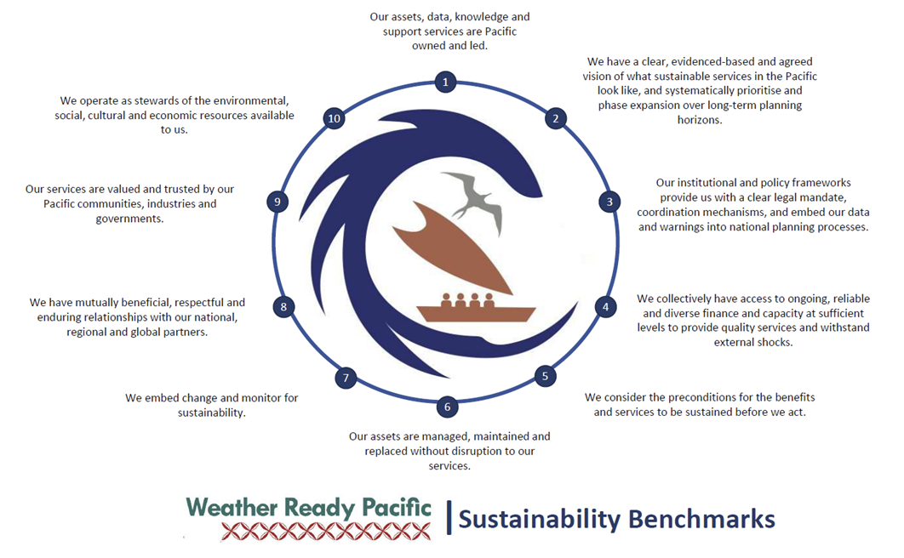

Slide 20
Sustainability Framework (10 Benchmarks + guiding questions) approved by SC in September 2025 and embedded in the MERL Framework.
2025 concept notes show growing awareness of sustainability but uneven depth of application — expected for a framework in its first year.
Benchmarks 1 (Pacific ownership) and 2 (shared vision, phased implementation) are well-represented across nearly all concept notes.
Benchmark 4 (sustainable financing) is being addressed structurally through the Asset Management Framework, PFIF, and long-term hydrometeorological financing via the Pacific Meteorological Council.
Benchmarks 5–10 (preconditions, maintenance, embedding change, partnerships, trust, stewardship) are consistently receiving superficial or procedural treatment — noted as 'per Operations Manual' rather than substantively designed into activities.
Two bright spots documented: Learning Story 1 (B1, B4) and Learning Story 3 (B2, B8, B9) demonstrate benchmarks applied with depth and rigour.
20–25% of WRP activities were led by Pacific institutions in 2025 (indicative estimate). Formal tracking via Programme Tracker from 2026.
2026 action: All concept notes to include a completed sustainability guiding question screening as a precondition for PMU assessment.

Slide 21
SUSTAINABILITY
& ESS
Sustainability & Environmental and Social Safeguards
Both frameworks were established in 2025. Application is underway but uneven — deeper integration is the 2026 priority.
Cross-cutting
Frameworks
SUSTAINABILITY
Completed
Partial
Framework approved
Uneven early application - expected
Status
Benchmarks 1 (Pacific ownership) and 2 (shared vision) well-represented. Benchmarks 5–10 receiving superficial treatment for now — noted procedurally rather than substantively designed in.
Both frameworks are new in 2025. Uneven or partial application is expected. Systematic rollout planned for 2026.
Sustainability Framework — 10 Benchmarks + guiding questions — approved by SC in September 2025. Benchmarks embedded in MERL Framework.
2026 action
ENVIRONMENTAL & SOCIAL SAFEGUARDS (ESS)
All three frameworks (GEDSI, Sustainability, ESS) will be embedded in concept note screening from 2026. ESS/GEDSI Officer recruitment is a critical enabling step.
In progress
Underway
Underway
SPREP ESMS applied meantime
Community engagement begun
Framework in development
In absence of WRP ESS Framework, SPREP's ESMS applied activity-by-activity. Specific actions include UXO and geotechnical assessments for Solomon Islands and Samoa radar sites.
Community engagement programme launched in Solomon Islands in December 2025 to support radar installation. ESS screening will be embedded in concept note assessment from 2026.
ESS Framework development began in 2025. Expected completion mid-2026 as part of Operations Manual. Ops Manual Chapter 12 tabled for SC4 approval.

Slide 22
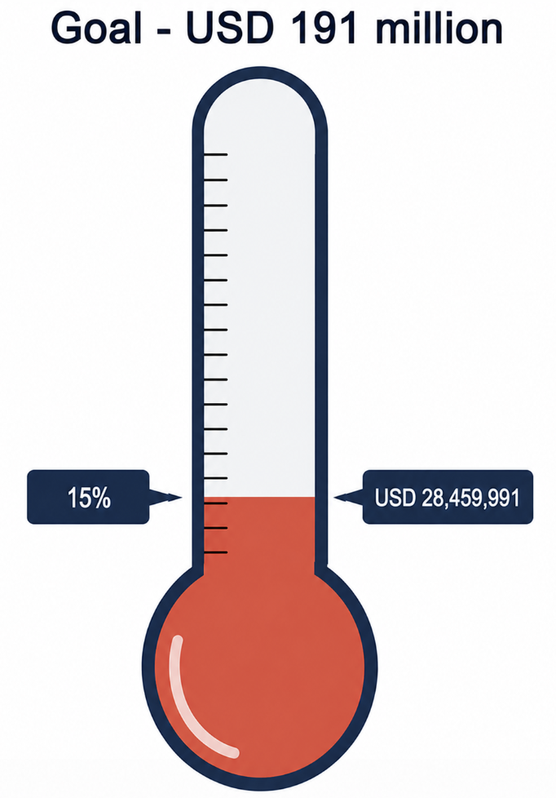
4.0 Programme Management & Governance
Contracts & Procurement
FUNDING AGREEMENTS – till 2025
PROCUREMENT
7 SPREP-managed contracts signed in 2025, totalling USD 1.84 million.
Key signed contracts include: Hydrological services & coastal inundation EW (AUD 1.55M); BOM Project Arrangements (AUD 861K); Tonga LOA (USD 83K); GEDSI Consultant Phase 1 (USD 28K).
10 contracts in negotiation, including LOAs for Cook Islands, Kiribati, RMI, Niue, Samoa, Solomon Islands, Tuvalu and Fiji.
1 contract under tender evaluation (Review of WRP Decadal Investment Plan, USD 50K).
Samoa Radar Supplier contract advertised.
Total committed funding: USD 28.5 million (excluding SPREP fees) from 3 donors.
Australia DFAT: AUD 30 million across 2 agreements (Nov 2023 & Mar 2025).
New Zealand MFAT: USD 1.33 million across 2 agreements (Aug 2024 & Jun 2025).
UK WISER: USD 0.81 million across 2 agreements (Apr 2024 & Feb 2025).
USD 18.1 million flows through SPREP; remainder managed by NZ MetService, ESNZ, ADB, and UNDRR.
Support contracted directly by donors to executing agencies (outside SPREP)
NZ MetService (NZ MFAT): USD 7.M · Earth Sciences NZ (NZ MFAT): USD 3.0M · GEDSI Specialist (UNDRR): USD 86.4K · Governance Adviser (ADB): USD 150K · MERL & Sustainability Consultancy (NZ MFAT): USD 57.9K
Weather Ready Pacific | FY2025 Annual Report

Slide 24
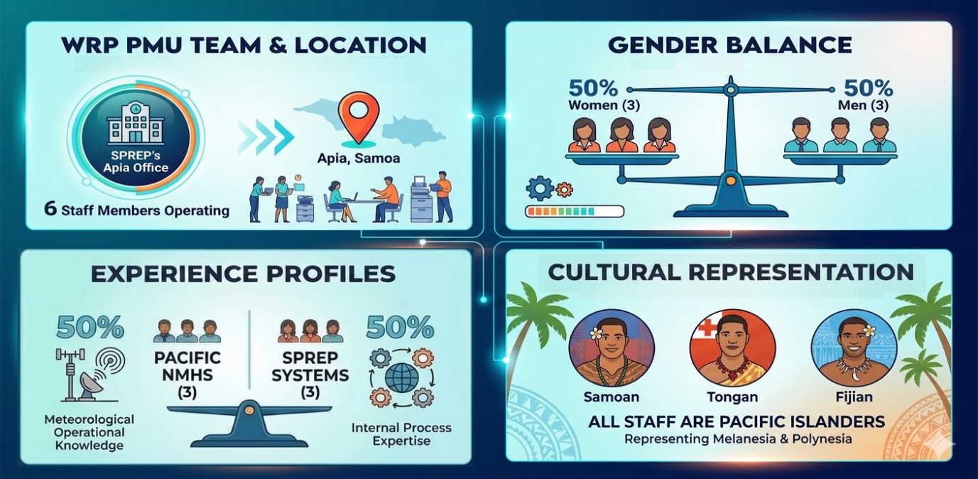
Programme Management & Governance
Recruitment & PMU Staffing
2025 APPOINTMENTS
Financial Accountant (May 2025)
Infrastructure and ICT Adviser (October 2025)
Capacity Development and Training Adviser (October 2025)
Procurement Officer (November 2025)
TARGETED FOR RECRUITMENT IN 2026
MERLA Officer (FILLED – April 2026)
ESS/GEDSI Officer (IN PROGRESS – MAY 2026)
Communications and Knowledge Management Officer (FILLED – Feb/Mar 2026)
6 staff · Apia, Samoa · 50/50 gender · All Pacific Islanders
Weather Ready Pacific | FY2025 Annual Report

Slide 25
Programme Management & Governance
OVERALL PROGRAMME
SPREP-MANAGED FUNDS – FY2025
Total committed funding: USD 28.5 million (excl. SPREP fees).
2025 actual expenditure: USD 3.9 million — 14.3% of committed funding.
2025 budget was USD 5.1 million; actual spend was USD 1.3 million below budget.
  Underspend driven by: staff recruitment delays; procurement and contract establishment delays with executing agencies; flow-on delays to activity execution; invoices not yet processed.
26.6% of total WRP spending attributed to personnel and related costs.
USD 7.92 million received from 3 donors; USD 1.74M spent; USD 0.87M committed.
AU DFAT: USD 6.22M received · 18.4% spent · 32.0% spent + committed.
NZ MFAT: USD 1.33M received · 34.7% spent · 34.9% spent + committed.
UK WISER: USD 369K received · 35.6% spent · 40.9% spent + committed.
DFAT's lower spend rate reflects the phased disbursement schedule — 4 further tranches (AUD 20M) due 2026–2028. This is consistent with a programme in establishment phase.
Remaining funds 2026–2029: USD 18.83M programmed — Revised 2026: USD 8.77M · 2027: USD 5.35M · 2028: USD 2.37M · 2029: USD 2.36M.
DFAT tranches 4–7 (AUD 6M–6M–6M–2M) due May 2026 through Oct 2028. UK WISER final disbursement (USD 123K) received Dec 2025.
Weather Ready Pacific | FY2025 Annual Report

Slide 26
Programme Management & Governance
Activity Pipeline & Country Disbursements
2025 ACTIVITIES DEFERRED TO 2026 (15 items)
2025 ACTIVITIES BY COUNTRY (USD)
Revised WRP Investment Plan (EW4All aligned)
3 PMU recruitment positions (ESS/GEDSI, Comms, MERLA Officers)
Business model review for RTC and RIC
Hydrologists training
CAP installation, training and regional workshop
3 network plans: Upper Air, Ocean & tides, Flood & hydrology
IFP Design and ICT Architecture + Peer review of IFP
LiDAR surveys (Marshall Islands) and Pacific LiDAR strategy
Regional hydrology strategy
ICT Specialist secondment (IFP, KRA 2 & 3)
COPE book translation and printing
Solomon Islands*
971,460
Tonga*
609,656
Samoa
357,863
Fiji
336,438
Cook Islands
269,141
Vanuatu
278,527
Kiribati
234,638
Niue
189,922
PNG
162,023
Tuvalu
133,863
FSM
81,824
Tokelau
65,896
Marshall Islands
56,471
Nauru
47,617
Palau
44,509
Risk WRP-20: Activity Pipeline Compression — rated INCREASING
* Radar installation (single capital investment)
Weather Ready Pacific | FY2025 Annual Report

Slide 27
Critical 2026 Priority Actions
What must happen in 2026 for WRP to deliver on its bold purpose
1
KRA 1
Fill 3 vacant PMU roles: MERLA, ESS/GEDSI, Communications Officers
Q1 2026
2
KRA 6
Complete KRA 6 Investment Plan & Implementation Plan — critical unblocking action
Q1-2 2026
3
KRA 5
Commence CAP training across multiple PICs — highest-impact KRA 5 action in 2026
H1 2026
4
KRA 4
Deliver IFP Phase 1 design workshop (Apr/May 2026, Nadi) and establish project team
Apr 2026
5
KRA 3
Formally adopt Regional Radar Strategy at SC4; complete Solomon Islands radar installation
Jun 2026
6
KRA 3/4
Finalise 7 pending ICT staffing LOAs for NMHSs (Cook Islands, Kiribati, Niue, RMI, Samoa, SI, Tuvalu)
Q1 2026
7
KRA 1
Complete WRP Operations Manual and table at SC4 (DFAT contract deliverable)
Jun 2026
8
KRA 2
Establish Pacific Meteorology Leadership Programme (PMLP)
Sep 2026
Weather Ready Pacific | FY2025 Annual Report | OFFICIAL

Slide 28
Steering Committee Proposed Resolution
To note, accept and endorse the FY2025 Annual Report
The foundations are holding.
The pathway to Climate and Disaster Security is becoming clearer
with every step taken.
Now we must build faster.
D5

Slide 29
Questions
Tank yu tumas

