Slide 1
FY2025 Programmatic
Risk Brief
Steering Committee Paper 4.1 Presentation
29 May-2 June 2026
Honiara, Solomon Islands

Slide 2
Purpose
Steering Committee Request
To note and accept the presented programmatic risk overview as part of paper 4.1 (annual report), with a particular focus on the two extreme risks
To provide the Steering Committee with a high-level overview of the FY2025 Weather Ready Pacific (WRP) programmatic risk environment, including the overall residual risk position, key programme risk themes, trend direction and critical risks requiring ongoing oversight.
(See Appendix Three of the 2025 Annual Report (page 103) for further details)

Slide 3
Summary
27 programmatic risks across governance, financing, operational delivery, partnerships, safeguards and ICT capability areas.
Overall, the residual risk profile is assessed as Moderate, with the majority of risks currently sitting within the Moderate and High categories following implementation of existing controls and mitigation measures. The overall direction of travel is considered positive, with 70% of identified risks currently trending downward.
Two residual Extreme risks remain and continue to require close Steering Committee oversight:
Procurement Inefficiencies (WRP-10)
Insufficient ICT Capability (WRP-19)
While progress is evident, several operational and structural pressures remain interconnected, particularly across procurement, staffing capacity, delivery sequencing and ICT capability. See Appendix Three of the 2025 Annual Report (page 103) for further details

Slide 4

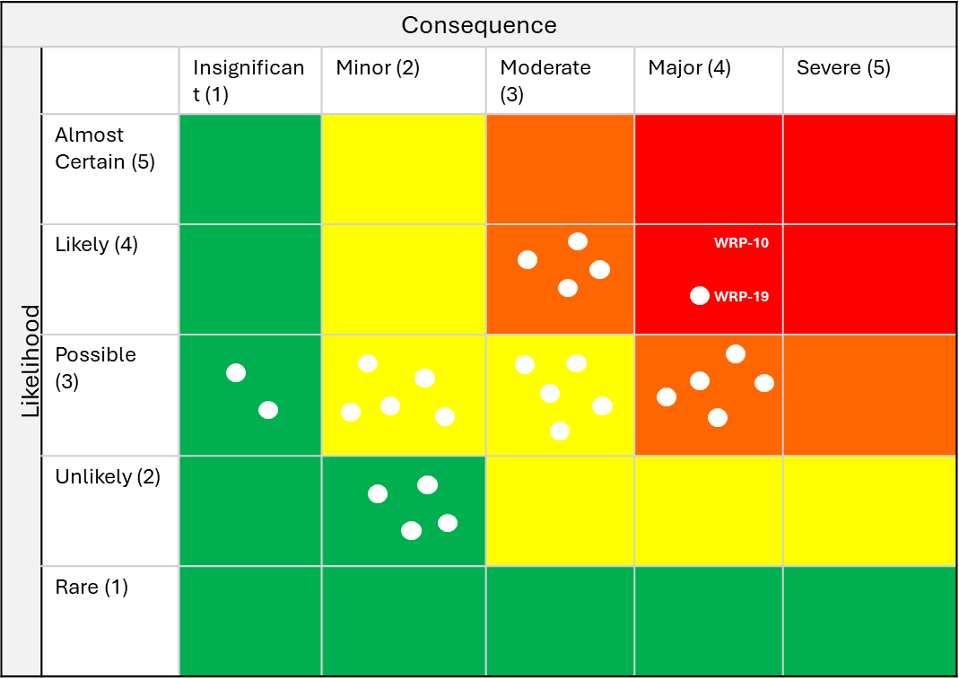
🔶 WEATHER READY PACIFIC FY2025 PROGRAMME RISK OVERVIEW🔷
🔷 🔶 CRITICAL RISKS
Risk | Residual Rating | Why it matters
Procurement Inefficiencies | Extreme | Delays affecting programme delivery
Insufficient ICT Capability | Extreme | High dependency on system capability
Sustainable Funding | High | Long-term programme continuity risk
Risks Requiring Close Oversight Two residual Extreme risks remain: WRP-10 Procurement Inefficiencies WRP-19 Insufficient ICT Capability These risks continue to represent key operational constraints with potential impacts on programme delivery timelines, coordination capability and long-term sustainability.
🔷 🔶 Existing controls have reduced the number of Extreme risks from 7 to 2, with most programme risks now sitting within the Moderate category.
Low 1-5
Moderate 6-10
High 11 -15
Extreme 16-25
🔷 🔶 KEY THEMES
Execution Capacity
Recruitment, procurement and delivery sequencing continue to place pressure on programme implementation timelines.
Financial Sustainability
Long-term funding sustainability and pooled financing arrangements remain under development.
ICT Capability
ICT capability constraints across SPREP and Pacific NMHSs remain a critical programme dependency.
🔷 🔶 OVERALL PROGRAMME RISK POSITION
Measure | Position
Inherent Risk | High
Residual Risk | Moderate
Overall Trend | Improving
🔷 🔶 TREND DIRECTION
The overall direction of travel is considered positive, with 70% of identified risks currently trending downward as governance arrangements, planning processes and mitigation measures continue to mature.
Conclusion
Mitigation actions and governance controls are beginning to stabilise the programme risk environment. While key operational and capacity-related pressures remain, the overall direction of travel is considered positive.
Notes:
This provides the Q1 baseline risk position. The overall profile remains high, with risk concentrated in three areas — external events, workforce, and health and safety. Financial and programme delivery risks remain high but stable. Movements are limited this quarter, with financial risk reducing slightly and health and safety newly elevated. Early Q2 signals indicate the overall profile remains broadly consistent. This establishes the baseline for how we will track and report risk going forward.

Slide 5
RISK REGISTER EXTRACT
Risk profile at a glance: 27 registered risks | 2 Extreme | 9 High | 10 Moderate | 6 Low | 8 Stable | 19 Decreasing
Risk ID | Risk title | Residual likelihood | Residual impact | Residual rating | Trend | KRA | Commentary
EXTREME — SC action required | 2 risks
WRP-10 | Procurement inefficiencies | Likely | Major | Extreme | ↓ Decreasing | All | Structural constraint within existing systems. Sequenced 2026 delivery calendar to be tabled at SC4.
WRP-19 | Insufficient ICT capability | Likely | Major | Extreme | ↓ Decreasing | KRA 4, 2 | High dependency on system capability. Recruitment of ICT capability required in 2026.
HIGH — management attention required | 9 risks
WRP-04 | Lack of sustainable funding (programme + maintenance) | Possible | Major | High | ↓ Decreasing | All | Critical long-term programme risk. Sustainability framework and financing roadmap must move to implementation.
WRP-05 | Infrastructure not resilient | Likely | Moderate | High | → Stable | KRA 3 | Partially accepted due to nature of infrastructure exposure. Regional insurance approach in development.
WRP-07 | Delays in programme execution | Possible | Major | High | ↓ Decreasing | KRA 3,4,5 | Compounding with recruitment and procurement risks. PMU vacancy resolution is the critical near-term action.
WRP-08 | Cost escalation | Likely | Moderate | High | ↓ Decreasing | All | Externally driven risk. Decadal investment plan costings to be updated in 2026.
WRP-09 | Slow recruitment | Possible | Major | High | ↓ Decreasing | All | Critical dependency for programme delivery. 4 PMU vacancies remain unfilled as at 31 Dec 2025.

Slide 6
WRP-16 | Insufficient fundraising | Possible | Major | High | ↓ Decreasing | All | Closely linked to sustainability risk. Resource Mobilisation Officer recruitment a priority.
WRP-18 | ICT collaboration limitations | Almost certain | Moderate | High | ↓ Decreasing | All | Frequent partner feedback. Driven by near-certain likelihood. SharePoint and PM system improvements underway.
WRP-24 | Pacific observation network data gap | Likely | Moderate | High | ↓ Decreasing | KRA 3 | Regional stocktake and workshop have established a shared plan. Risk trending down as remediation workplan is implemented.
WRP-27 | Low Pacific ICT capacity (slow country response to LOA) | Likely | Moderate | High | ↓ Decreasing | KRA 4, 2 | High baseline dependency on BoM and JMA/JICA. ICT staffing LOA delays slowing progress.
MODERATE — monitor through Technical Committee | 10 risks
WRP-02 | Uncoordinated bilateral funding | Possible | Minor | Moderate | → Stable | All | Risk partially accepted due to nature of bilateral funding. Coordination mechanisms strengthening.
WRP-03 | Regional coordination failure | Possible | Moderate | Moderate | → Stable | All | Increasing dependency on regional alignment. Standardisation policy in development.
WRP-06 | Misaligned programme expectations | Possible | Minor | Moderate | → Stable | All | Manage through consistent messaging. Communications strategy to be developed 2026.
WRP-17 | Unsustainable PMU staffing | Possible | Moderate | Moderate | → Stable | All | Dependent on long-term funding certainty. Financing roadmap in development.
WRP-20 | Activity pipeline compression | Possible | Moderate | Moderate | ↓ Decreasing | KRA 1,3,4,5 | 15 activities reallocated from 2025 to 2026. Sequenced delivery calendar being prepared for SC4.

Slide 7
WRP-21 | GEDSI mainstreaming limited in practice | Possible | Minor | Moderate | ↓ Decreasing | KRA 1-5 | Strategy approved; operationalisation and data quality remain the primary gap. ESS/GEDSI Officer recruitment critical.
WRP-22 | Insufficient EA delivery capacity | Possible | Moderate | Moderate | ↓ Decreasing | KRA 4 | Retainer and secondment partially address the gap. IFP workshop preparation timeline is tight.
WRP-23 | Delayed ESNZ activity commencement | Possible | Minor | Moderate | ↓ Decreasing | KRA 3,4,5 | Design phase largely complete; execution risk shifts to fieldwork and procurement in 2026.
WRP-25 | NMHS-NDMO working arrangements | Possible | Moderate | Moderate | ↓ Decreasing | KRA 4,5,6 | CAP implementation will be the primary vehicle for formalising NDMO-Met arrangements.
WRP-26 | KRA 6 workplan not yet developed | Possible | Minor | Moderate | ↓ Decreasing | KRA 6 | KRA 6 is the newest WRP pillar. Direct-source procurement for Investment Plan underway.
LOW — accepted / routine management | 6 risks
WRP-01 | Pooled fund not operationalised | Possible | Insignificant | Low | → Stable | KRA 1 | Dependent on resourcing and donor alignment.
WRP-11 | Delegation constraints | Unlikely | Minor | Low | → Stable | KRA 1 | Low-level but efficiency-related risk. Delegation levels to be reviewed 2026.

Slide 8
WRP-12 | Inefficient SC structure | Unlikely | Minor | Low | ↓ Decreasing | KRA 1 | Improvement actions already identified. Membership and quorum requirements under review.
WRP-13 | Slow SC decision-making | Unlikely | Minor | Low | ↓ Decreasing | KRA 1 | Improvement actions expected to reduce delays. Delegation policy to empower PMU.
WRP-14 | Delays from PMC/ministerial approvals | Unlikely | Minor | Low | ↓ Decreasing | KRA 1 | Dependent on external governance processes. Out-of-session approvals used when required.
WRP-15 | Duplication of liaison platforms | Possible | Insignificant | Low | → Stable | All | Low impact but worth monitoring. Roles to be clarified through PRP Technical Working Group TORs.

Slide 9
Questions
Tank yu tumas

