Slide 1


Agenda 14.1: Pacific Hydrological Services Panel Progress Update
Mr. Asuao Malaki Iakopo
ACEO MNRE Water Resources (Samoa) & PHS Chair

Slide 2
The purpose of this agenda item is to:
Inform the Pacific Meteorological Council (PMC) of the Hydrology panel progress since its establishment at the Fourth Meeting of the Pacific Meteorological Council (PMC-4) in Honiara 2017;
Note progress on the Needs and Gaps Analysis of Pacific Hydrological Services;
Note the approved PHS Term of Reference and PHS Work Plan 2018-2026.

Slide 3
Progress
Advancement of the Hydrology panel since inception 2017
UNESCO meeting in Nadi, Nov 2017 to map a way forward
Face-to-face work planning session, August, 2018 through the partnership of NZ’s MFAT, SPC and UNDP
Representation of PHS on international forums:
UNESCO Pavilion at COP23 on Water Action Day (11 Nov 2017)
UNESCO Asia Pacific Steering Committee in Nov 2018
WMO’s Commission of Hydrology session in Feb 2019
Reviewed and strengthened work plan, Aug 2019, as well as support the progress of the Fiji FFGS Project

Slide 4
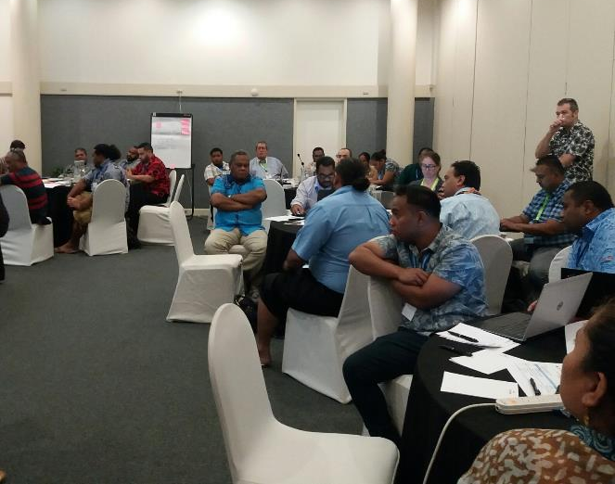
Workplan Development and Review of Term of Reference
Meeting outcomes includes:
Confirmed and agreed all members of the panel to be selected from national hydrology community and Met Directors to be kept informed on progress;
Technical support to be provided by PMDP (WMO & SPREP), SPC, UNESCO, NIWA and others
Membership to be revised and updated on expressions of interest and relevance from countries and partners
Notes:
Acknowledge contribution from PHS partners including WMO CREWS 20k, UNDP 30k and UNESCO 10k USD

Slide 5
PHS Membership
Kiribati
Vanuatu
American Samoa
Fiji
Tonga
Tuvalu
Solomon Islands
Samoa
Tokelau
Supported by: SPREP, SPC, UNESCO, UNDP, WMO, USP

Slide 6
Roles & Responsibilities
The roles and responsibilities of the PHS Panel include the provision of technical advice and guidance to the PMC on the following:
To establish links and improve coordination between the PMC and international and regional organizations with an interest in hydrological services;
To provide guidance on the design and scope of current and future programmes that support hydrological services at the community, national and regional levels;
To work with partners, including the WMO RA V Working Group for Hydrology, to progress the development and implementation of new programmes and initiatives to address identified gaps in PICTs
To provide regular reporting to the PMC on progress of the PHS Panel activities.

Slide 7
Pacific Hydrological Services panel Workplan
Output
Output 1: Impacts of climate variability and climate change on water resources better identified and quantified
Output 2: Improved collection, management and use of hydrometric and meteorological data.
Output 3: Strengthened capacity of hydrological and meteorological services.
Output 4: Improved hydrological infrastructure, communications and forecasting systems to support hydrological services
Implementation contingent upon available funding - primarily through existing projects and country initiatives.

Slide 8
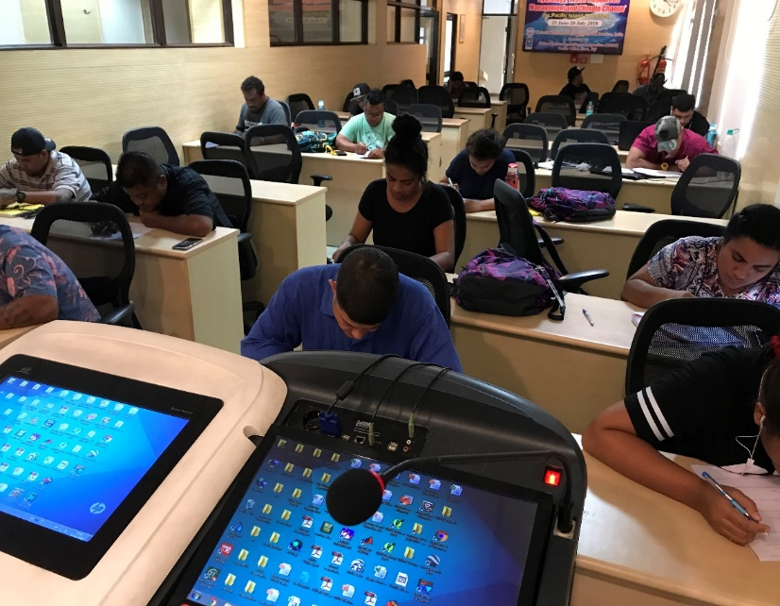
Progress continued
UNDP – India CLEWS – Hydrology Training Roorkee, India 17 participants ( countries)
Capacity building
Partnerships
Policy
Monitoring
Data management
User engagement
Training
Funding & revenue
UNESCO, WMO and UNDP supported Needs and Gaps Analysis in PHS, June 2019

Slide 9
Areas of service delivery requiring support

Slide 10
Status of hydrological monitoring stations

Slide 11
Barriers to working with meteorological services

Slide 12
Acknowledgements
Chair – Mr. Issac Leke (Solomon Islands)
Technical Partners – SPC, SPREP, RAV Hydro President – John Fenwick (NZ/NIWA), UNESCO, WMO
Development Partners – UNDP, UNESCO, WMO
Climate and Oceans Support Programme in the Pacific (COSPPac)

Slide 13
Recommendation
Note the progress of PHS panel including the revised Term of Reference and Workplan.
Note the Needs and Gaps Analysis undertaken by consultant;
Encourage Hydrology counterparts and technical partners to provide feedback via online survey.
Acknowledge current support through the Panel Partners, and request continued access to resources & opportunities for the implementation of the PHS workplan.
Recommend the Council members to further strengthen and extend support and collaboration with hydrologists. This should include sharing of resources, data, and development of joint actions and initiatives for national and regional benefits.

