Slide 1
^{6th} Project Steering Committee Meeting – SC-6
Thursday 09 November, 2023 – Grand Hotel, Port Vila, Vanuatu
Van-KIRAP Project
Agenda item 5: Update on the Weather Radar

Slide 2
Recommendations
PSC to NOTE update on the weather radar and actions items.
PSC to ACKNOWLEDGE the efforts by VMGD, SPREP and project stakeholders/partners in advancing the weather radar activity.

Slide 3
Background
Fifth Steering Committee - PSC-5 Decisions (April 2023):
PSC to note update on the weather radar and actions items.
PSC to endorse the weather radar procurement to proceed.
PSC to approve the USD3,079,254.00 budget allocation for the weather radar.
PSC to approve the project no-cost extension to December 2025 to accommodate for the procurement, commissioning, training and demonstration of the weather radar.
Land approval
Noting the urgency and the national benefits of the weather radar to the people of Vanuatu and their security, the Government of Vanuatu (VMGD) in consultation with Department of Lands to finalise the land acquisition (currently at Stage 4), consider the State of Emergency (SOE) in place to expedite the approval process.
NPP for the weather radar
VMGD to provide GCF with the NPP approval which includes the co-financing for the weather radar.

Slide 4
Activity 1.2.1.4 Weather radar
Objectives:
High quality data for planning and responding to climate variability and change is available and accessible for decision makers, and end users (sectors and communities)
Procurement of climate observations instruments to fill spatial and temporal gaps essential for developing early warnings (NSDP Env PO 3.2)
Procurement (supply, install, commissioning and demonstration of use) of Radar to be conducted. National budget appropriation has been approved in March 2023 and land acquired in progress (Stage 4)
Radar activity is the cornerstone activity of the Van-KIRAP project.

Slide 5
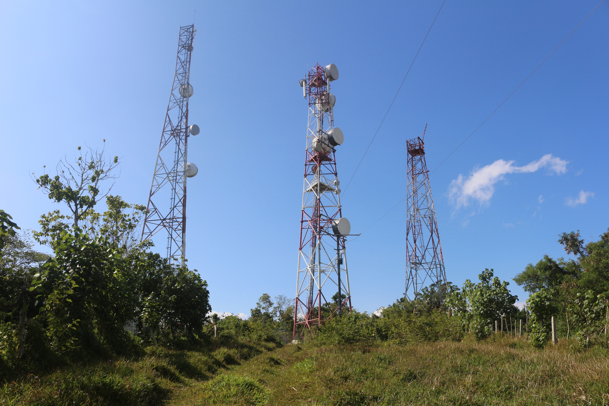
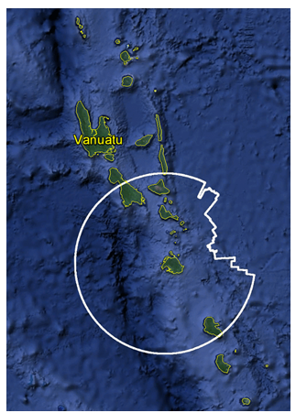
Activity 1.2.1.4 Weather radar site

Slide 6
Activity 1.2.1.4 Weather radar budget
VMGD Engineer (Staff) – USD27,846
Radar equipment – USD 2,025,000 (training)
International Travel (Engineer and Radar Technicians) – USD 8,000
Vanuatu Government co-financing – USD595,100 (access road, utilities, communications, maintenance and spare parts costs)
Contingency funding (GCF) – USD 415,538
Total budget – USD3,079,254.00
SPREP facilitate the weather radar procurement (SPREP Procurement System).

Slide 7
Update
June 2022, Hon Minister MoCC, DG MoCC met with SPREP Director General and agree to cooperate in the delivery, installation and commissioning of the weather radar.
29 June 2022, the Acting DG MoCC submitted all the requirements to SPREP. This includes
1. Full radar budget
2. Letter from Min of Lands (land acquisition underway – completed in August 2022)
3. Letter from Min of Finance (co-financing in the 2022/23 budget for radar)
4. Environmental Permit for weather installation
5. Radar technical specifications
6. Radar operations, maintenance plan (OMMP)
7. Tender documents (Request for Tender – RFT)
8. Geo-technical assessment report
9. Cost benefit analysis report (CBA)
10. Environmental Management and Social Safeguards Plan

Slide 8
Update (2)
12 February 2023, SPREP Accredited Entity (IE) informed GCF (Weather Radar Report) that Vanuatu has met all the FAA requirements for the weather radar.
February 2023, SPREP Director General met with Minister Hon Ralph Regenvanu, DG MoCCA, Director VMGD and sector agencies agree to proceed with radar activity.
SPREP IE has indicated to VMGD that all project implementation will close on 1 October 2022. Note project end date is 10 December 2022.
SPREP has requested GCF for a no-cost extension for an additional 24 months (to December 2025) for the implementation of the radar (procurement, installation, commissioning, monitoring and handover) – note Agenda item 4 (PSC-6)

Slide 9
Update (3)
Radar tender was advertised on 19 July 2023 (3 months) closed on 23 Sept 2023.
Four detailed compliant bids were received and evaluated by committee consisting of :
Tagaloa Cooper-Halo – Director CCR Programme, SPREP.
Rupeni Mario – Project Coordination Unit, SPREP
Esther Saul – Manager, ICT and Engineering, VMGD
Jino Moli, Electronics Engineer, VMGD
Tessa Tafua, World Meteorological Organization (WMO)
Sunny Kamuta Seuseu, Climate Information Services Officer, SPREP
Maraea Slade-Pogi, Procurement Officer, SPREP
Evaluation committee has recommended to award the contract to a successful supplier, subject to approval from GCF (No-cost extension 2024-2025)
Environmental Social Management Plan for the Weather Radar prepared (see Agenda item 6) submitted for SC approval.

Slide 10
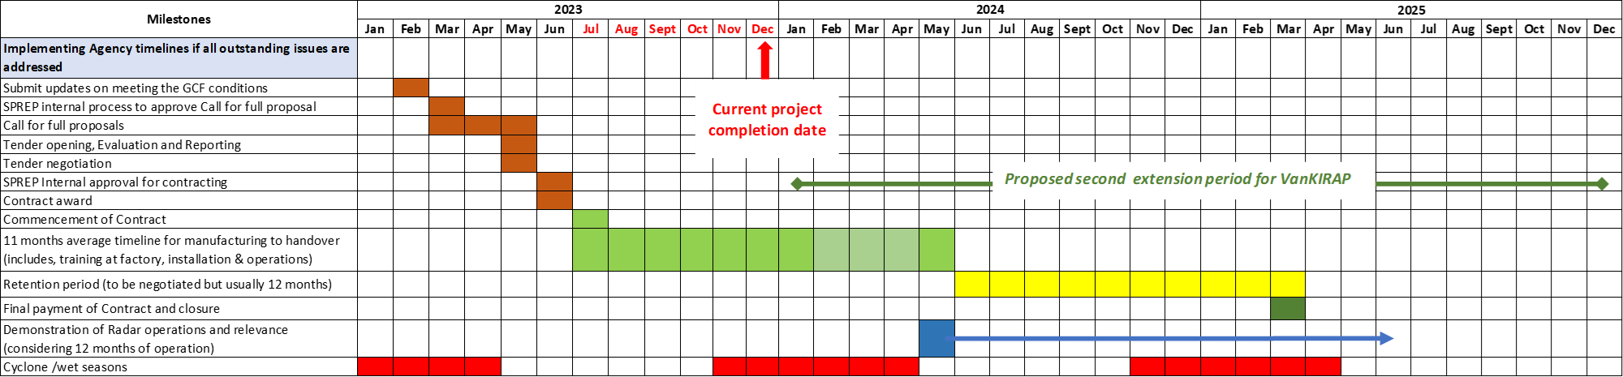
Update (4) – Radar timelines/extension

Slide 11
Recommendations
PSC to NOTE update on the weather radar and actions items.
PSC to ACKNOWLEDGE the efforts by VMGD, SPREP and project stakeholders/partners in advancing the weather radar activity.

Slide 12
Outstanding matters
Outstanding matter pertaining to the Weather Radar that Vanuatu needs to address includes:
Government of Vanuatu, Dept of Lands to finalise land acquisition (at Stage 4)
Ministry of Finance provide written approval the radar co-financing budget for VMGD
- USD595,100.

Slide 13
Acknowledgements
Government of Vanuatu – Council of Ministers, Minister of CC
Chairwoman Project SC – Vanuatu NDA to the Green Climate Fund.
VMGD – Director, Division Managers and staff (past and present) – Hon Napat, DG, PM, BP, JB
Government Departments for the support Dept of Lands, Finance, PWD, DEPC, NDMO, DLA, Civil Aviation Authority,
Chairman, members of the Van-KIRAP Technical Working Group (TWG)
Moirah Matou, the PMU and project team, consultants
SPREP Director General, Executive, Rupeni Mario and hardworking team at the SPREP PCU.
Tagaloa Cooper-Halo, Director CCR and Climate Change Resilience Programme, Salesa Nihmei and PacMetDesk Partnership with WMO, WMO Radar Expert Group.
Funding support from the Green Climate Fund (GCF).

