Slide 1

Agenda Item: 8.2
Title: Weather Ready Pacific Governance Options
Presenter: Patricia Sachs-Cornish

Slide 2
Purpose of the paper:
provides an overview of the WRP Governance Assessment for consideration by members of the PMC; and
provides some thoughts on the Next steps highlighting the importance of operationalizing WRP in advance of the PIFLM52

Slide 3
Background
PMC 5 Decision in 2019
WRP Decadal Program of Investment – May 2021
30th SPREP Meeting of Officials – July 2021
PIF Leaders Forum - August 2021

Slide 4
Outline of presentation
Pacific Islands Leaders’ endorsement in 2021
Focuses on
  The importance of sound governance;
  Sustainability
  Governance options
  Working relationships
  Possible investment facility options
Next steps

Slide 5
Pacific Islands Leaders’ Endorsement
  August 2021
  Leaders endorsed the Weather Ready Pacific Decadal Programme of Investment, which seeks to reduce the human and economic cost of severe weather, water and ocean events across Pacific Island communities, by strengthening national meteorological and hydrological organisations and their partnerships with national disaster management organisations.

Slide 6
WRP Decadal Program of Investment Framework
Components
  Strategy & Governance
  Production of Forecasts & Warnings
  Communication and delivery of forecasts and warning to end-users
  Infrastructure
  Capacity building
Interaction with regional observing networks and forecast centers
Pacific participates and benefits from advances in forecast and warning systems

Slide 7
Importance of Sound Governance
Good governance lies at the heart of our ambitions
Characteristics
Models and frameworks need to cover roles & responsibilities required; decision making processes; internal processes; polices and procedures
Crucial to attain results
Participatory | Consensus-oriented
Accountable | Transparent
Responsive | Effective & efficient
Equitable | Inclusive
Rules | Regulations

Slide 8
Sustainability of WRP
Investment
  Partners/investors
  NMHSs
Institutionalizing within the Regional Hub
Resource mobilization
Diversity of investment base
WRP Communication Strategy
Review (mid term) or more frequently

Slide 9
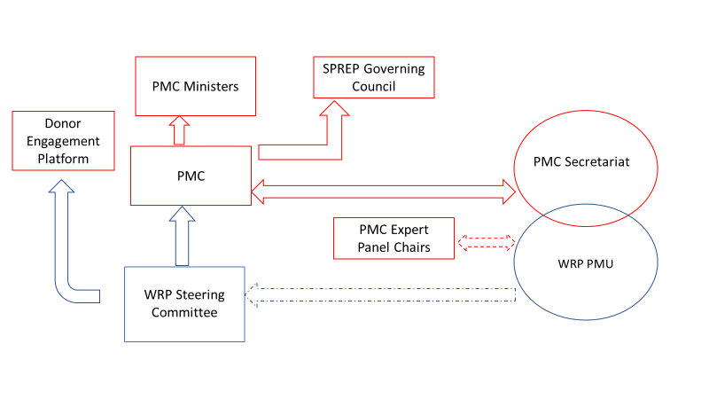
Governance Options – Simplified

Slide 10
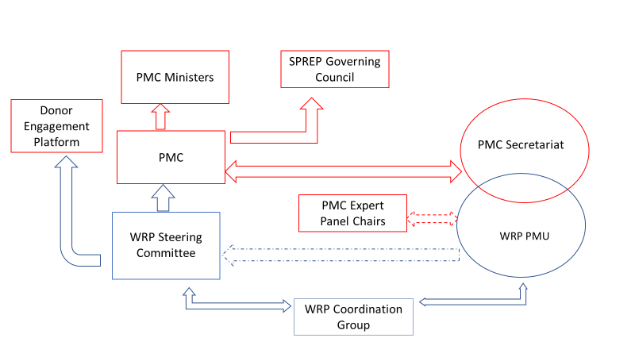
Governance Options – Variation

Slide 11
Other possible options
Pacific Women Lead
EQAP
Regional NDC Hub

Slide 12
WRP Steering Committee
Composition - to be determined by PMC
Options
  Committee of full representation of all PMC Pacific Members & Partner representation
  Committee of a subset of PMC – rotational by sub-region & Partner representation
  Potential for representative of end users of information (NDMOs)

Slide 13
Role of WRP SC
Provide strategic direction
Review and validate
  technical reports
  financial reports
Approve annual workplans
Explore partnership opportunities
Other functions as determined by PMC

Slide 14
Role of WRP Coordination Group
Operational program management forum
Coordination and collaboration
Monitor performance
Identify risks
Work closely with
  panel of experts
  Technical partners
  Funding partners
  GEDSI reps

Slide 15
WRP PMU
Secretariat support to WRP SC and WRP Coordination Group
Embedded in the Pac Met Desk
Technical delivery
Work plan development
Delivery of services
M&E
Communications

Slide 16
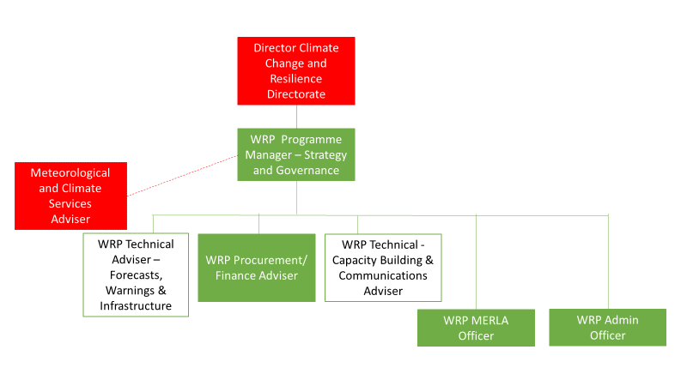
WRP PMU
Start Up
Phase

Slide 17
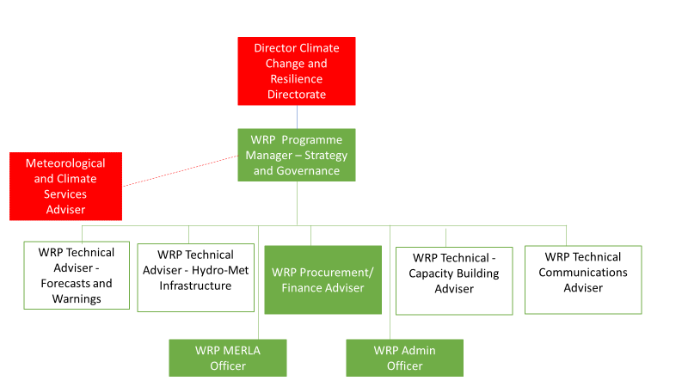
WRP
PMU

Slide 18
Key considerations for choice of Investment Facility
Does it provide for the flexible and predictable funding agreed on a specific programmatic scope, budget, and deliverables;
Does it adopt a pragmatic approach to address due diligence requirements of development partners that are obstacles to access and procurement;
Does it adopt a single legal framework and harmonise systems and reporting;
Does it reduce administrative burdens?

Slide 19
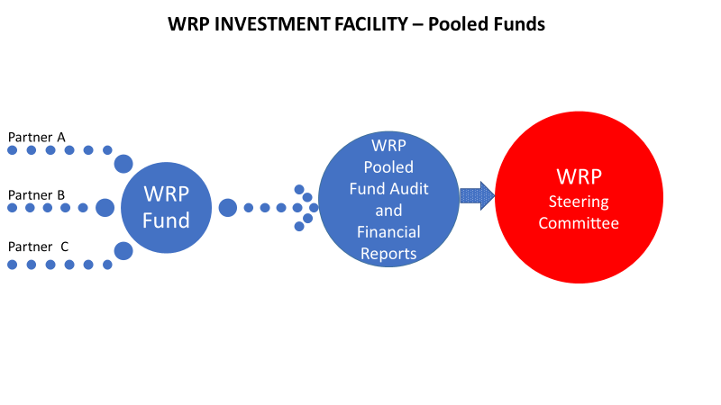

Slide 20
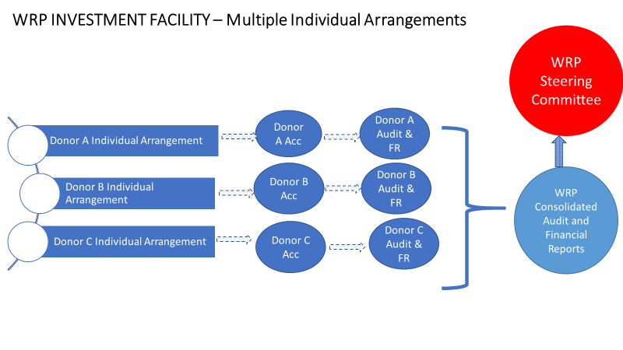

Slide 21
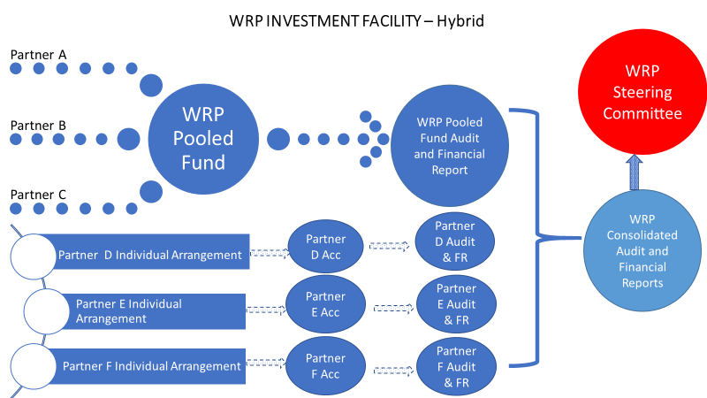

Slide 22
Roadmap to Operationalise WRP
  Recommendation from PMC to Ministers on choice of WRP Governance Framework
  Recommendation from PMC to Ministers on best option for WRP Investment Facility
  Development of implementation plan by PMC and SPREP with clear milestones to be achieved within specific timeframes

Slide 23
Recommendations:
The Meeting is invited to:
Discuss governance options and investment facility options;
Agree to the development of an implementation plan that will outlines the next steps to bring WRP to fruition

Slide 24
Thank you very much

