Slide 1

Agenda Item: 5
World Meteorological Congress and Hydrological Assembly outcomes including the human and economic costs of weather-, water-, climate- and ocean-related events and socioeconomic benefits of investment in hydro-met

Slide 2
Purpose of the paper:
To share with Council the key outcomes of the 19th World Meteorological Congress and Hydrological Assembly held in May-June 2023.
To inform the Council on human and economic costs attributed to weather-, water-, and climate-related events.
To update the Council on the relevance and current status of socioeconomic benefit assessments of weather, climate and water services.
To recommend that the Pacific National Meteorological and Hydrological Services (NMHSs) prioritize undertaking socioeconomic benefit assessments in order to encourage investment and enhance their services.

Slide 3
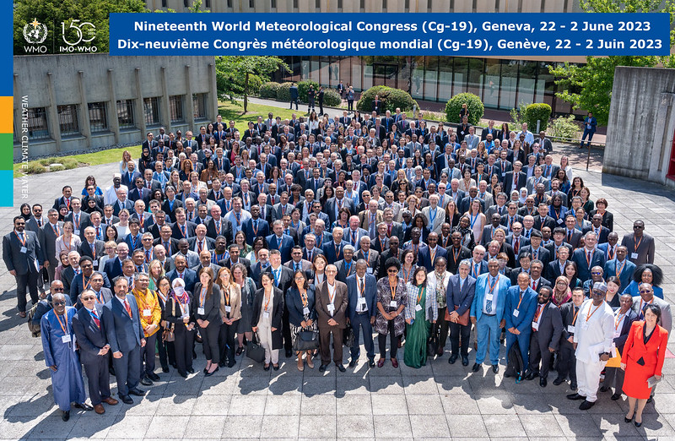
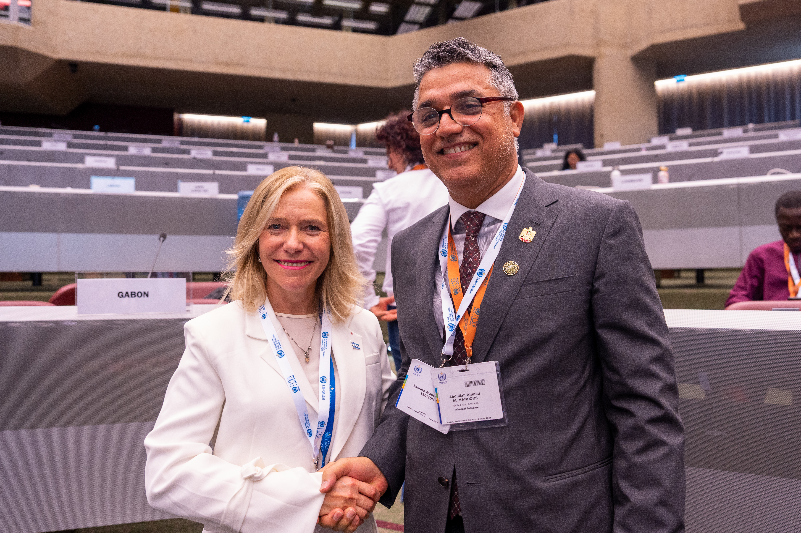
19th World Meteorological Congress:
The 19th World Meteorological Congress (Cg-19) was held in Geneva from 22 May to 2 June 2023.
Leadership and governance:
Prof. Celeste Saulo was elected as the WMO Secretary-General and will commence on 1 January 2024. Prof. Petteri Taalas has now served two, four-year terms as WMO Secretary-General.
Dr Abdulla Al Mandous was elected as WMO President.
The 1st, 2nd and 3rd Vice-Presidents are Douada Konate, Eoin Moran and Mrutyunjay Mohapatra respectively. The President and Vice-Presidents assumed their roles at the end of Cg-19.
RA V – status quo for the four allocated Executive Council seats.

Slide 4
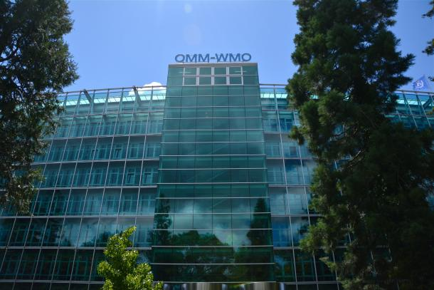
19th World Meteorological Congress:
Key resolutions:
Early Warnings for All
Global Greenhouse Gas Watch
WIS 2.0
Cryosphere
Hydrology (flood forecasting and drought management)
Science and Innovation
Gender equality
Capacity building
WMO Strategic Plan 2024-2027:
Enhance preparedness for extreme climate, weather and water
Support climate-smart decision making to adapt and build resilience
Enhance socio-economic value of services

Slide 5
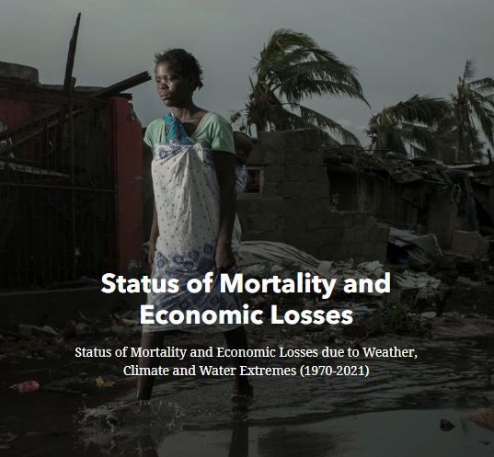
Updated WMO Atlas of Mortality and Economic Losses from Weather, Climate and Water Extremes (1970-2021):
Between 1970 and 2021, 11 778 disasters were attributed to weather, climate and water extremes, resulting in
2 087 229 deaths and US$ 4.3 trillion in economic losses globally.
Economic losses have increased, but improved early warnings and coordinated disaster management has decreased the human casualty toll.
Source: WMO Atlas of Mortality and Economic Losses from Weather, Climate, and Water Extremes (1970–2019) (WMO-No. 1267) 2022 update
Note: Economic losses are reported in 2021 US$ values.

Slide 6
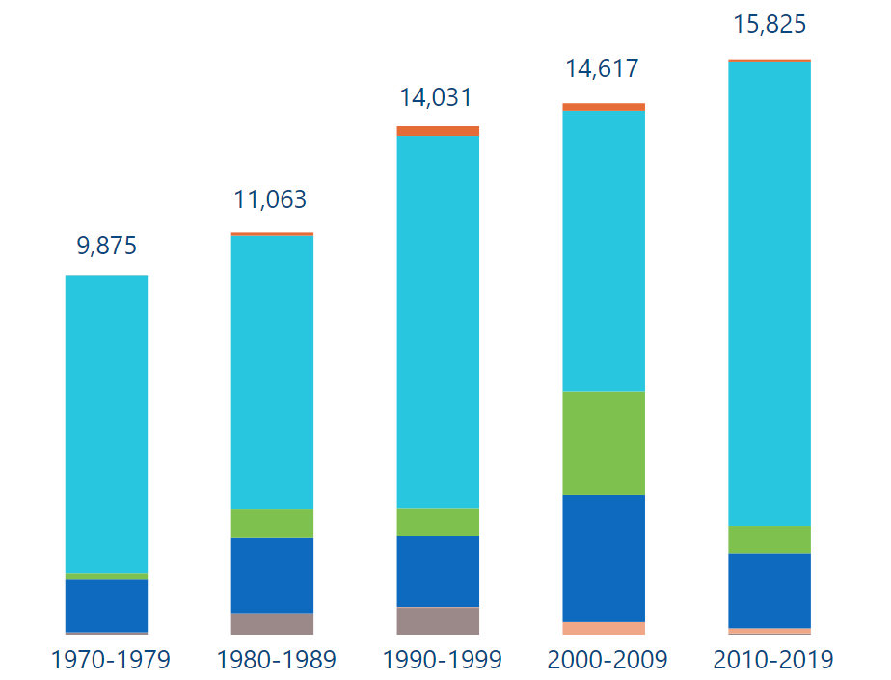
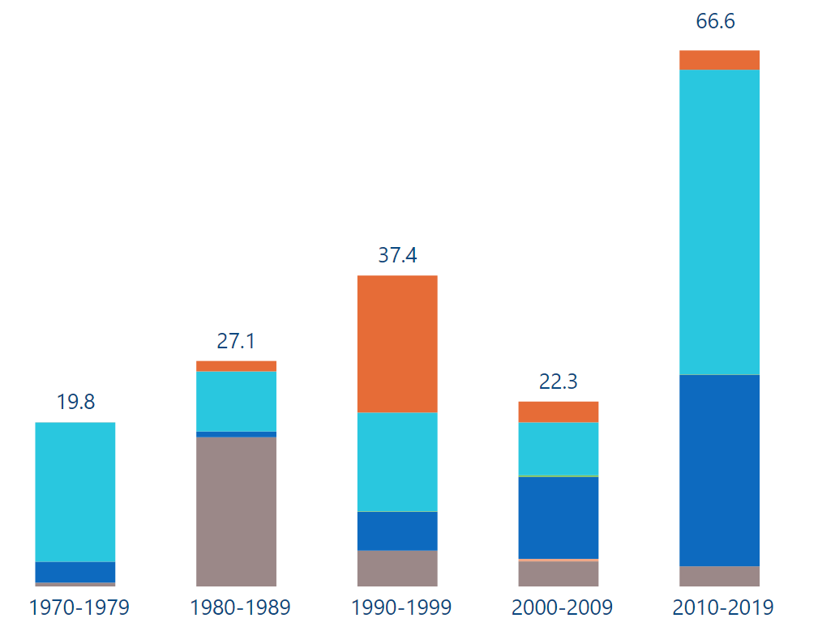
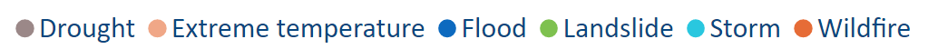
Human and economic costs in RA 5 – South-West Pacific (1970-2021):
Number of reported
deaths by decade
Between 1970-2021, 1 493 disasters were reported in the region, resulting in 66 951 casualties and US$ 185.8 billion in economic losses.
Some disasters caused economic losses equivalent to more than 100% of the respective GDPs.
Reported economic losses
in US$ billion by decade
Source: WMO Atlas of Mortality and Economic Losses from Weather, Climate, and Water Extremes (1970–2019) (WMO-No. 1267) 2022 update
Note: Hazard type to the EM-DAT classification. Economic losses are reported in 2021 US$ values.

Slide 7
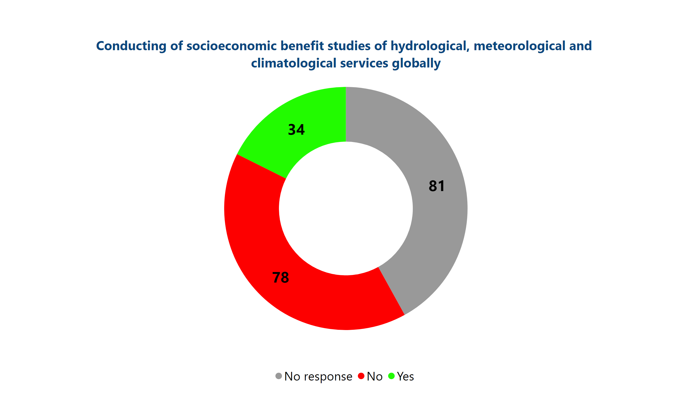
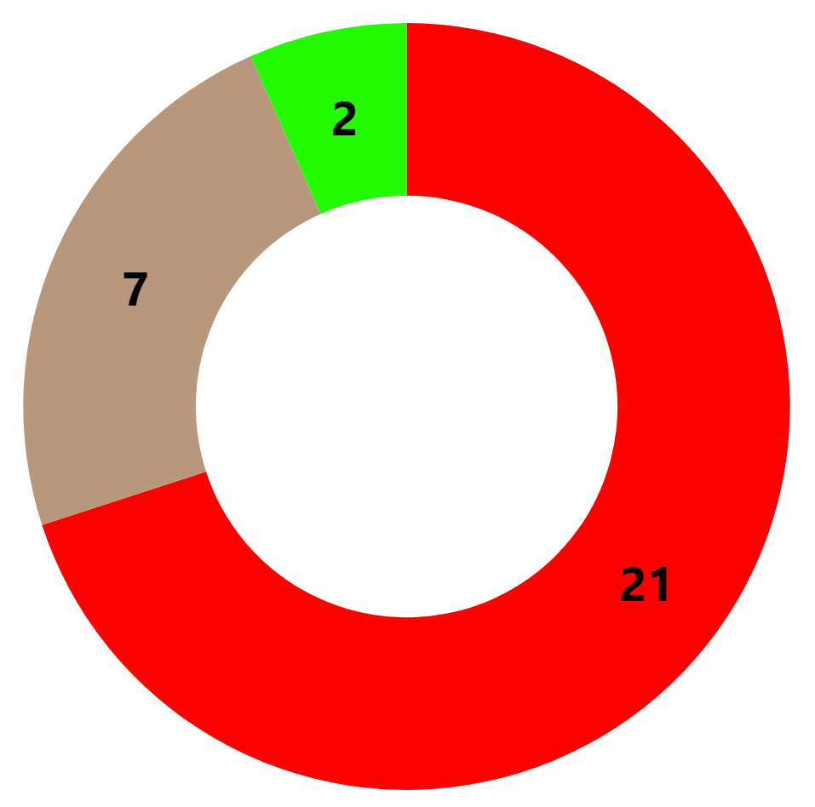
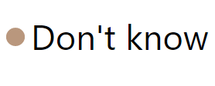
WMO Members globally reporting to have conducted
SEB assessments, as of Dec 2021
Status of socioeconomic
benefit (SEB) assessments:
Weather, climate and water services provide multiple benefits to the society.
Valuing of those benefits remains a persistent challenge, especially in the EW4All initial group of countries.
Only 2 out of 30 EW4All initial group of countries have reported to have conducted SEB assessments.
Source: WMO (2022), Performance Monitoring System.
EW4All initial group of countries reporting to have conducted SEB assessments, as of Jun 2023
Source: WMO (2023), EW4All Rapid Assessment.
Note: *ongoing assessment

Slide 8
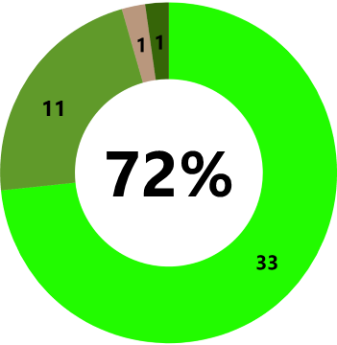
Relevance of socioeconomic
benefit (SEB) assessments:
MAIN PURPOSES OF SEB ASSESSMENTS
Based on a survey conducted at the Nineteenth World Meteorological Congress (22 May – 2 June 2023):
1
Evidence-based justification for new investments
39
2
Determining NHMS value to user
objectives
25
72% of respondents* recognized socioeconomic benefits assessments as very important for long-term planning and decision making.
3
Prioritizing & (re)allocating resources
24
4
Validating existing services
24
5
Validating previous and current
investments
21
Note: For the above-mentioned question on the purposes of SEB assessments, multiple answers could be selected; all 47 survey respondents responded to the above-mentioned question on the purposes of SEB assessments.
Note: *There have been 47 structured interviews. 46 survey respondents responded to the above-mentioned question on the importance of SEB assessments.

Slide 9

Panel on Socioeconomic Benefits to Support Early Warnings for All:
ESTABLISHMENT
Established in June 2022 at the seventy-fifth session of the WMO Executive Council (Decision 17 (EC-75)); Inaugural Meeting in June 2023.
OBJECTIVE
The Panel aims to strengthen aligned efforts to inform on the benefits of early warning systems in support of the UN Secretary-General’s Early Warning for All (EW4All) initiative.
MEMBERS
14 Members from UN Regional Commissions, and International Organizations; Development Agencies; Academia; Civil Society & Private Sector; and the WMO Community.

Slide 10

HydroHub Ministerial Roundtables
Ministerial Roundtables aim to inform on costs and benefits of investing in hydrological data:
Step 1: In consultation with national authorities, WMO HydroHub facilities the provision of expert services to carry out the cost benefit assessment.
Step 2: The WMO HydroHub identifies and engages with the relevant Ministries responsible for NMHSs and budget allocations in the country.
Step 3: WMO HydroHub together with NMHSs and Basin Organizations, prepares, organizes and carries out Roundtables.
Source: WMO HydroHub, 2020: Ministerial Roundtables, Ministerial Roundtables | HydroHub (wmo.int)

Slide 11
Recommendations:
The Meeting is invited to:
Note the societal and economic costs incurred due to weather-, climate- and water-related disasters;
Further note the importance of socioeconomic benefit assessments of weather, climate and water services and the gap that exists in terms of performing such assessments;
Encourage the conducting of socioeconomic benefits assessment to raise awareness on the importance of investing in weather, climate and water services in the region.

