Slide 1

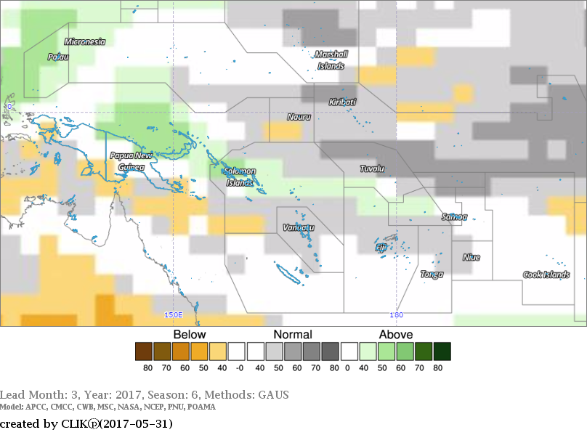
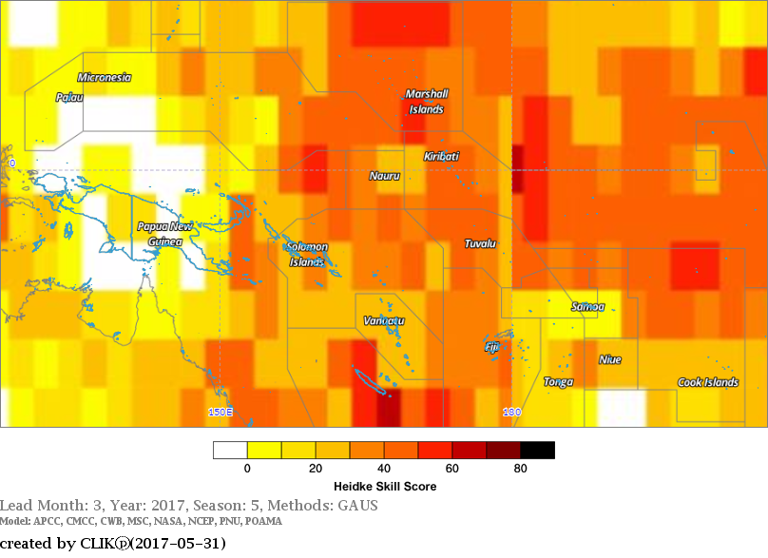
Republic of Korea-Pacific Islands
Climate Prediction Services Project
Consensus Rainfall Forecast – June to August 2017
2017-006 Edition
Figure 1: Consensus Rainfall Forecast for the Pacific Islands – June to August 2017 period
Figure 2: Rainfall Forecast Skill for the Pacific Islands – June to August 2017 period
Country | Rainfall Outlook | Skill
Cook Islands | Normal | Moderate
FSM | Normal | Moderate
Fiji | Normal | Moderate
Kiribati | Normal | Moderate to High
Marshall Islands | Normal | Moderate to High
Nauru | Normal | Moderate
Niue | Normal | Moderate
Palau | Above Normal | Low
PNG | Normal | Low
Samoa | Normal | Low
Solomon Islands | Above Normal | Moderate
Tonga | Normal | Moderate
Tokelau | Normal | Moderate
Tuvalu | Normal | Moderate
Vanuatu | Normal | Moderate
The consensus rainfall and temperature forecasts are derived from a multi-model ensemble (MME) of all available Dynamical Models that are provided by WMO Global Producing Centers (GPCs) available on CLIK Pacific (CLIK℗) or Climate Services Toolkit for the Pacific.
CLIK℗ is a product of the Republic of Korea-Pacific Islands Climate Prediction Services Project (ROK-PI CliPS).
The dynamical model data from individual models is available in the Supplementary material.
Contact your location Meteorology Service for site specific forecast
.
Visit the CLIK℗ Online Climate Prediction System: clikp.sprep.org
Note: Variation in the skill is due to model agreement and data availability at each location.

Slide 2
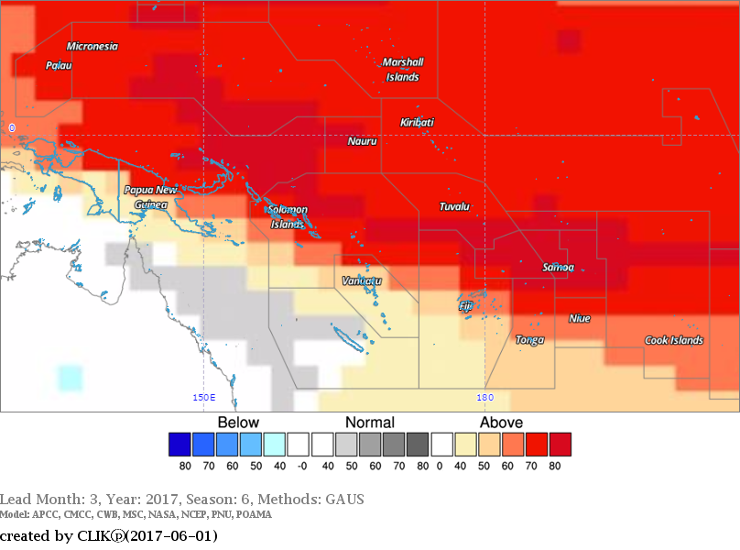
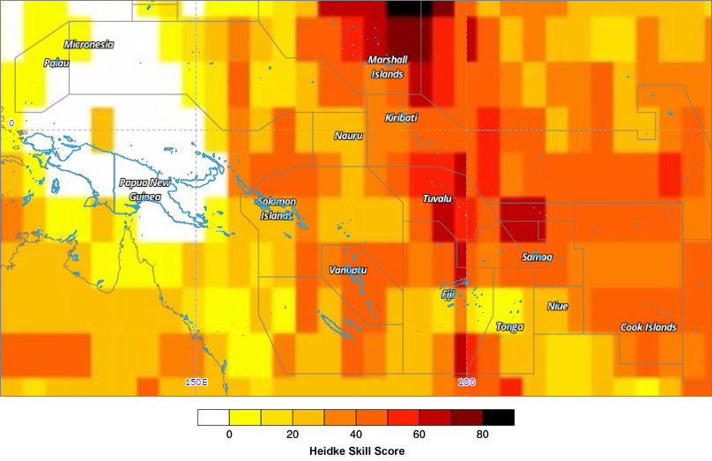

Republic of Korea-Pacific Islands
Climate Prediction Services Project
Consensus Rainfall Forecast – June to August 2017
Figure 3: Consensus Temperature Forecast for the Pacific Islands – June to August 2017 period
Figure 4: Air Temperature Forecast Skill for the Pacific Islands – June to August 2017 period
Country | Air Temperature Outlook | Skill
Cook Islands | Above Normal | Moderate
FSM | Well Above | Low
Fiji | Above Normal | Low
Kiribati | Well Above | High
Marshall Islands | Well Above | Very High
Nauru | Well Above | Moderate
Niue | Well Above | Moderate
Palau | Well Above | Low
PNG | Above Normal | Very Low
Samoa | Well Above | High
Solomon Islands | Well Above | Moderate
Tonga | Above Normal | Low
Tokelau | Well Above | Very High
Tuvalu | Above Normal | High
Vanuatu | Normal to Above
Important:
This publication is developed from information in the CLIK Pacific (CLIK℗) Online Climate Prediction Toolkit for the Pacific. clikp.sprep.org
It is compiled to provide dynamical model data to support and complement statistical model information generated by Pacific Islands National Met Services.
CONTACT INFORMATION:
For more information please contact Mr. Sunny Seuseu, Climate Prediction Services Coordinator, SPREP
sunnys@sprep.org
PO Box 240, Apia, Samoa
E: sprep@sprep.org
T: +685 21929
F: +685 20231
W: www.sprep.org
A resilient Pacific environment, sustaining our livelihoods and natural heritage in harmony with our cultures.

