Slide 1



Vanuatu TC Risk Workshop 2024
  This workshop was delivered by Cameron Do and Yuriy Kuleshov from the Bureau of Meteorology to an audience at VMGD and NDMO on the 26th June and 1st July 2024 respectively.
  In partnership with Van-KIRAP and SPREP, the goal was to present research on a Tropical Cyclone risk assessment for Vanuatu, receive feedback and discuss future improvements.
  This document contains the presentation slides used, as well as a summary of responses and discussions had during the workshops.

Slide 2

TC risk in Vanuatu
Comparing estimated risk to real-world impacts

Slide 3
Introduction
Prof. Yuriy Kuleshov
Cameron Do
  CREWS (Climate Risk and Early Warning Systems) at the Bureau of Meteorology, Australia
  Working with Van-KIRAP to build capacity in Vanuatu
  Today, sharing findings from a study we have published on TC risk in Vanuatu

Slide 4
Agenda
Explain what we did
Share results from our study
Discuss the importance of recording impact data
Show what impact data we have so far
Discuss areas of improvements

Slide 5
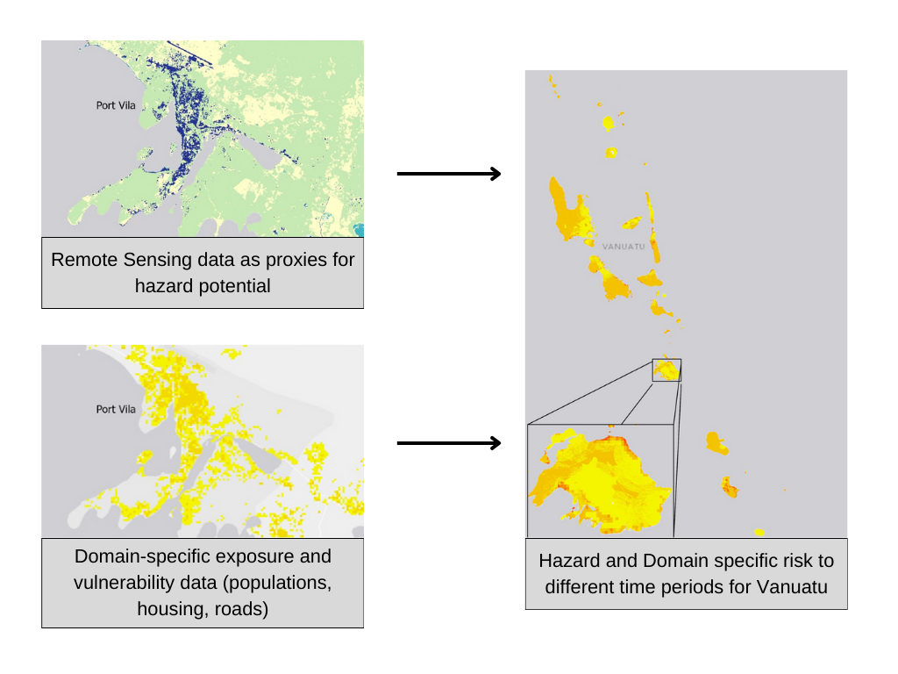
What we did
We estimated TC risk from hazards of flooding, storm surge and wind by combining:
  Hazard potential
  Exposure
  Vulnerability
  -> to create maps estimating risk

Slide 6
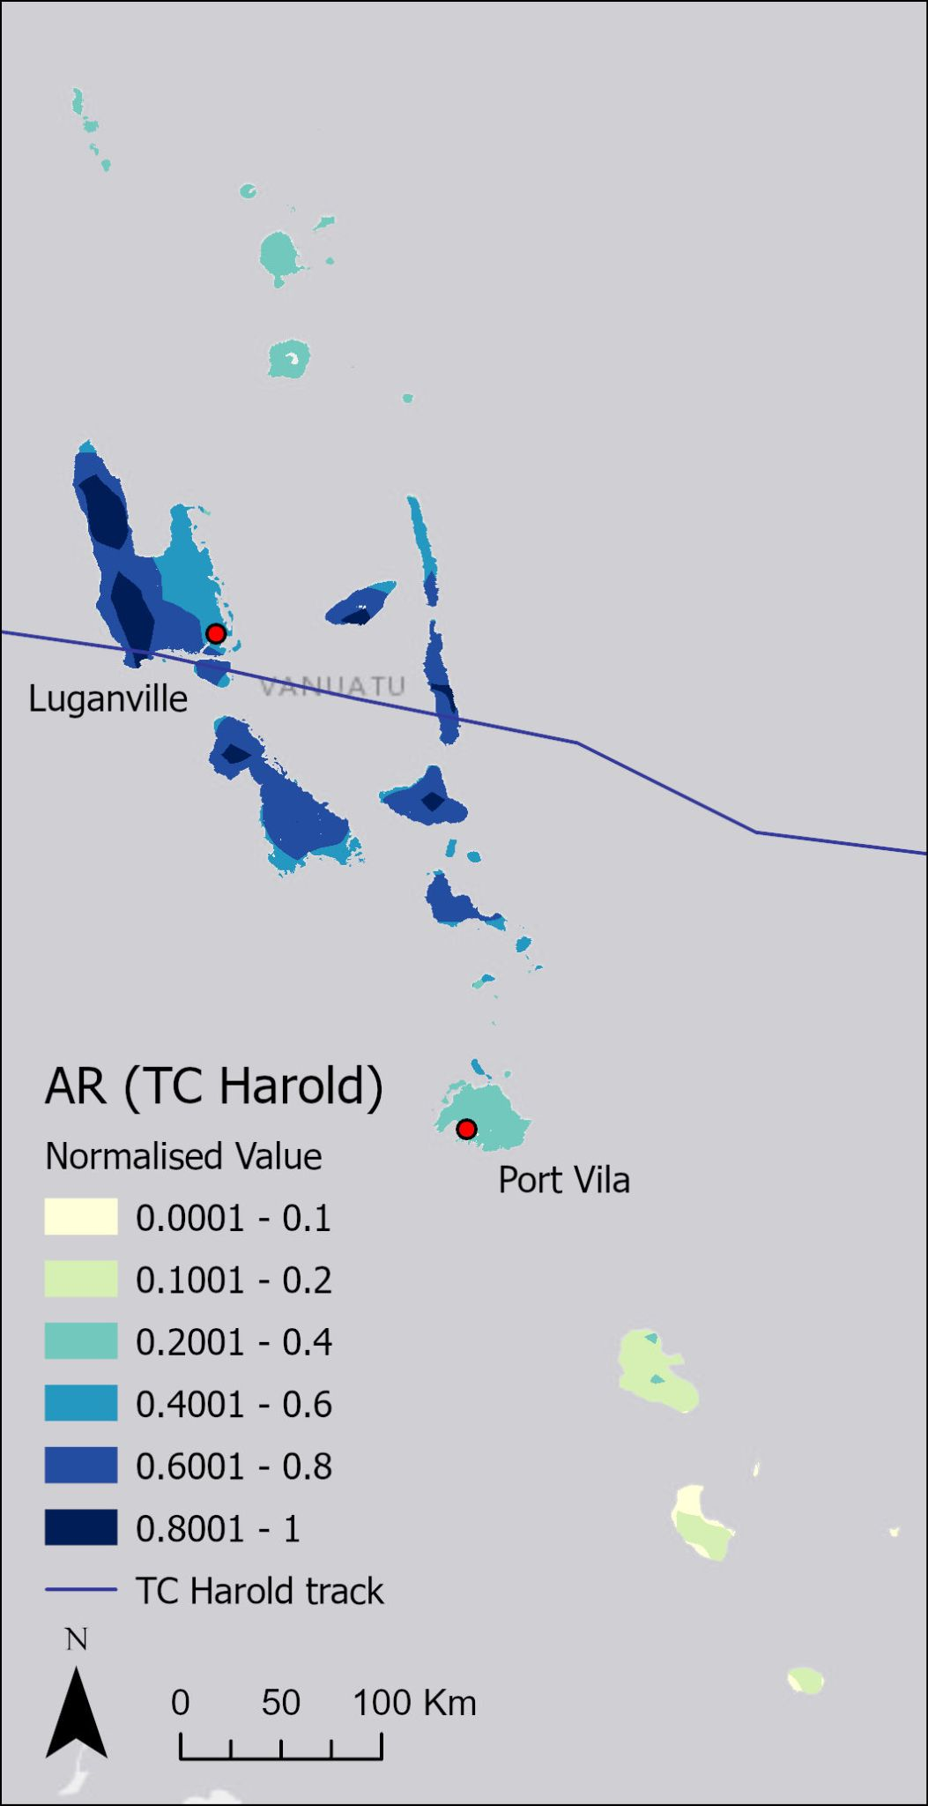
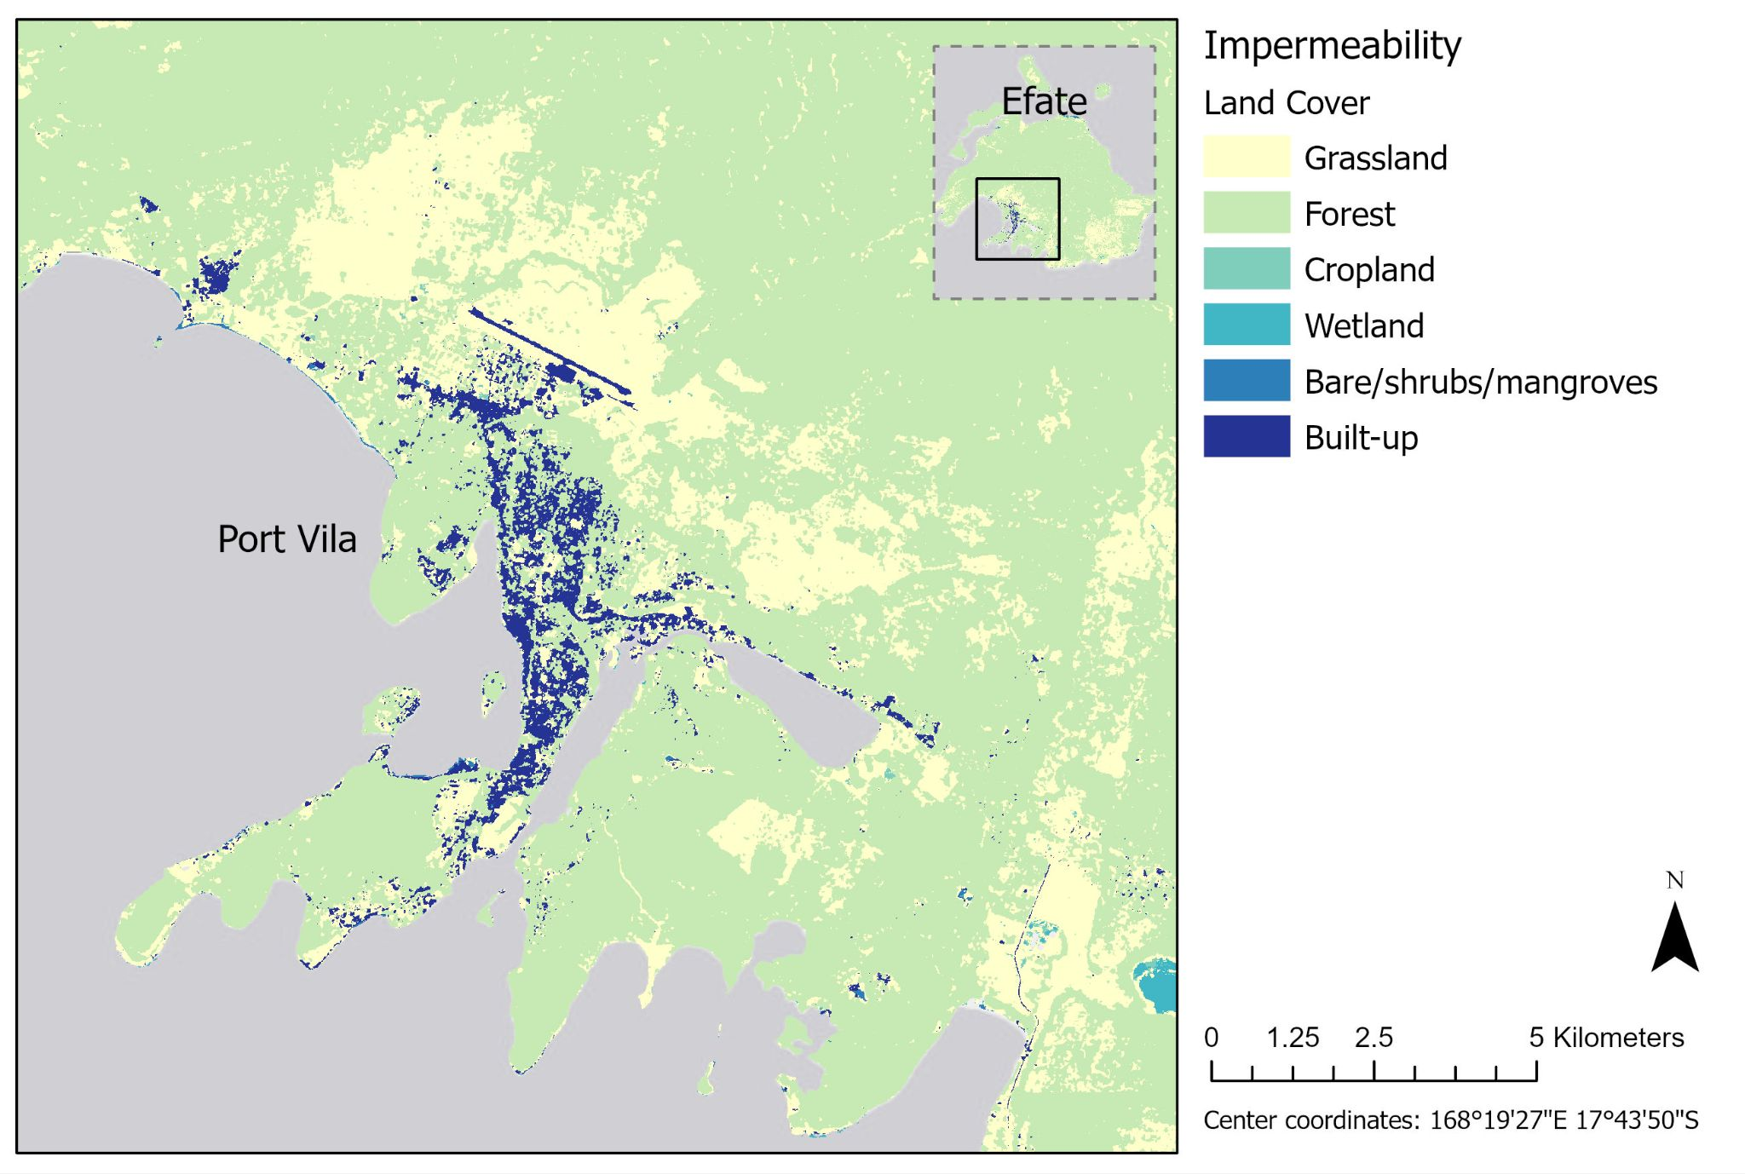
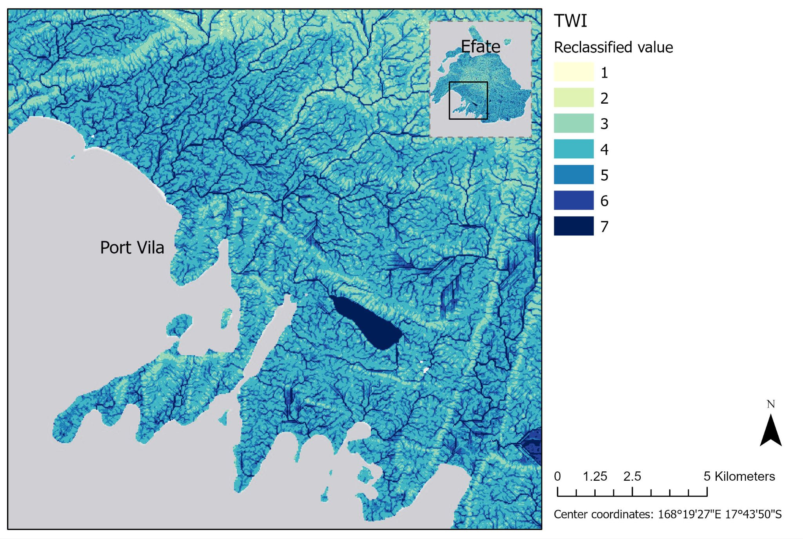
TC flood potential
Impermeability map from land cover data
Topographical Wetness Index (TWI) from elevation/slope data
Accumulated Rainfall (AR) from satellite rainfall data
Together they tell us where is most likely to flood due to the physical features of the land, and where received rainfall during the event

Slide 7
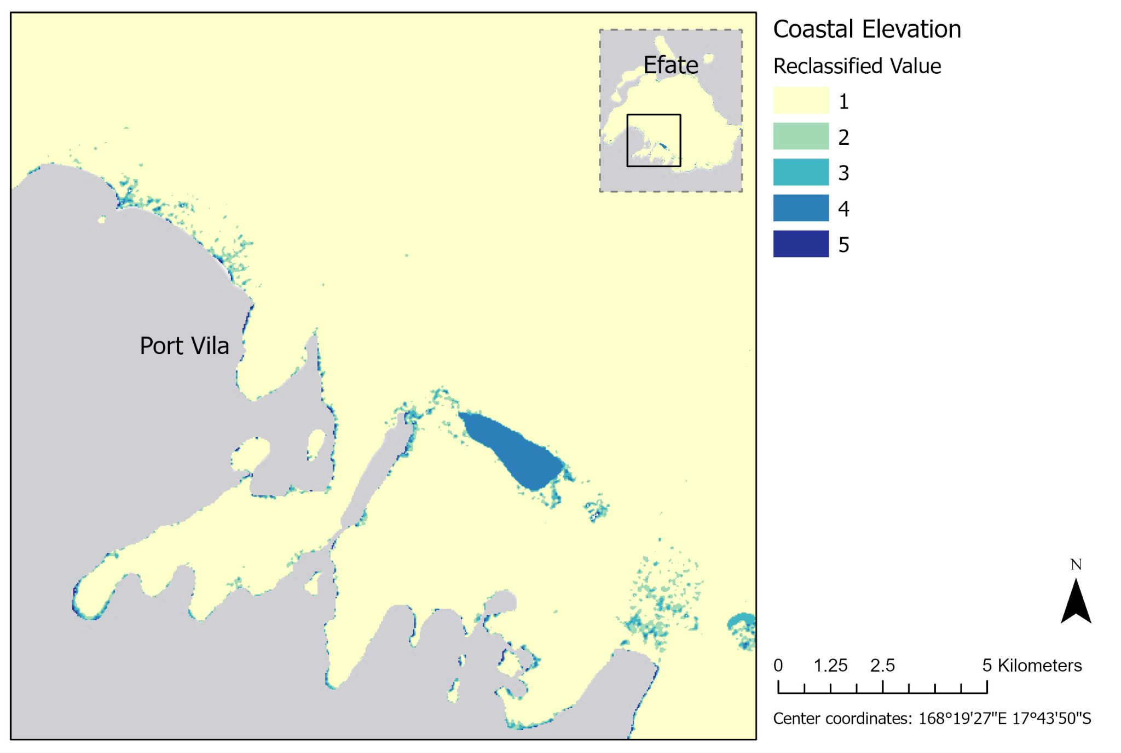
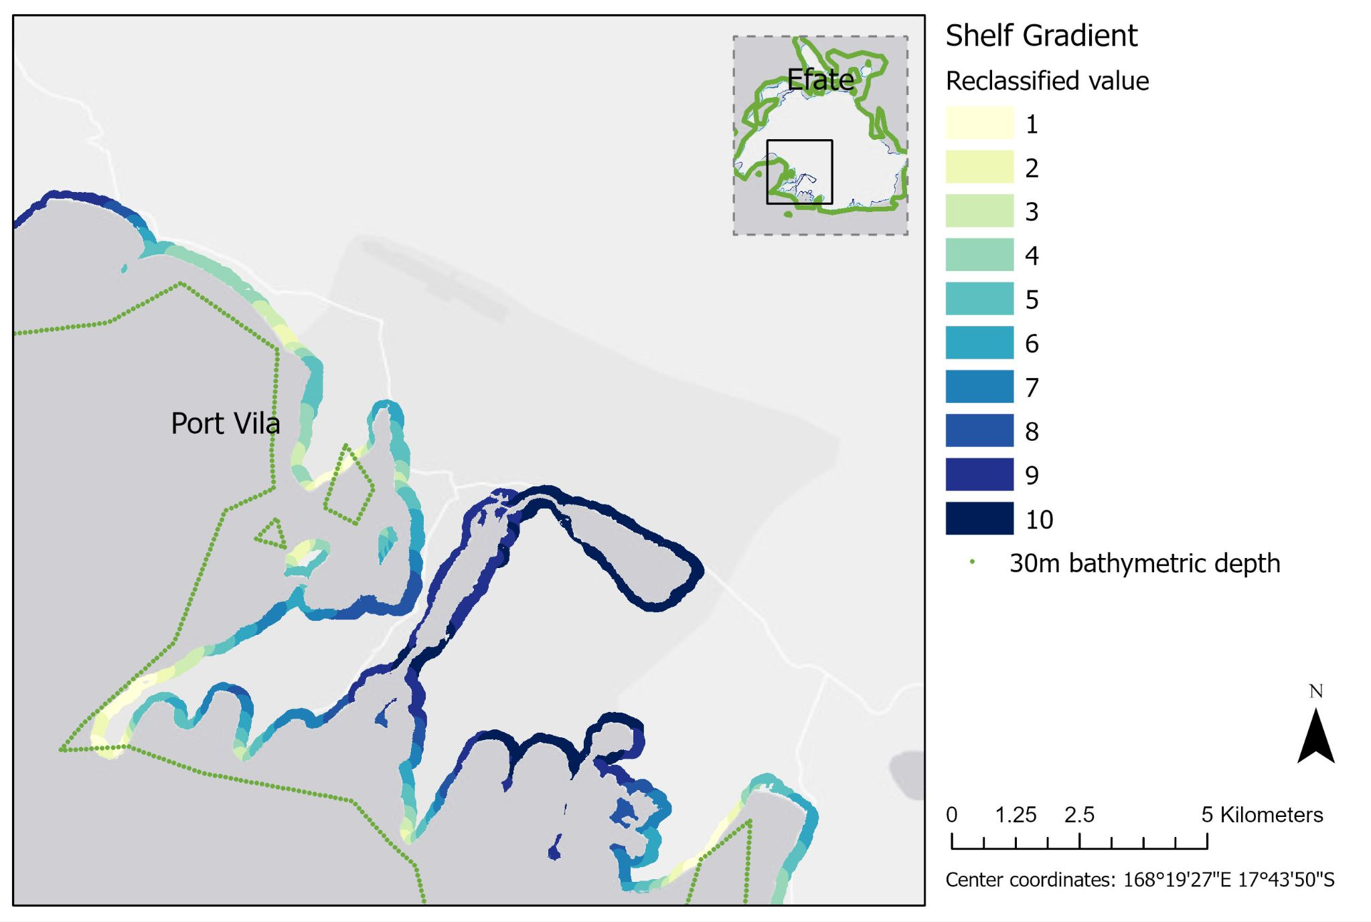
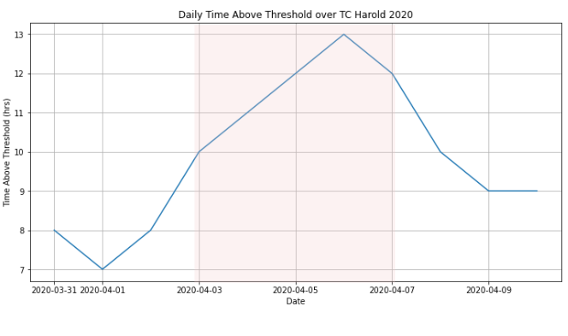
TC surge potential
Coastal Elevation from elevation data
Shelf Gradient from bathymetry data
Time Above Threshold from tide gauge data
Together, they tell us which coastlines are particularly susceptible to surge occurrences.

Slide 8
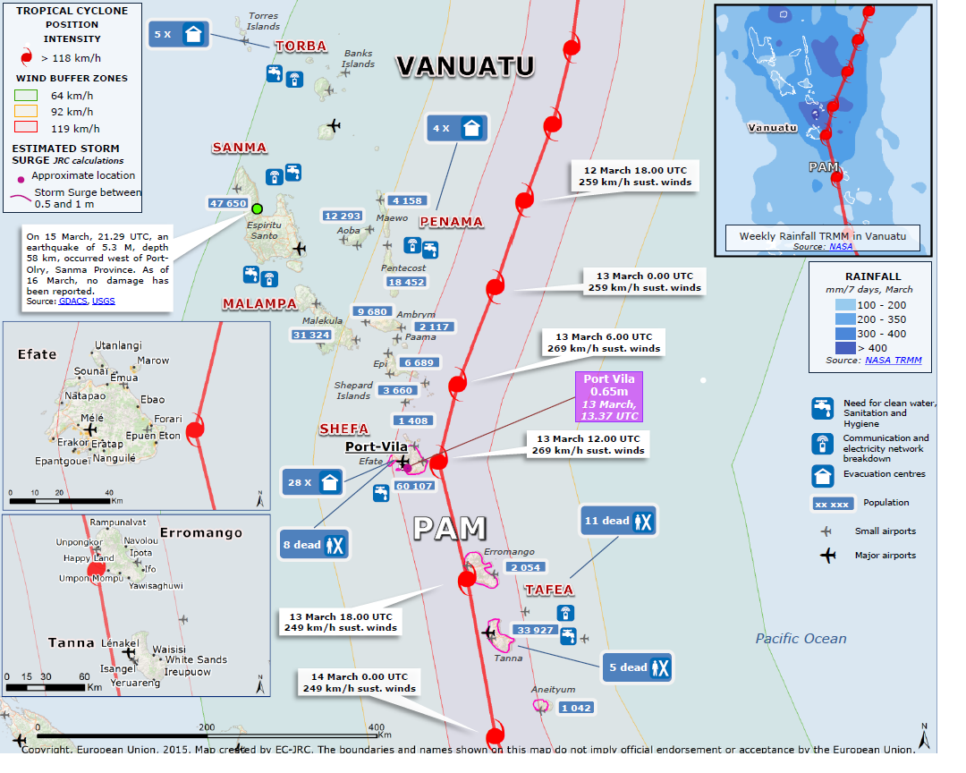
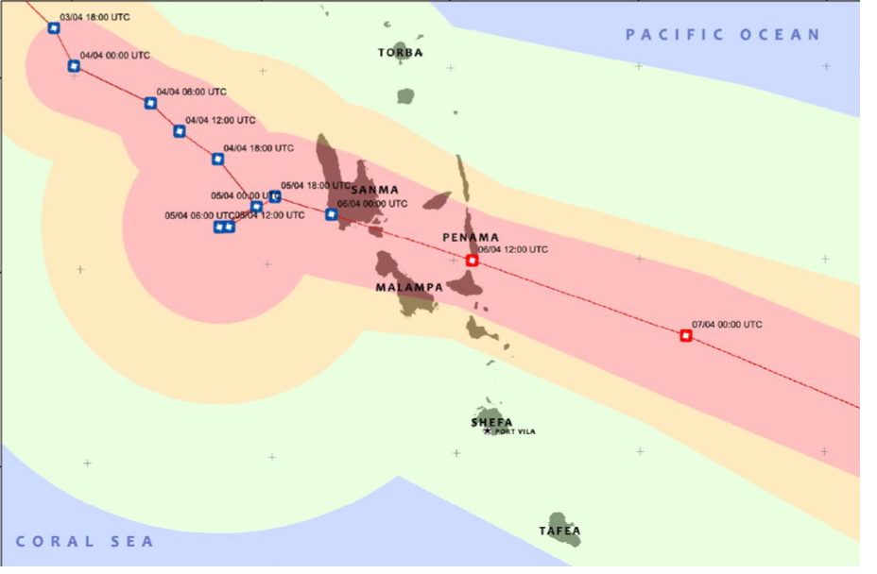
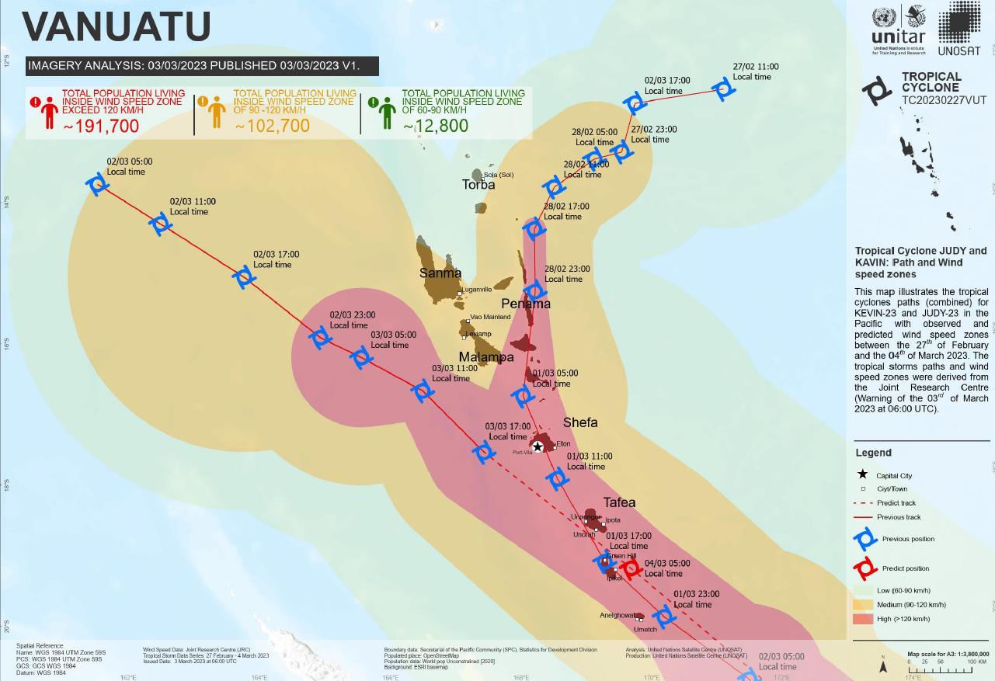
TC wind
Wind intensity zones from event maps (0-60km/h, 60-90km/h, 90-120km/h, 120km/h+ zones)
Event-specific wind buffers that show proximity to the TC path.

Slide 9
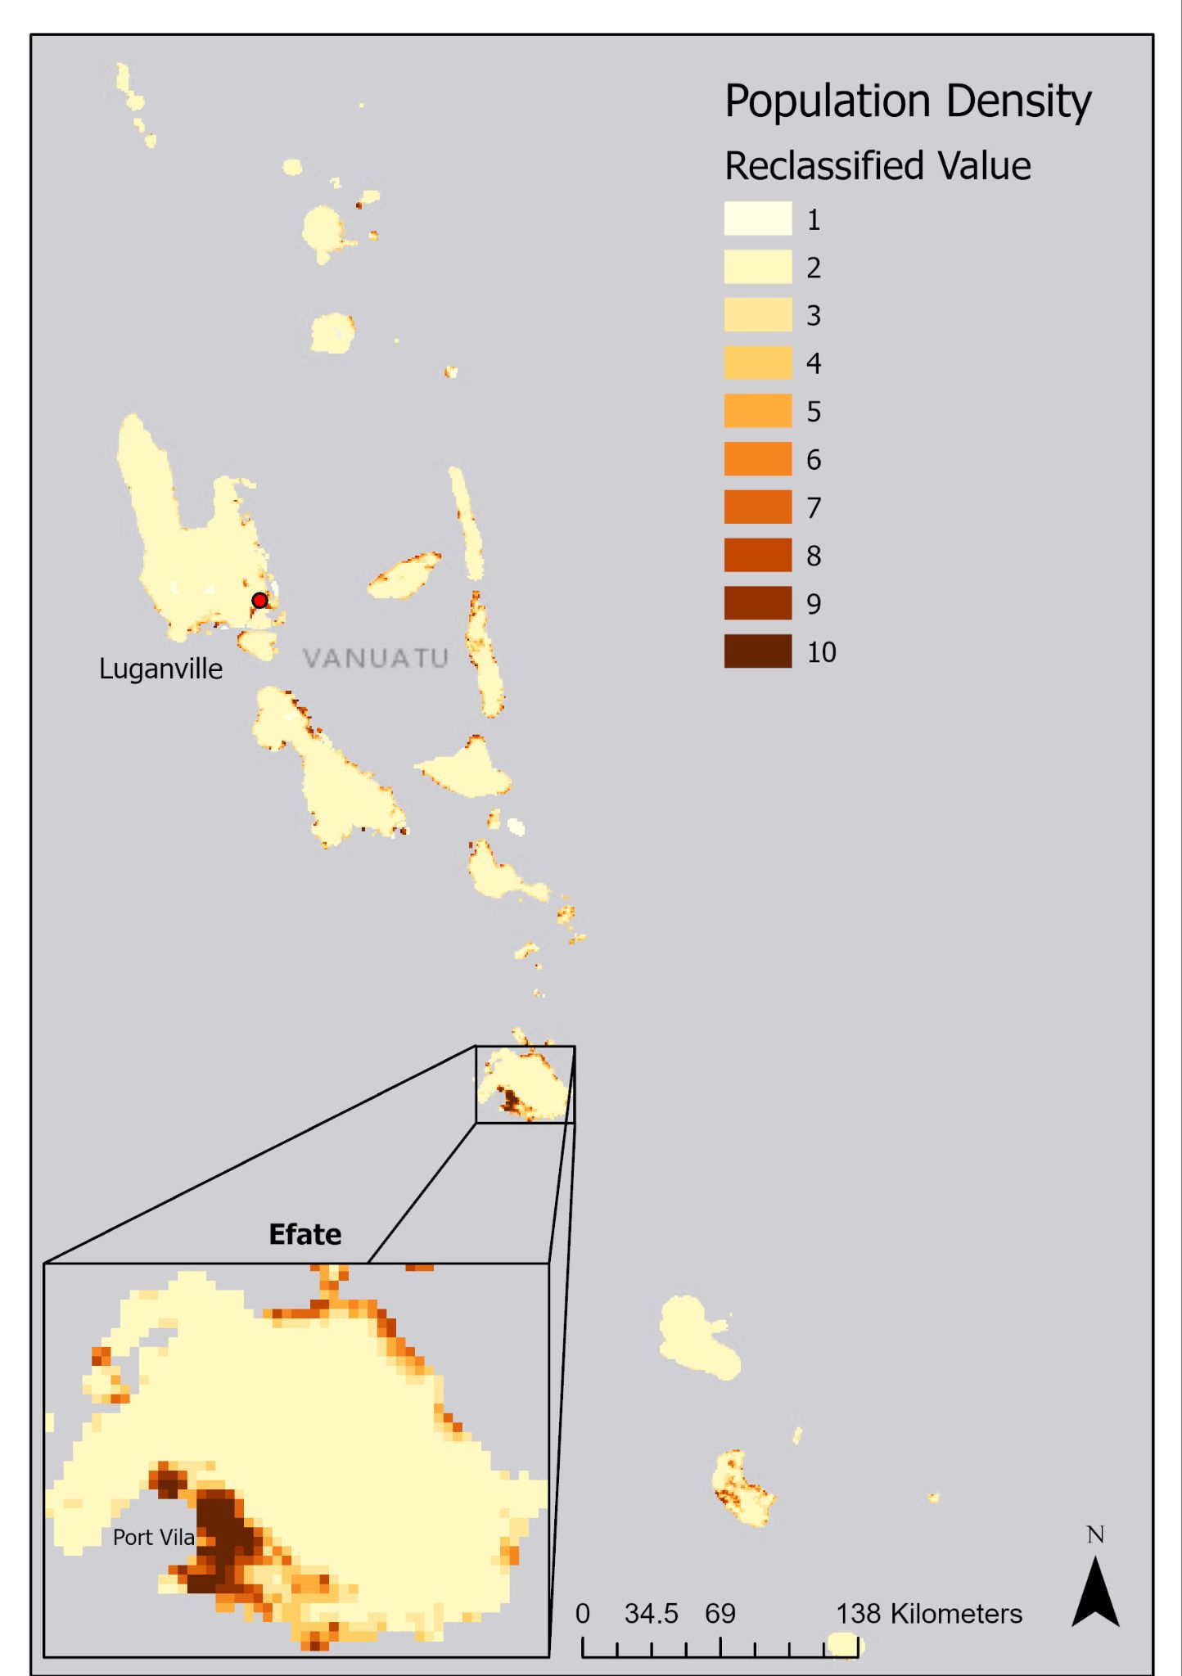
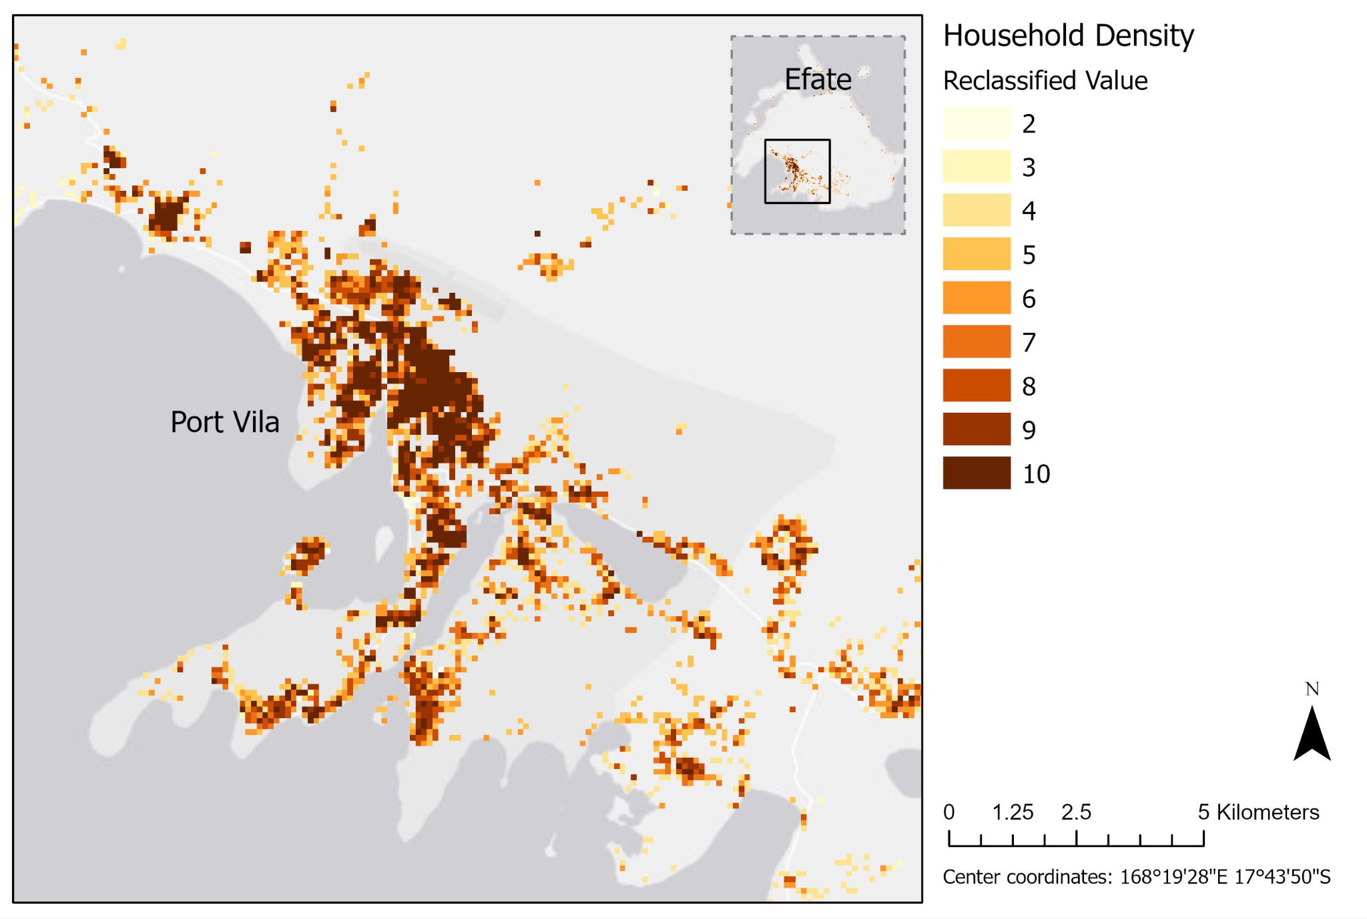
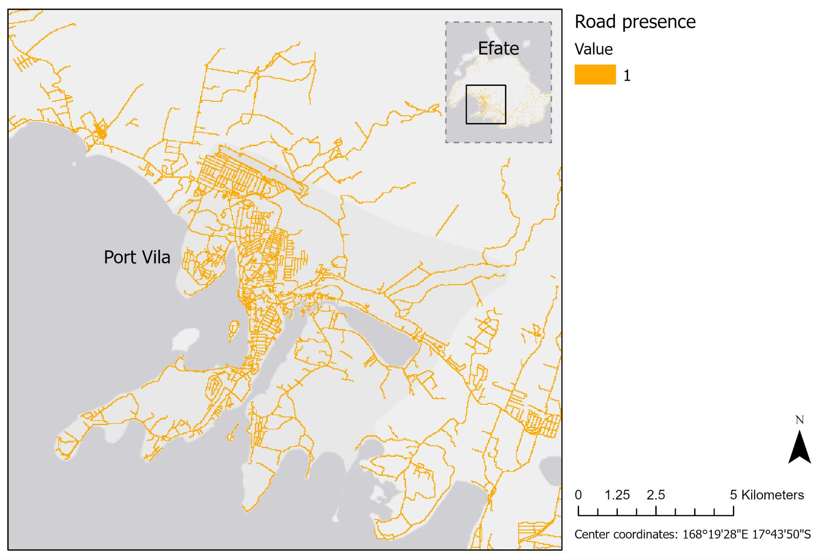
Exposure
People (population density)
Houses (household density)
Roads (road presence)
These exposure indicators quantify where has the most assets and is therefore more at risk to impacts and damages

Slide 10
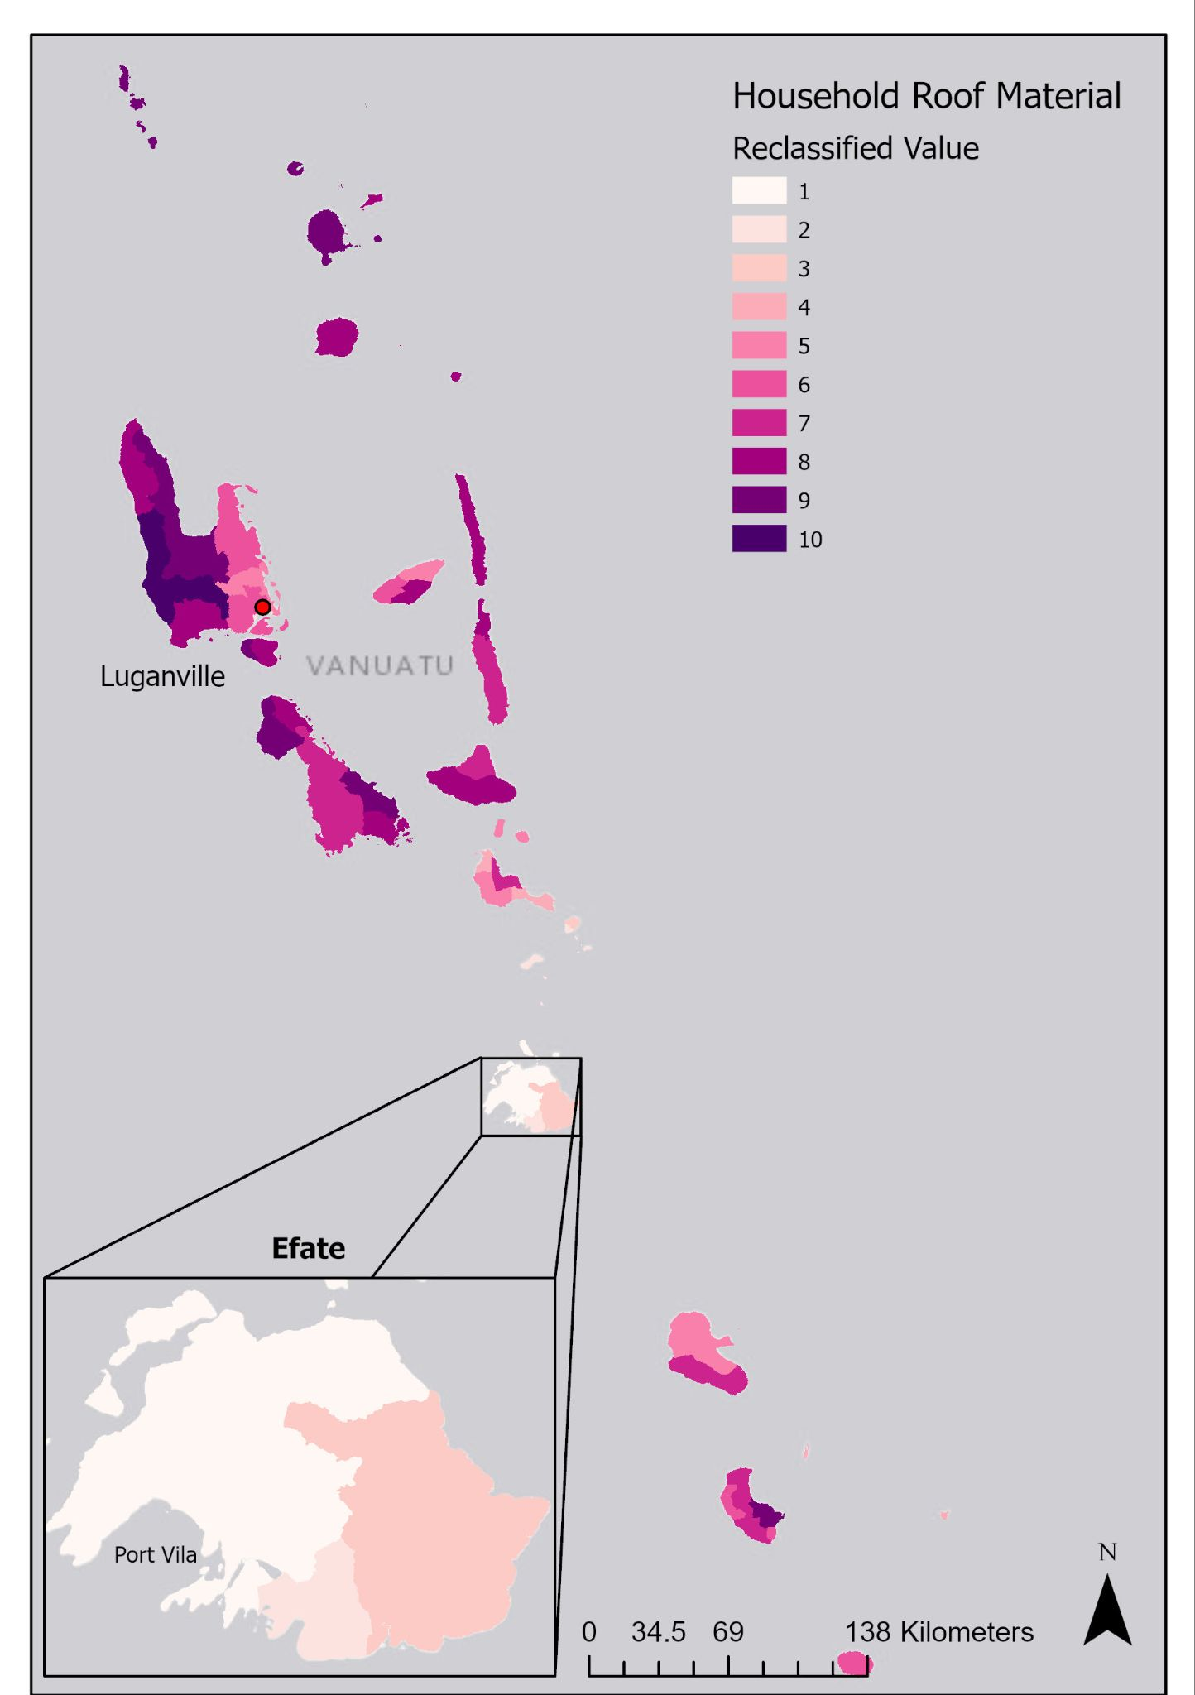
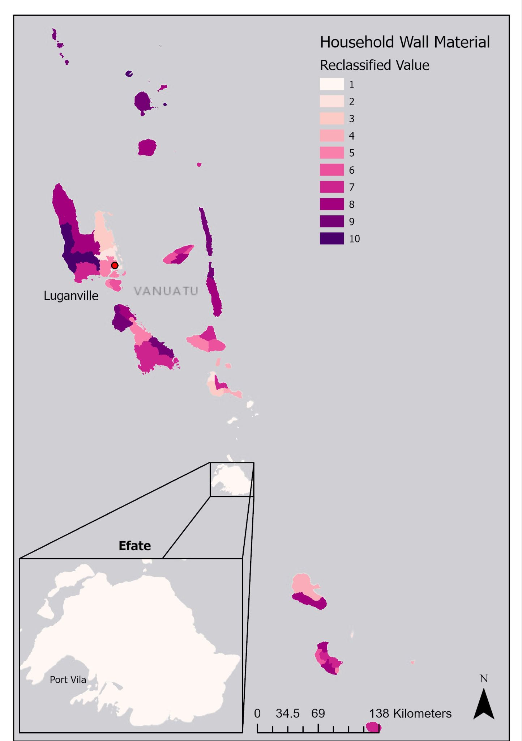
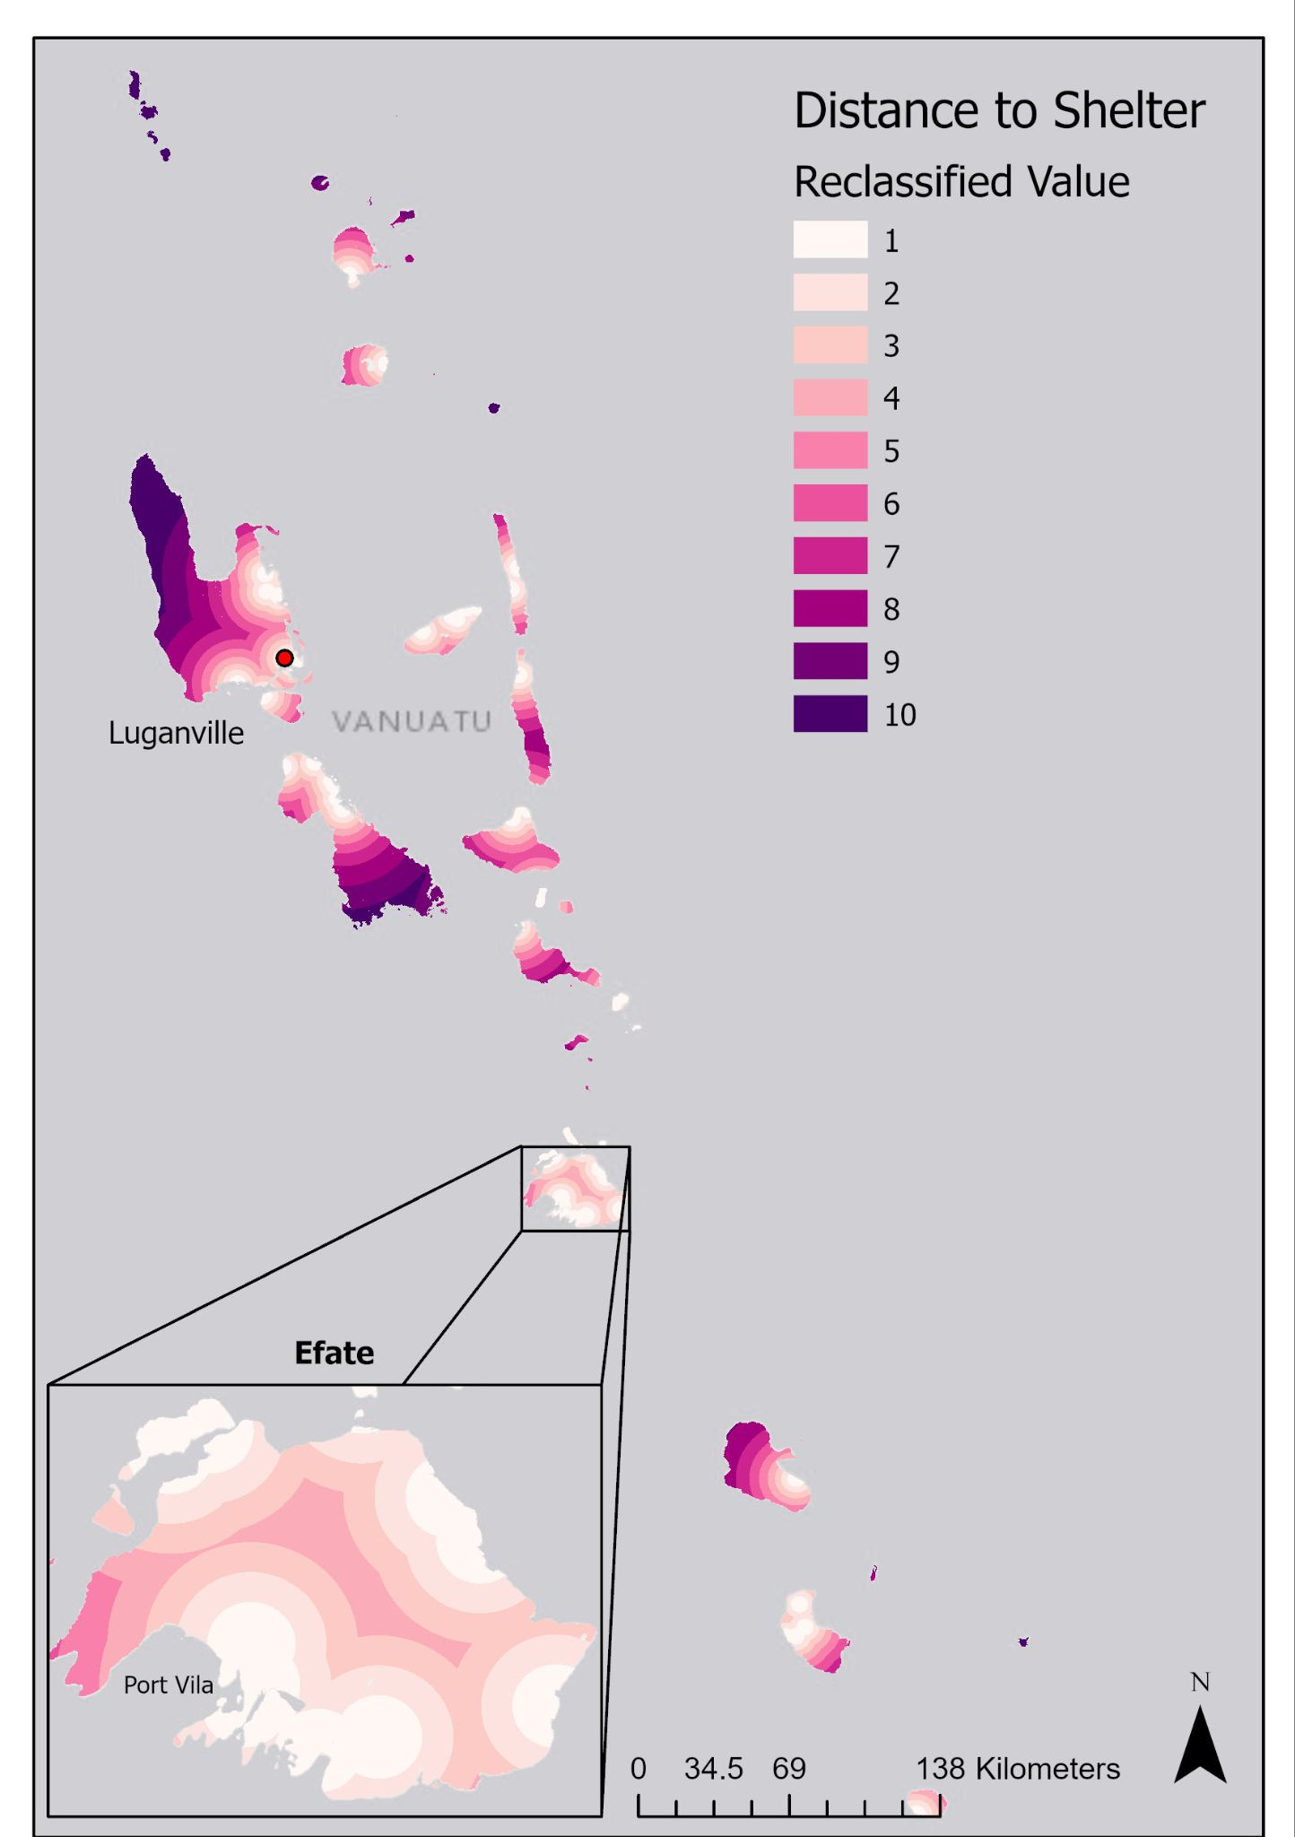
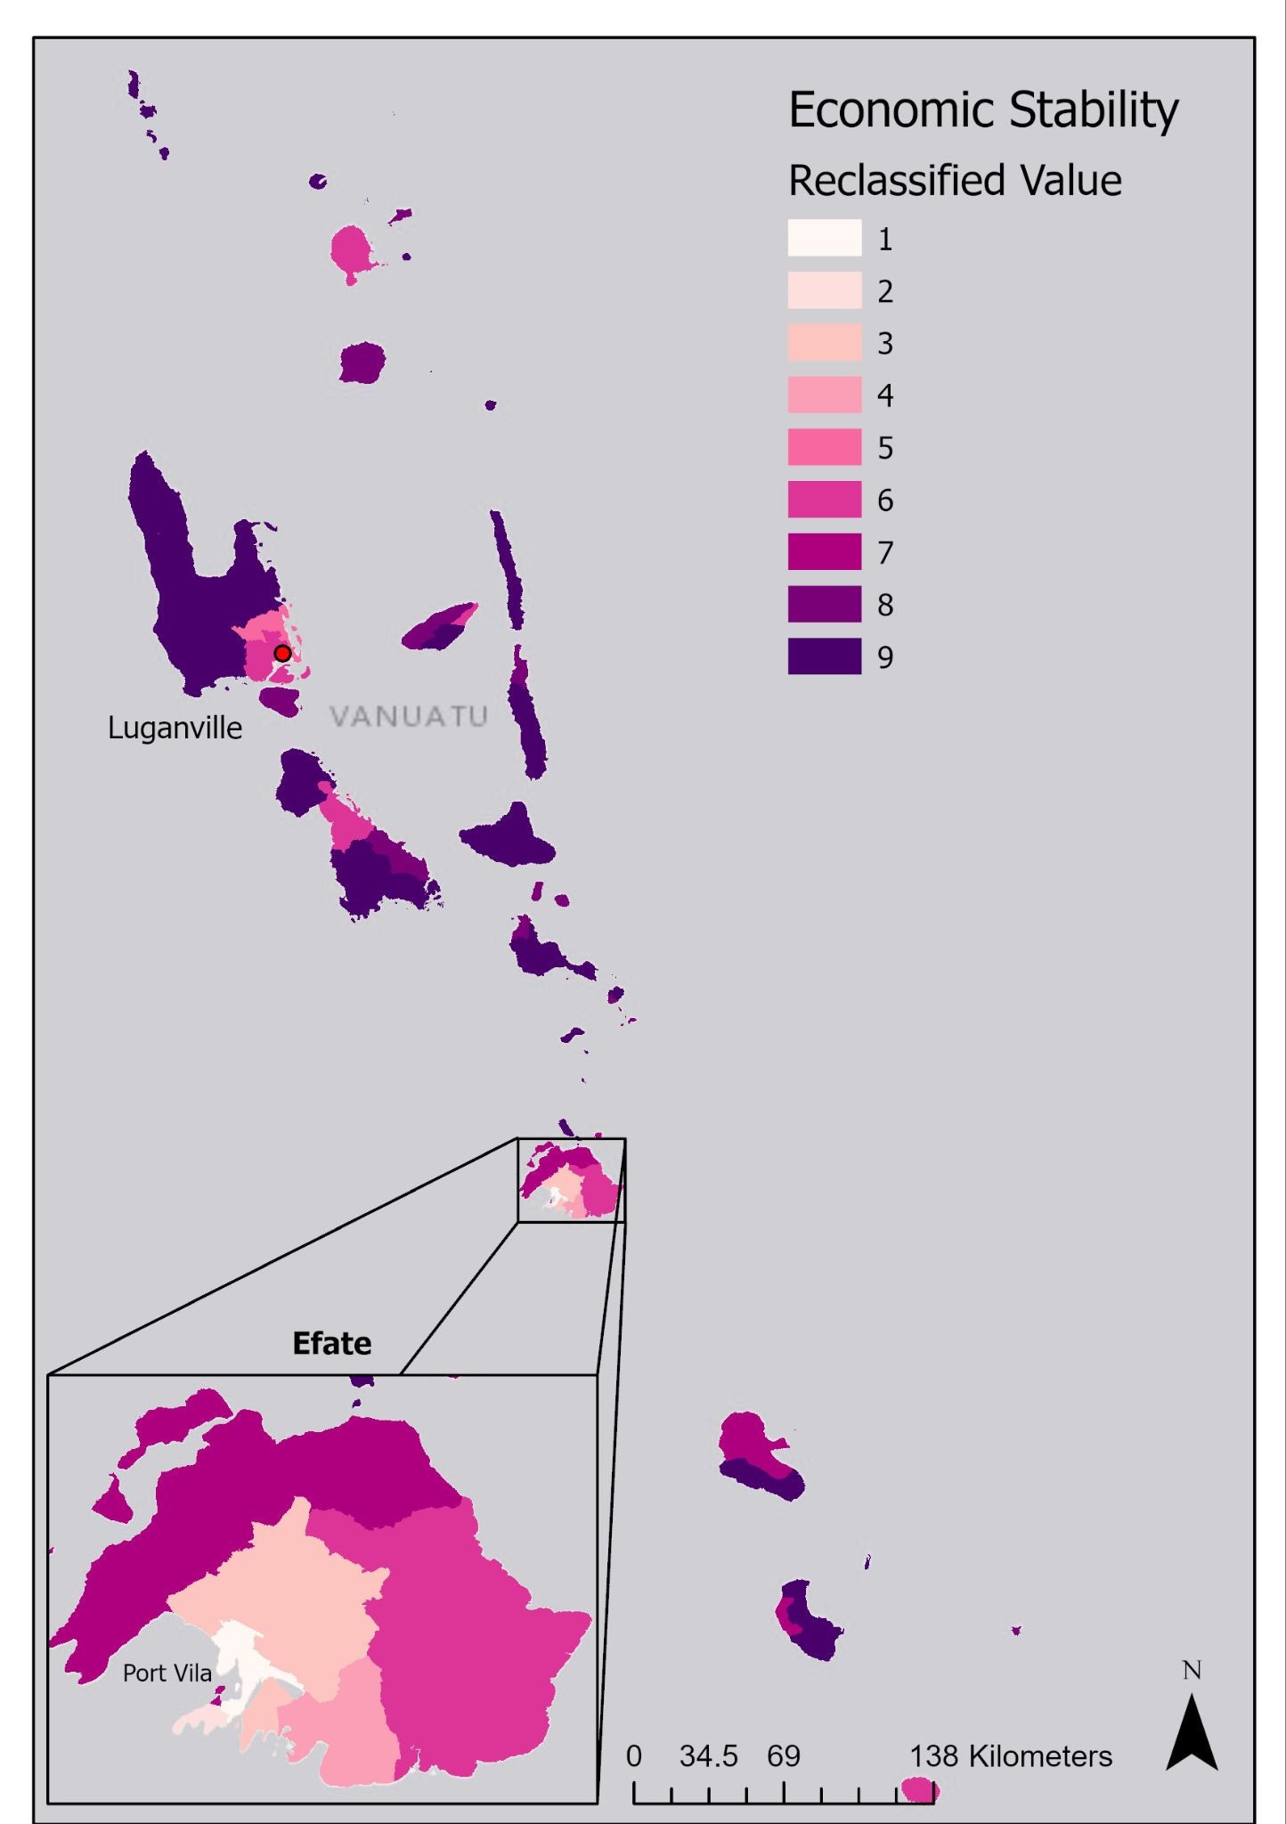
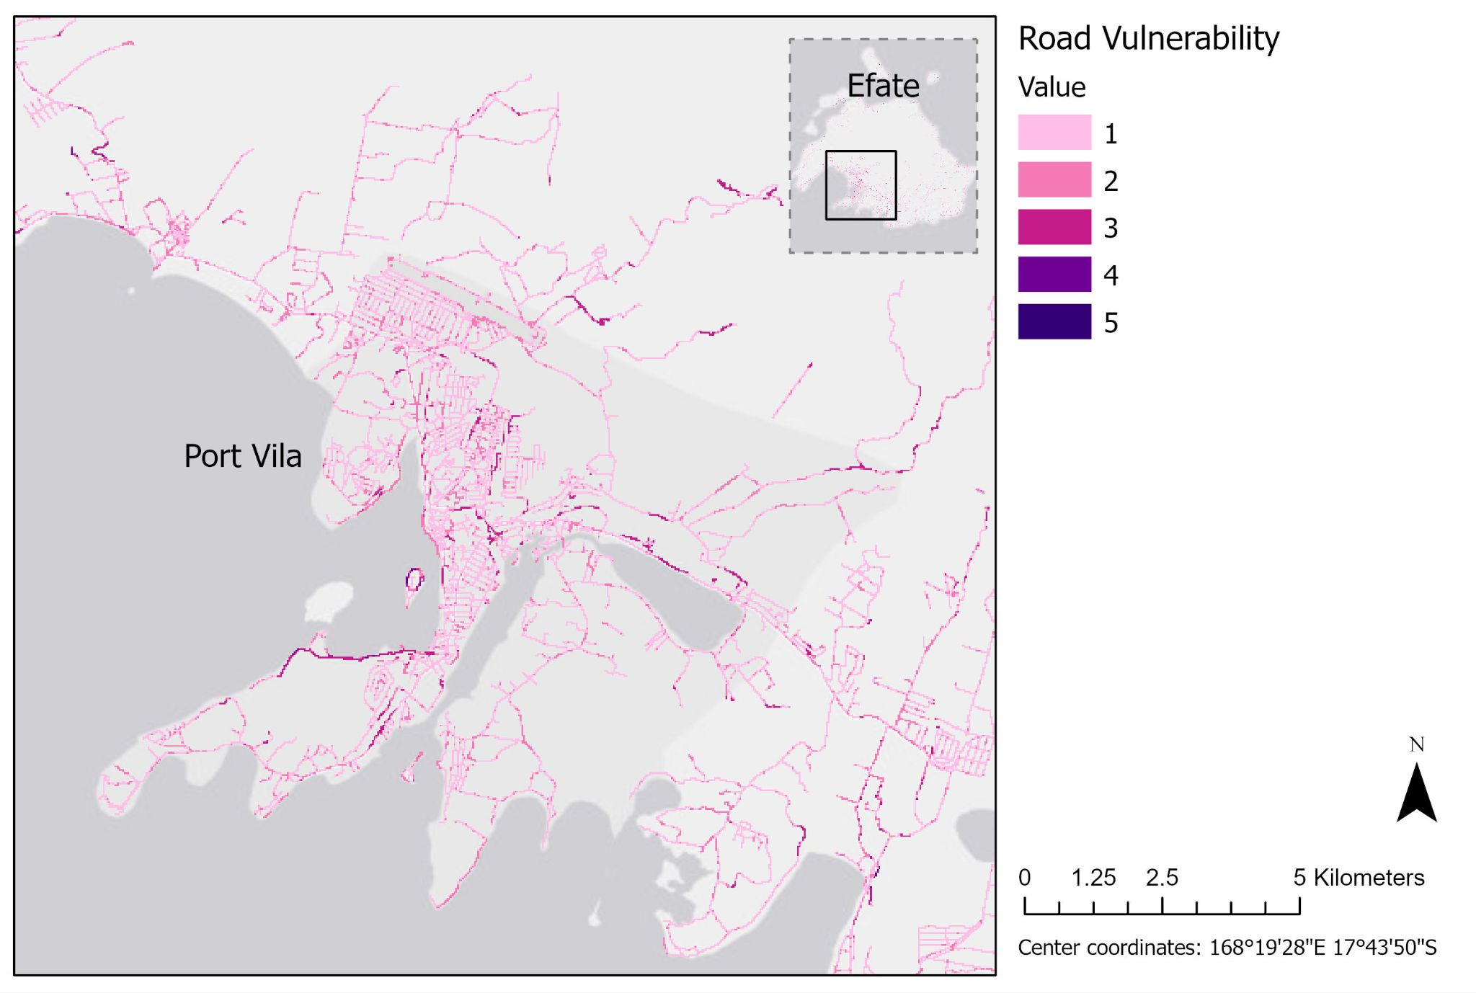
Vulnerability
People (Distance to Shelter, Economic Stability)
Houses (Roof material, Wall material)
Roads (Road characteristics)
These vulnerability indicators tell us how badly affected we expect the valued assets in those areas to be.

Slide 11
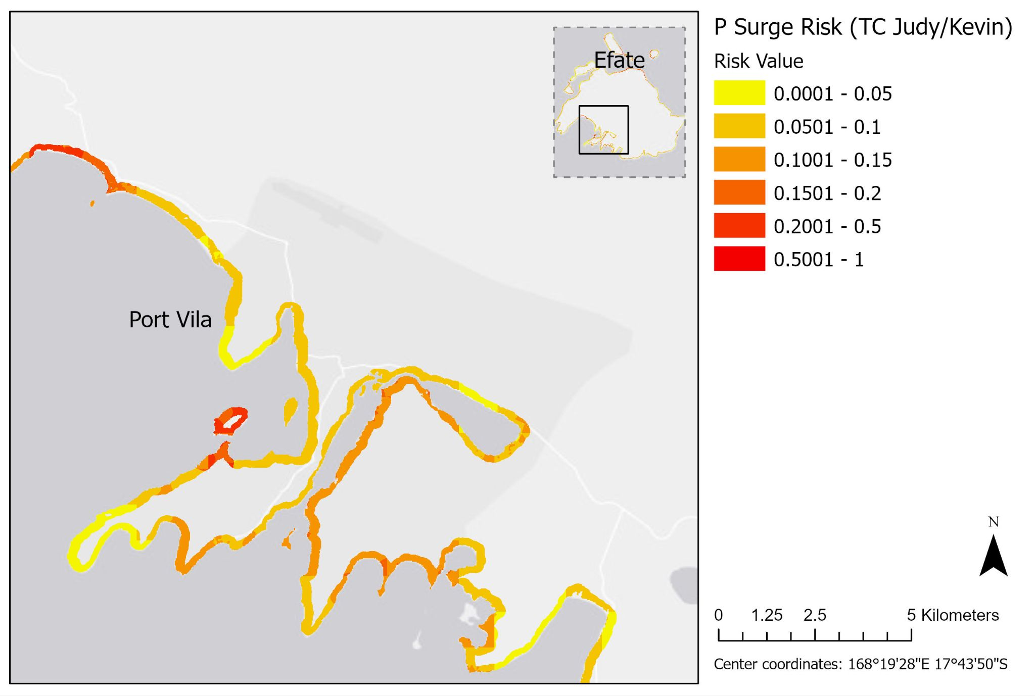
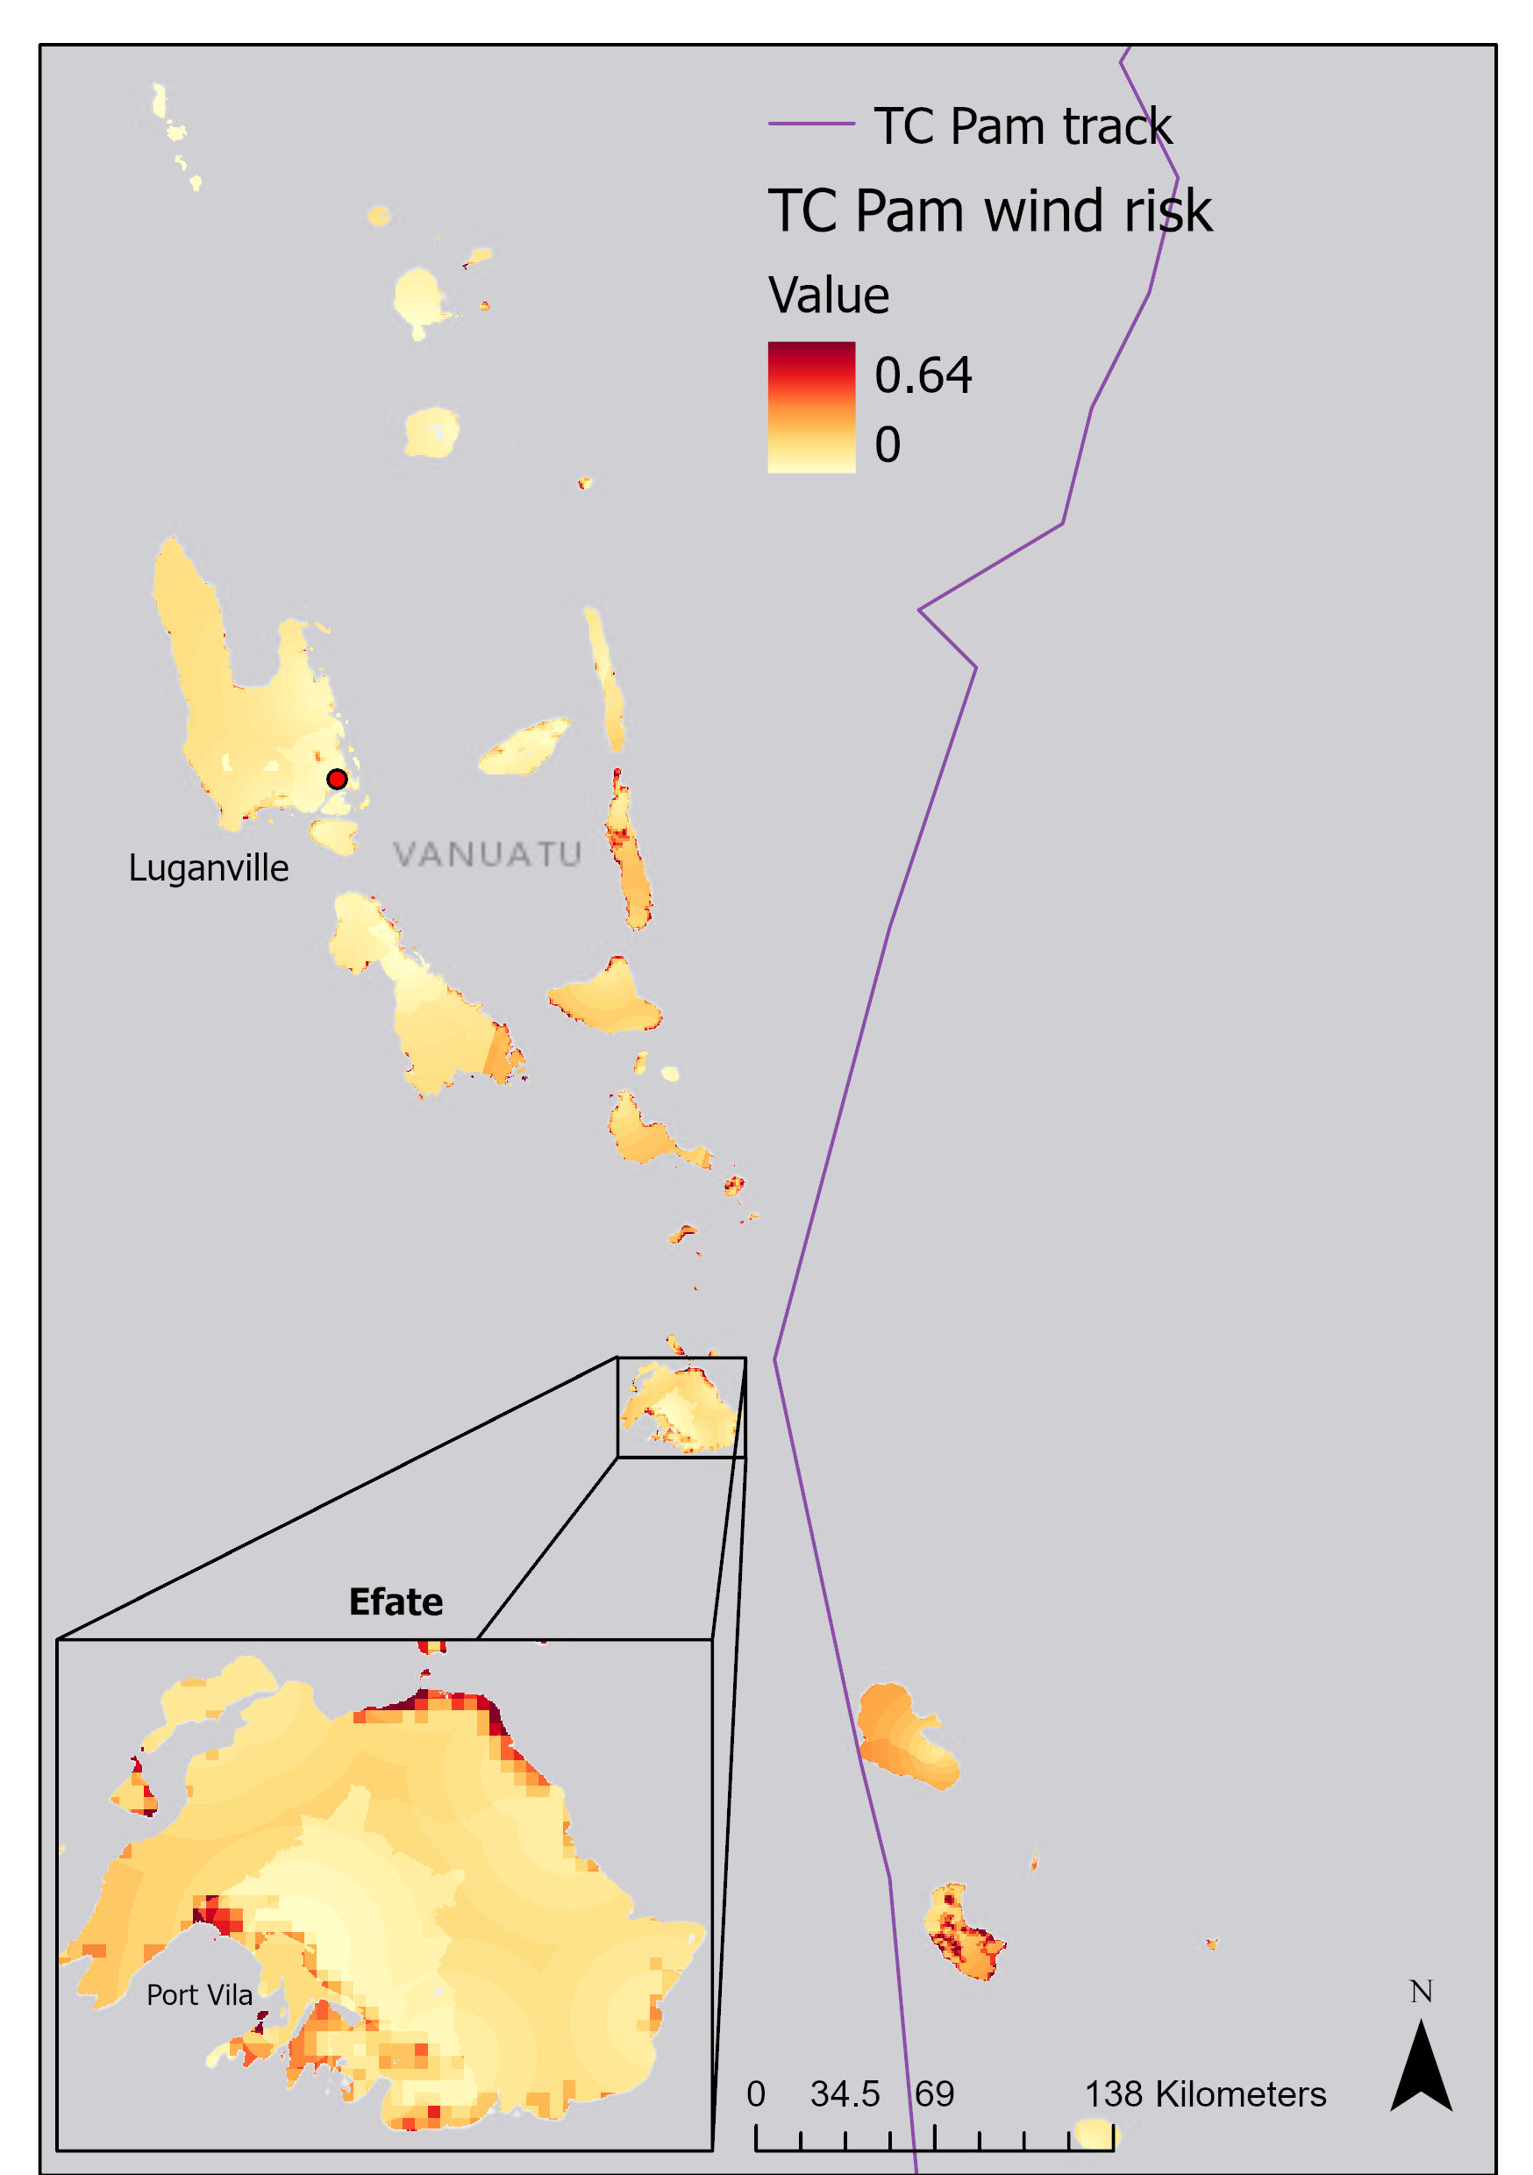
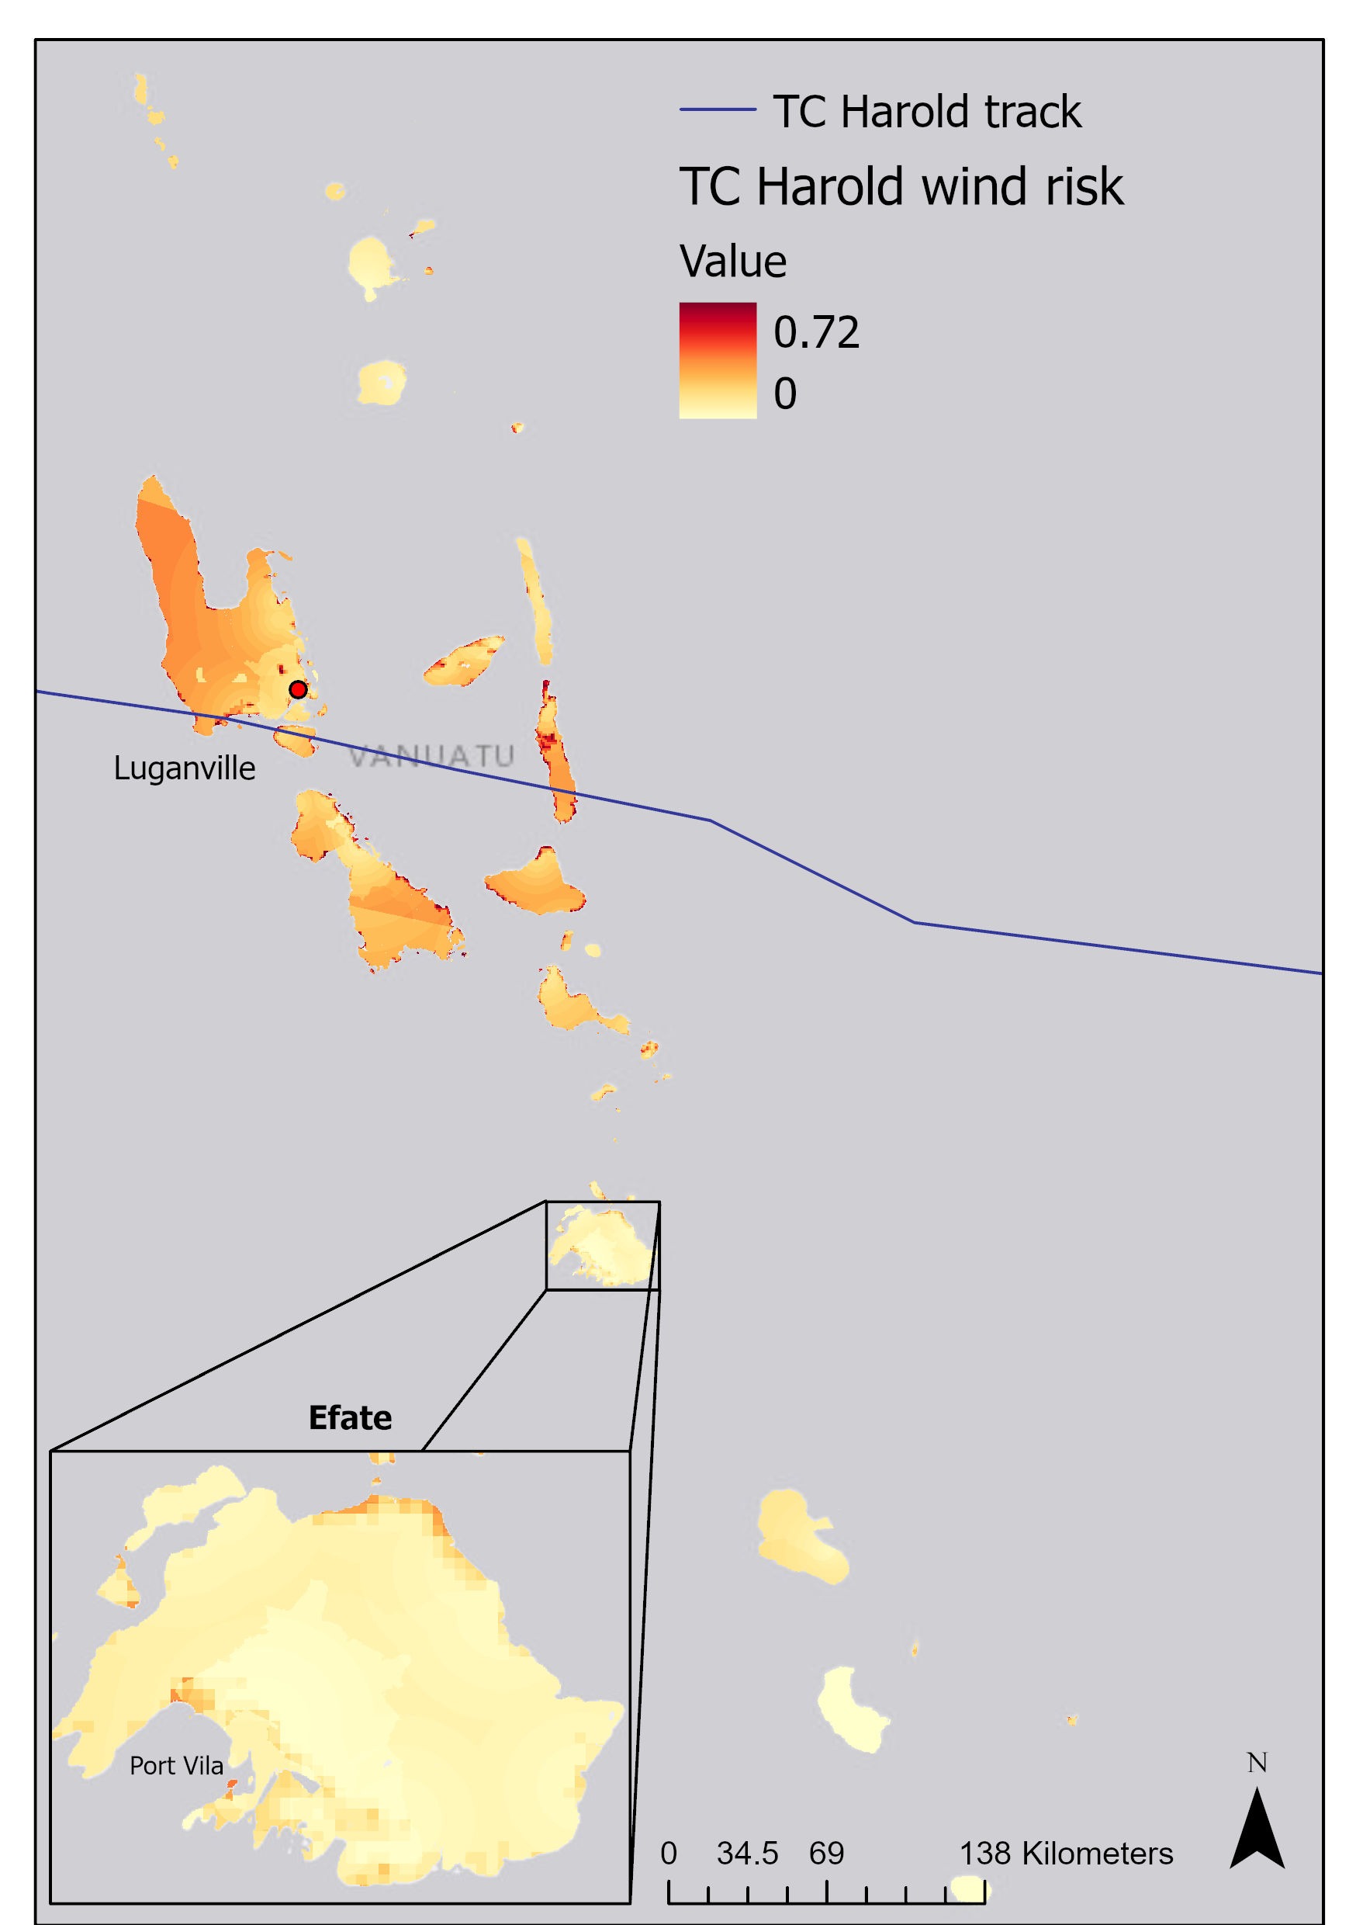
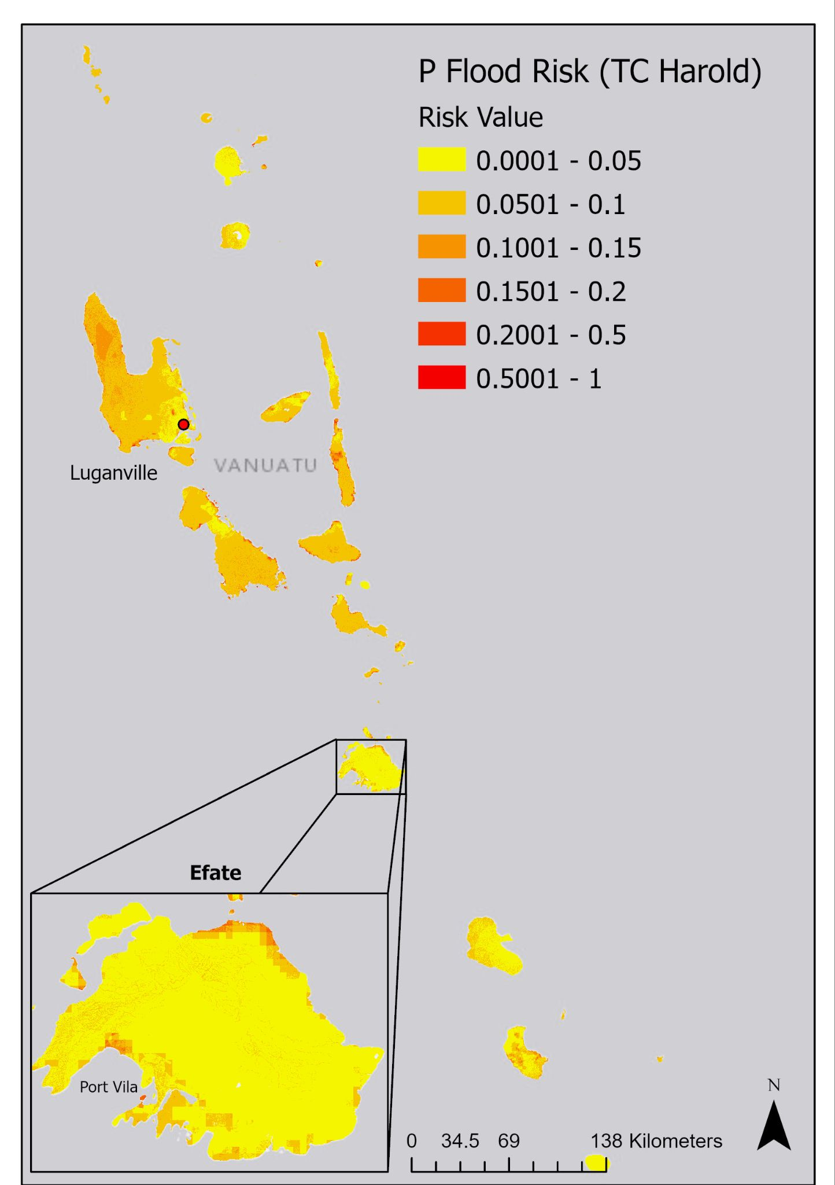
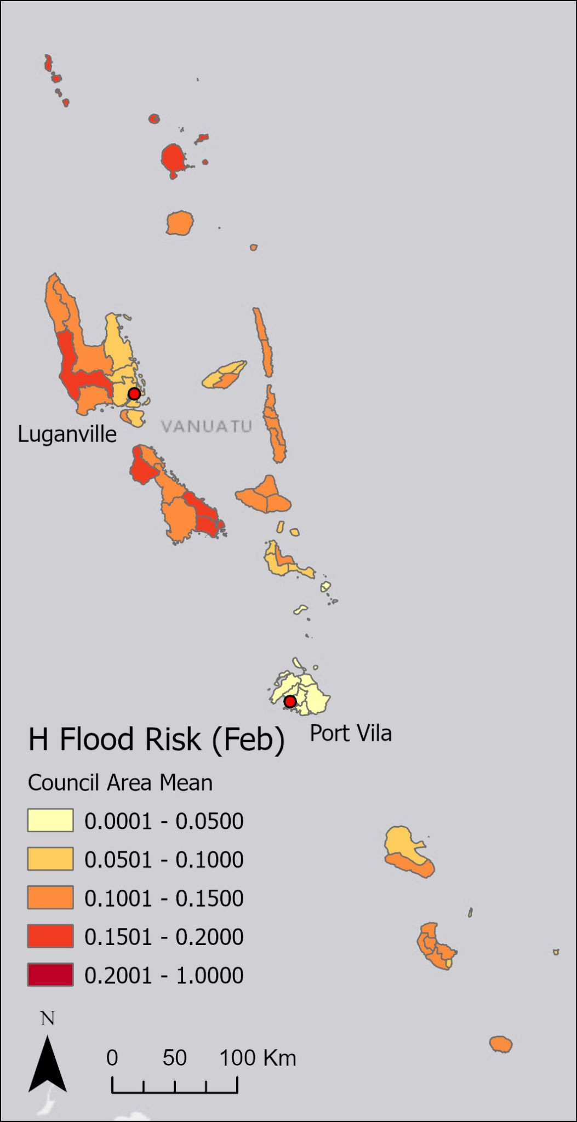
Risk
We produced risk maps for:
  Three domains of populations, housing, and roads
  TC-induced hazards of wind, flood and storm surge
  Case study events of TC Pam, TC Harold, TC Judy and Kevin, and a February average.

Slide 12
Importance of impact data
Impact data is any recorded information about the extent, intensity or magnitude of an event’s damages or effect.
E.g. :
  Number of people impacted
  number of houses moderately damaged
  areas where road is damaged
Impact data is used for assessing where is most in need for aid in the aftermath of an event
For research, impact data is an important part of validating risk. They help improve our estimations and thus strengthen our confidence in using risk maps to prepare for future events

Slide 13
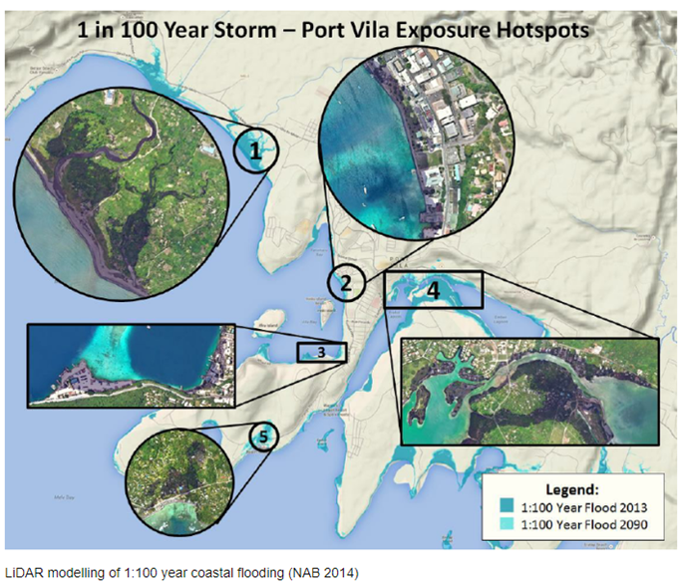
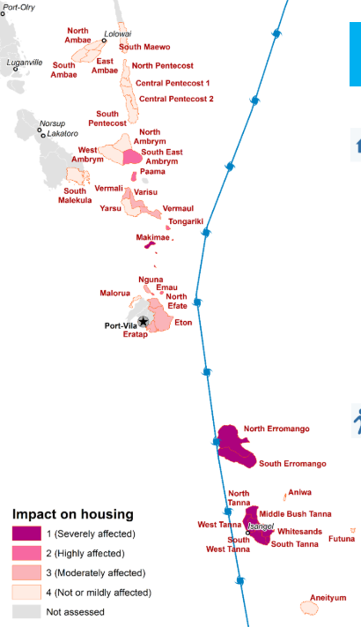
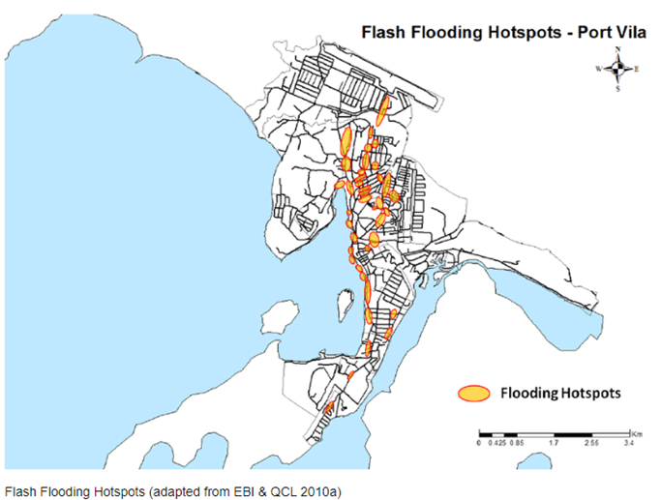
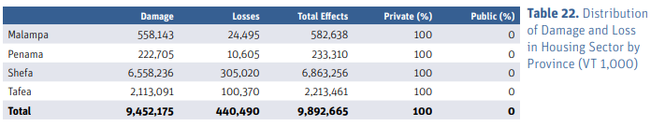
Impact data availability
This is the quality of online published impact data we have.
Our ask is if there is any unpublished/internal data about how these events impacted the country.
Is there anything more comprehensive?
RMIT/UN-Habitat 2014
WFP Food Cluster Security (TC Pam)
PDNA TC Pam

Slide 14
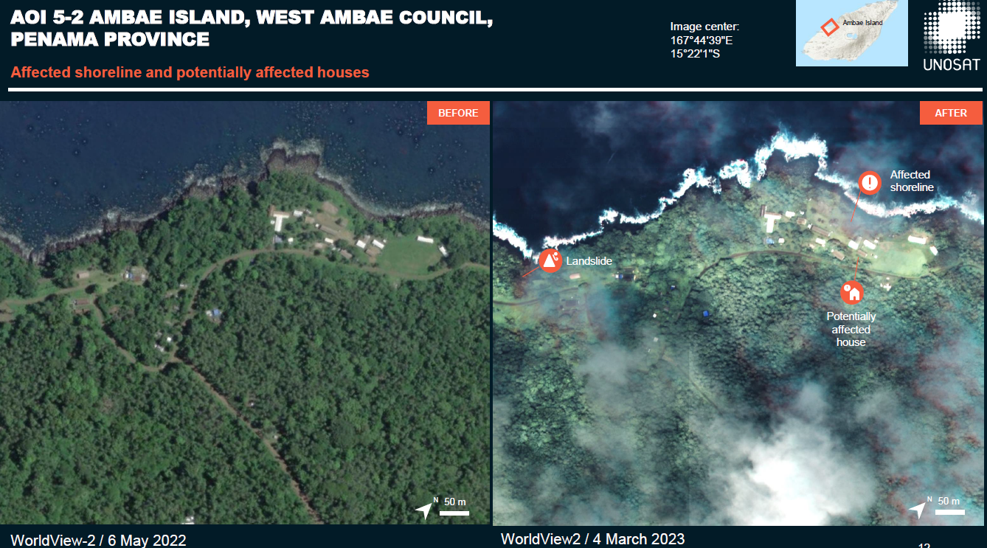
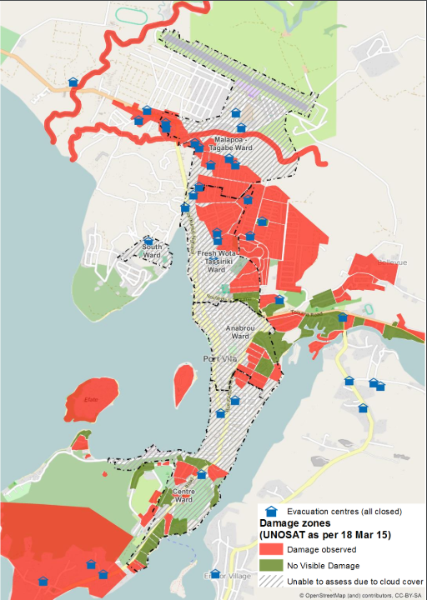
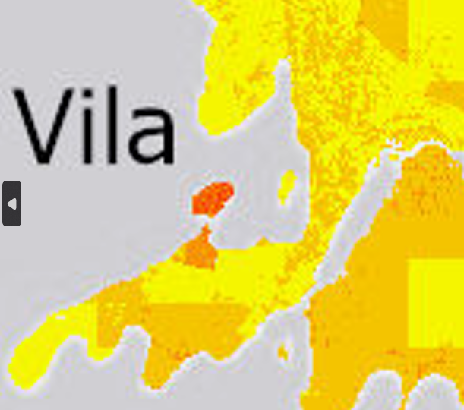
Impact data ask
Please let us know if you remember seeing any more detailed or comprehensive impact data.
For TC Pam, Harold, Judy or Kevin
For wind, flooding or storm surge damage
Impacts to people, housing or roads.
UNOSAT TC Judy/Kevin
UNOSAT TC Pam
TC Pam Flood Risk estimate

Slide 15

Workshop discussion
What can be improved?

Slide 16

Housing vulnerability in Efate Island
We used proportion of households using traditional/palm/straw materials for their walls and roofs (2016 mini-census)
Efate Island has lowest % of households with traditional/palm/straw, indicating lowest vulnerability.
Is it true that traditional/palm/straw buildings are weakest to TCs? Do concrete/brick buildings in Efate withstand TCs well?
Which costs more to repair?
Is % of households damaged a good measure of impact, or is total cost of damages more relevant?

Slide 17
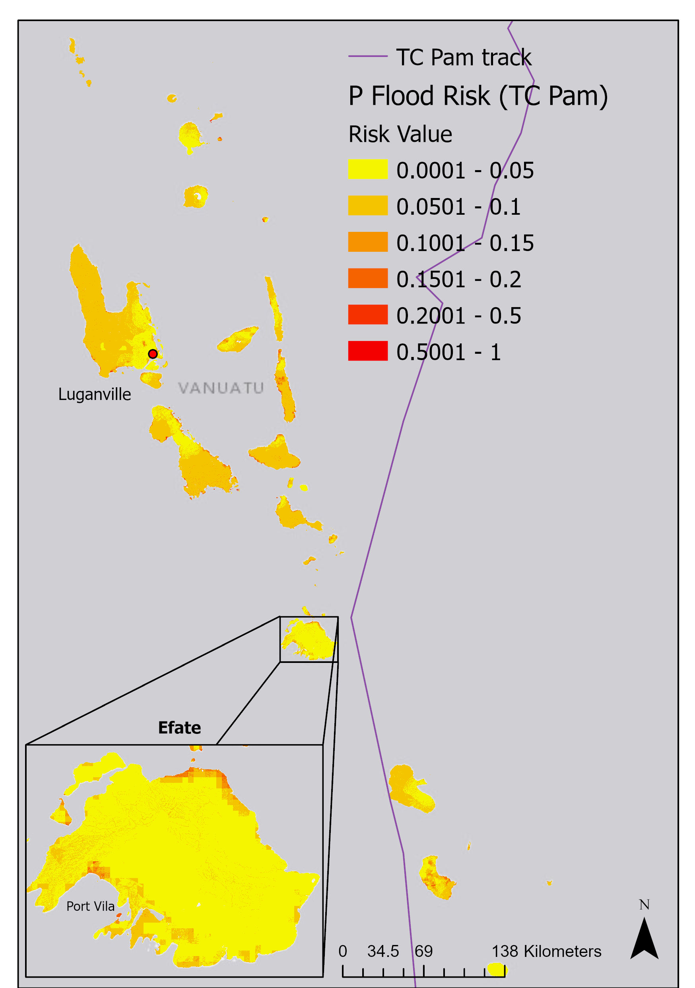
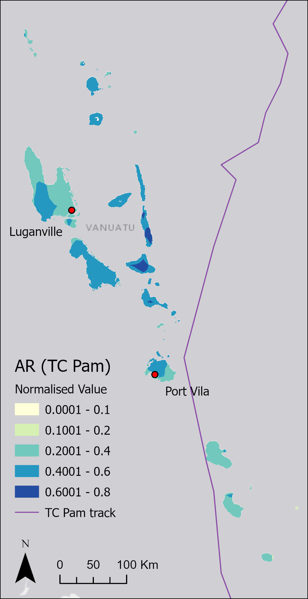
Reach of TCs in Vanuatu
Flood risk
Pam rainfall
Wind risk (track-sensitive)
Due to the methods we used, looking at the potential hazard from TCs, islands far from the TC path still had considerable risk.
Looking at examples of TC Pam:
Have I overestimated risk in islands far away from the TC track?
Does the reach of TC impacts change when thinking about winds vs flood vs storm surge?

Slide 18
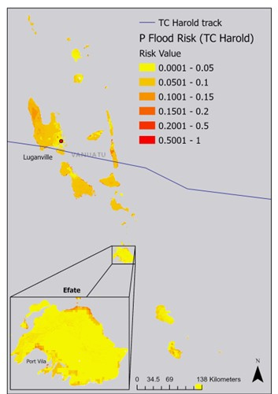

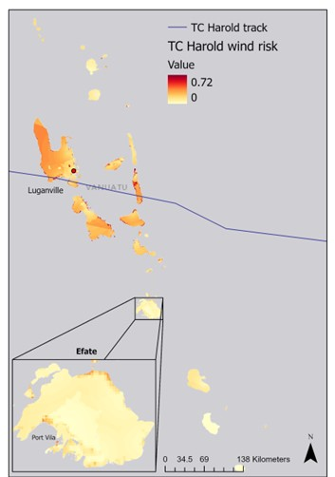
Reach of TCs in Vanuatu
Have I overestimated risk in islands far away from the TC track?
Does the reach of TC impacts change when thinking about winds vs flood vs storm surge?
Flood risk
Harold rainfall
Wind risk (track-sensitive)

Slide 19
Distance from Shelter
We received a list of emergency shelters such as schools, churches or other sturdy community buildings that were used during TCs Judy and Kevin.
We then calculated the distance to nearest shelter for every spot across the country.
What proportion of people leave their homes to take refuge at a shelter? Does it depend on island?
What do people living far away from a shelter do?

Slide 20
Economic indicators
In our study, we assumed that people whose main income source was from a salary or wage was less vulnerable than those with incomes through other means (e.g. farming/fishing, selling crafts, etc.)
Is this true?
Ideally, we would have a better indicator wealth. The assumption is those with more money can recover faster than those with less.
Has there been a survey or study on the distribution of wealth throughout the country?

Slide 21
What are the most valued assets?
In our study, we looked at people, houses and roads as important valued assets that we want to know the risk to.
What is considered the most important asset to reduce the risk to? What other assets would you add to a future assessment?

Slide 22
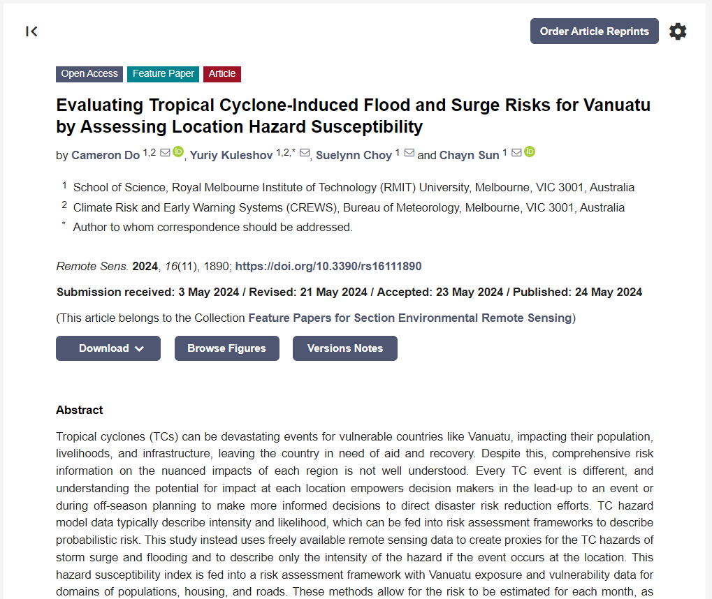
Do, C., Kuleshov, Y., Choy, S. and Sun, C., 2024. Evaluating Tropical Cyclone-Induced Flood and Surge Risks for Vanuatu by Assessing Location Hazard Susceptibility. Remote Sensing, 16(11), p.1890.
https://doi.org/10.3390/rs16111890

Slide 23

Thank You!
If you have any ideas of better data to use, please let us know.

Slide 24
Discussion summary
Feedback and responses

Slide 25
Discussion summary
  Housing vulnerability:
  Construction material does not determine how well a home is built or how well it will withstand a TC.
    There are strong, TC-resistant traditional houses that are well built with angled roofs that reach the ground
    There are poorly built concrete/brick buildings where particularly roofs are torn off
    There are informal houses not built with traditional material that is blown away during TCs
  Cannot compare the cost of traditional house repair vs concrete/brick.
    Traditional houses require more labour and use vegetation from nature which is free but may or not be available
  Both the number (%) of households damaged and the cost of damages are important measures of impact.
    While the cost in more rural areas may be low due to higher proportions of traditional houses, many houses may have been impacted
    Comparing both gives a better understanding
    An ideal housing vulnerability indicator would describe how TC-resistant homes are built regardless of materials used. Building codes are apparently in development. Impact assessment should consider both the number of houses damaged as well as the cost.

Slide 26
Discussion summary
  Reach of TCs:
  Yes, it is very hazard dependant. The track itself only tells part of the story.
    The reach of floods depends on the cloud bands rather than the track, as well as the speed of TC movement and how long they reside over an area
    Topography plays a part in where it rains too
    For storm surge, it is also dependent on timing and duration at particular locations
    The reach of considerable hazard values far from the TC track in results are justified as for example, flood hazard is based on satellite rainfall bands and factors like topography.
    Discussion revealed however, other factors such as speed of TC and duration at locations that also plays a part but cannot easily be assessed.

Slide 27
Discussion summary
  Distance from shelter:
  Several factors influence how utilised emergency shelters are used.
    In general, the stronger the TC, the more people go to these shelters
    Better and earlier warnings as well as the availability and capacity of shelters also plays a part
    Social norms and/or community relationships also affect how people go about preparations
    The proportion of people that use these shelters have not been analysed
  A common alternative is to fortify homes.
    This includes closing windows, sealing the house, staying inside
    This is particularly for those not expecting the harshest impacts of TCs or those with no nearby shelter
    Other alternatives include sheltering in naturally sheltered structures such as caves.
    The use of the distance from shelter indicator was supported, however responses from discussion about the use of these shelters reveals the indicator is more relevant during severe TCs or near the track, becoming less relevant where it is sufficient to fortify homes instead.

Slide 28
Discussion summary
  Economic indicators:
  While those with more income can recover better, not all communities rely on the use of money.
    In rural areas, money is not perceived as important as they rely on subsistence and trade or work together as a community
    In urban areas, money is more important, and those that are related to a well-off family or are in a community with good governance recover better
  Everyone is affected by a TC event
    Even if an individual may have dodged direct impacts, they will be negatively affected by other’s losses
    For example, the prices of food and crops would be high, there may be disruptions to work or communities
    Whether someone has a salary or is a subsistence farmer, they are all affected negatively
    Main income source as a wage/salary is not the best proxy for amount of income, and income is not necessarily an ideal indicator of vulnerability. This is because it would not capture the vulnerability of all communities.
    Access to aid was discussed as another indicator where those with access are less vulnerable, however aid organisations target providing for the most vulnerable too.

Slide 29
Discussion summary
  Valued assets:
  Assets that bring income to families are also extremely valuable.
    In addition to people, homes and roads, income related assets were discussed as valuable
    E.g. farming equipment, fishing equipment.
    Additionally, any expensive items at home such as motor vehicles, fishing boats and solar panels
  People are the first priority.
    The primary priority is to ensure the safety and empowerment of people
  Considering the complexity of developing an indicator to capture the distribution of income related assets across different professions, the chosen assets of people, homes and roads were considered sufficient.

